Slide 1
Policy Priorities for California’s Water Management
April 25, 2019
Alvar Escriva-Bou, Research Fellow
Water Resources and Policy Initiatives Annual Conference
Chico, California

Slide 2
Outline
California Water: the Big Picture
Policy priorities for California’s water management

Slide 3
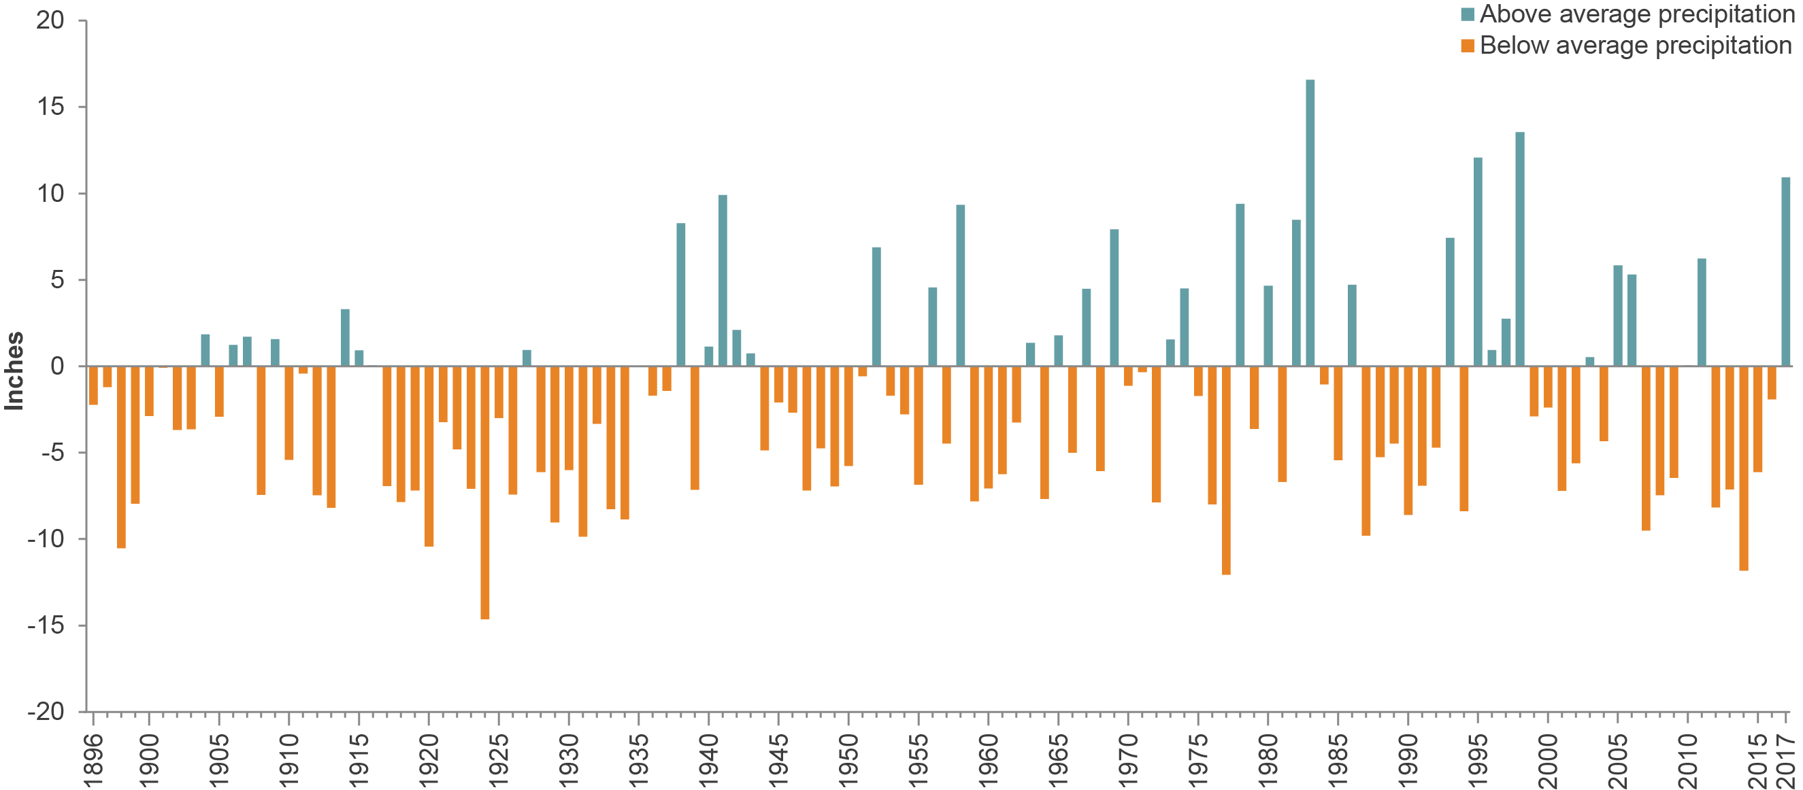
California’s highly variable climate requires preparing for extremes
SOURCE: Western Regional Climate Center. Bars show inches above/below statewide average precipitation for 1980-2000 (23.8 inches) based on water year (October–September).

Slide 4
20th century legacy: a highly engineered water system…

Slide 5
….and a very complex water rights system
Surface water rights
Riparian (English common law)
Pre-1914 appropriative (mining law)
Post-1914 appropriative (state permits)
Groundwater rights
Mostly common law
Limited state oversight

Slide 6
Who uses water in California?
Cities: 10% of water use, 98% of economy
Farms: 40% of water use, 2% of economy
Ecosystems: 50% of available water, and performing poorly
Environment 50%
SOURCE: Dept. of Water Resources (1998-2015 average)

Slide 7
Much variation in water use across regions, years
SOURCE: Dept. of Water Resources (1998-2015 average)

Slide 8
Total human water use has been declining, but economy has been growing
SOURCE: Hanak et al., Water and the California Economy (PPIC, 2012), updated to 2010 with data from the Department of Water Resources, the Department of Finance, and the U.S. Bureau of Economic Analysis.

Slide 9
Local agencies raise most of the >$30 billion spent annually on water

Slide 10
Too many Californians lack access to safe and reliable drinking water sources

Slide 11
Groundwater is a vital component of California’s water supply, but is overused in some parts of the state
On average, underground aquifers provide nearly 40% of the water used in California’s
Oversight of groundwater use has been minimal
Consequences are dry wells, sinking lands, reduced supplies for droughts
Groundwater pumping is depleting reserves in California

Slide 12
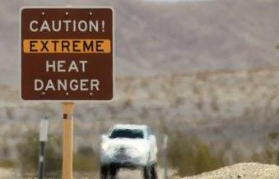
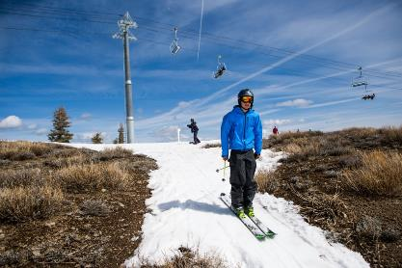
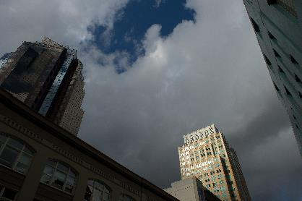
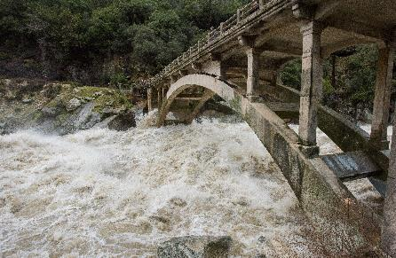
Changing climate is affecting water management
Warming temperatures
Shrinking snowpack
Shorter wet seasons
More volatile precipitation
Rising seas

Slide 13
Outline
California Water: the Big Picture
Policy priorities for California’s water management

Slide 14
A roadmap of water priorities for California
Ensure clean and reliable water supplies
Provide safe drinking water to underserved communities
Strengthen portfolio to manage drought and floods
Bring groundwater basins into balance
Improve capacity to store water by managing “the water grid”
Enhance the environment
Innovate to protect natural habitats
Increased urgency for new approaches in headwaters
Tackle problems in key watersheds
Big decisions ahead on supply, environment in Colorado River, the Salton Sea, and the Delta

Slide 15
Provide safe drinking water to underserved communities
Identify durable funding sources
Support cost-effective solutions
Develop programs to mitigate the risk of drinking-water wells during droughts

Slide 16
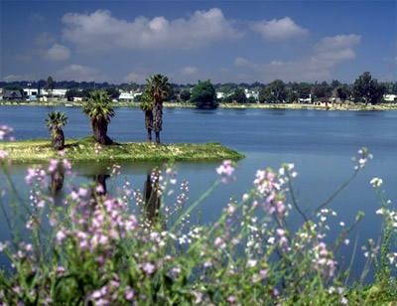
Strengthen “portfolio” to manage droughts and floods
Diversify supplies
Recycled water, stormwater capture, desalination,…
Manage demand
Expand water trading
Modernize governance
Rates, codes, regulations, measurement
Provide technical support for local decision-making
Anaheim Lake, a groundwater recharge basin

Slide 17
Cooperation and flexibility will be key in implementing the Sustainable Groundwater Management Act
SGMA directs local agencies to plan for groundwater sustainability, avoiding 6 undesirable results
Most basins must adopt plans by 2020, achieve sustainability by 2040
Impacts will vary across the region
Trading and recharge will reduce transition costs significantly

Slide 18
Managing California’s water grid will lower risks against droughts and climate impacts
Most California water supply and use is a part of a connected network of surface storage, conveyance and groundwater facilities
Solutions to groundwater sustainability issues should, where appropriate, incorporate the “grid”
Re-operating the system to increase recharge and water trading is key

Slide 19
Innovate to protect natural habitats
Focus on projects that bring multiple benefits to multiple species
Promote watershed-scale planning to build ecosystem health
Adopt ecosystem water budgets for main watersheds
Create more reliable sources of funding

Slide 20
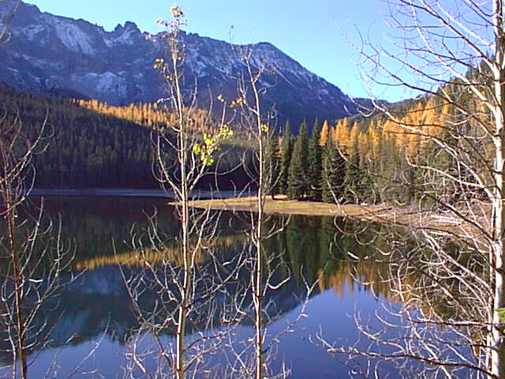
Make forest health a top priority for management
Expand pace and scale of treatments (managed fire, mechanical thinning) to rebuild forest health
Improve accounting of forests at risk, treatments used
Malheur National Forest, Oregon

Slide 21
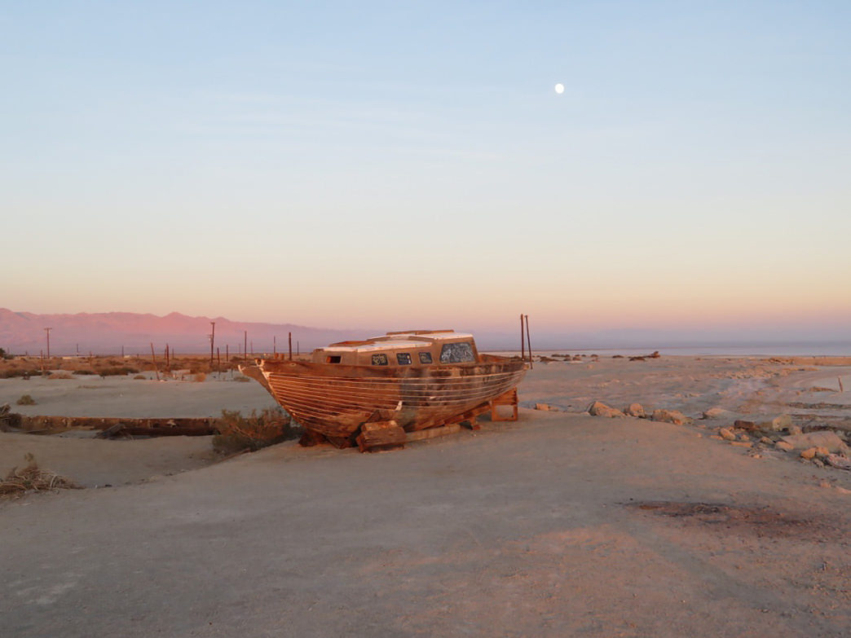
The Delta, the Salton Sea, and the Colorado River: Unsolvable Problems?
Cooperative agreements are key for durable solutions
Examples exist in California: Yuba Accord, Putah Creek Accord
Source: Krista Diamond, Rootsrated (https://rootsrated.com/stories/why-the-salton-sea-is-the-most-important-lake-you-ve-never-visited)

Slide 22
If you want to know more…
Escriva-Bou et al. 2016. Accounting for California’s Water. Public Policy Institute of California.
Gray et al. 2015. Allocating California’s Water. Public Policy Institute of California.
Hanak et al. 2019. Water and the Future of the San Joaquin Valley. Public Policy Institute of California.
Hanak et al. 2018. Replenishing groundwater in the San Joaquin Valley. Public Policy Institute of California.
Hanak et al. 2014. Paying for Water in California. Public Policy Institute of California.
Mount et al. 2018. Managing Drought in a Changing Climate: Four Essential Reforms. Public Policy Institute of California.
Mount et al. 2017. Managing California’s Freshwater Ecosystems: Lessons from the 2012-16 Drought. Public Policy Institute of California.
Van Butsic et al. 2017. Improving the Health of California’s Headwater Forests. Public Policy Institute of California.
…

Slide 23
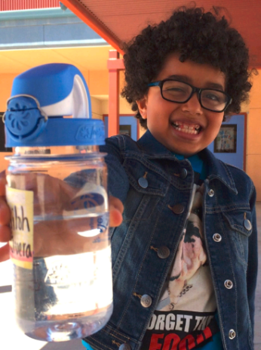
Thank you

Slide 24
Notes on the use of these slides
These slides were created to accompany a presentation. They do not include full documentation of sources, data samples, methods, and interpretations. To avoid misinterpretations, please contact:
Alvar Escriva-Bou
escriva@ppic.org
916 - 440 -1125
@AlvarEscriva
Thank you for your interest in this work.

