Slide 1
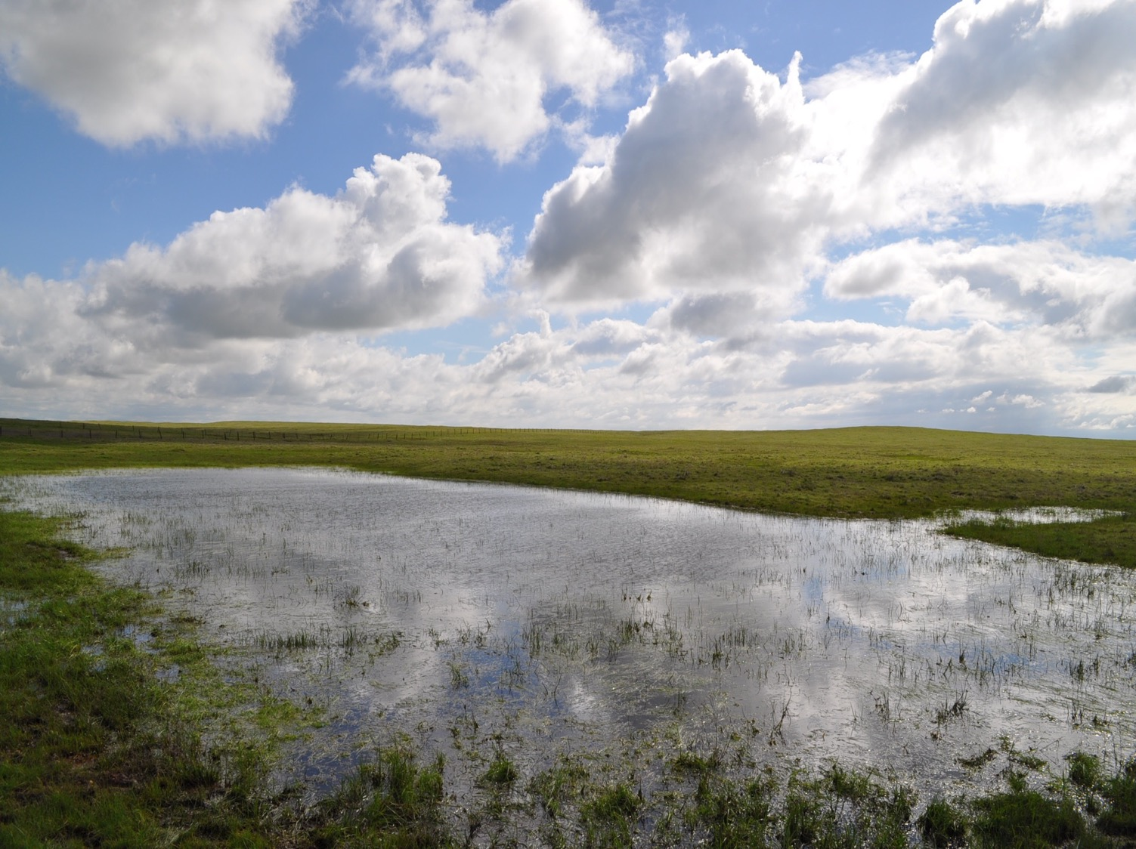
The Effects of Fire Retardants in Mediterranean Aquatic Ecosystems
Jamie Kneitel
Lital Ozeri, Rael Horwitz,
Eyal Rahav, Leon Blaustein
Department of Biological Sciences, CSUS
Evolutionary and Environmental Biology, University of Haifa Israel Oceanographic and Limnological Research

Slide 2
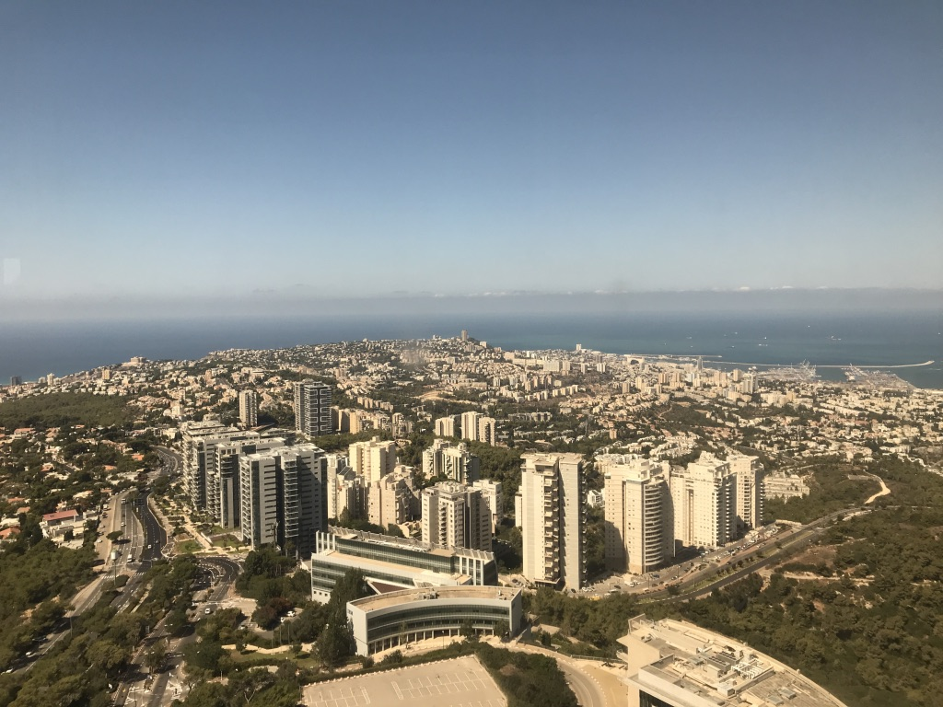

Slide 3
Notes:
Wildfire is an ubiquitous realty worldwide and has been for millenia. Forest fires are a common disturbance in many ecosystems in the world and in particular in the Mediterranean region, climate favors regular occurrence of fire
5% of land surface
Cool wet winters
Hot dry summers
30-45 degrees latitude
Southwest edge
Fire with diverse destructive effects, especially with large human populations adjacent to natural areas in these regions. Fire management and policy tend to be focused on protecting human property and life

Slide 4
Fire Retardants (FR)
Fertilizing salts
In Israel: FR CROS 134
ammonium phosphate, orthophosphate and iron oxide
Avoid aerial application within 90m of water bodies (USFS 2000)
Notes:
Chemical fire retardants play an important role in protecting human safety and forest resources from destructive fires. Their use has increased steadily since their introduction in the1930's used for aerially fighting wildfires. They are typically made of…. when retardant comes in contact with water, the retardant chemicals can be toxic to aquatic wildlife and alter water quality

Slide 5
Effects on Aquatic Ecosystems
Direct deposit or mobilization
Effects:
Negative on fish
Variable on invertebrates
Cause eutrophication
FR interacts with drought
Few studies
Full food web
Amphibians
Seasonal wetlands/ temporary ponds
Angeler et al. (2006)
Notes:
FR can make its way into aquatic habitats, streams and ponds, by way of direct deposit (intentional or accidental) or mobilization or retardants after rains. Over decades many studies have documented ecosystem level effects…however few studies….

Slide 6
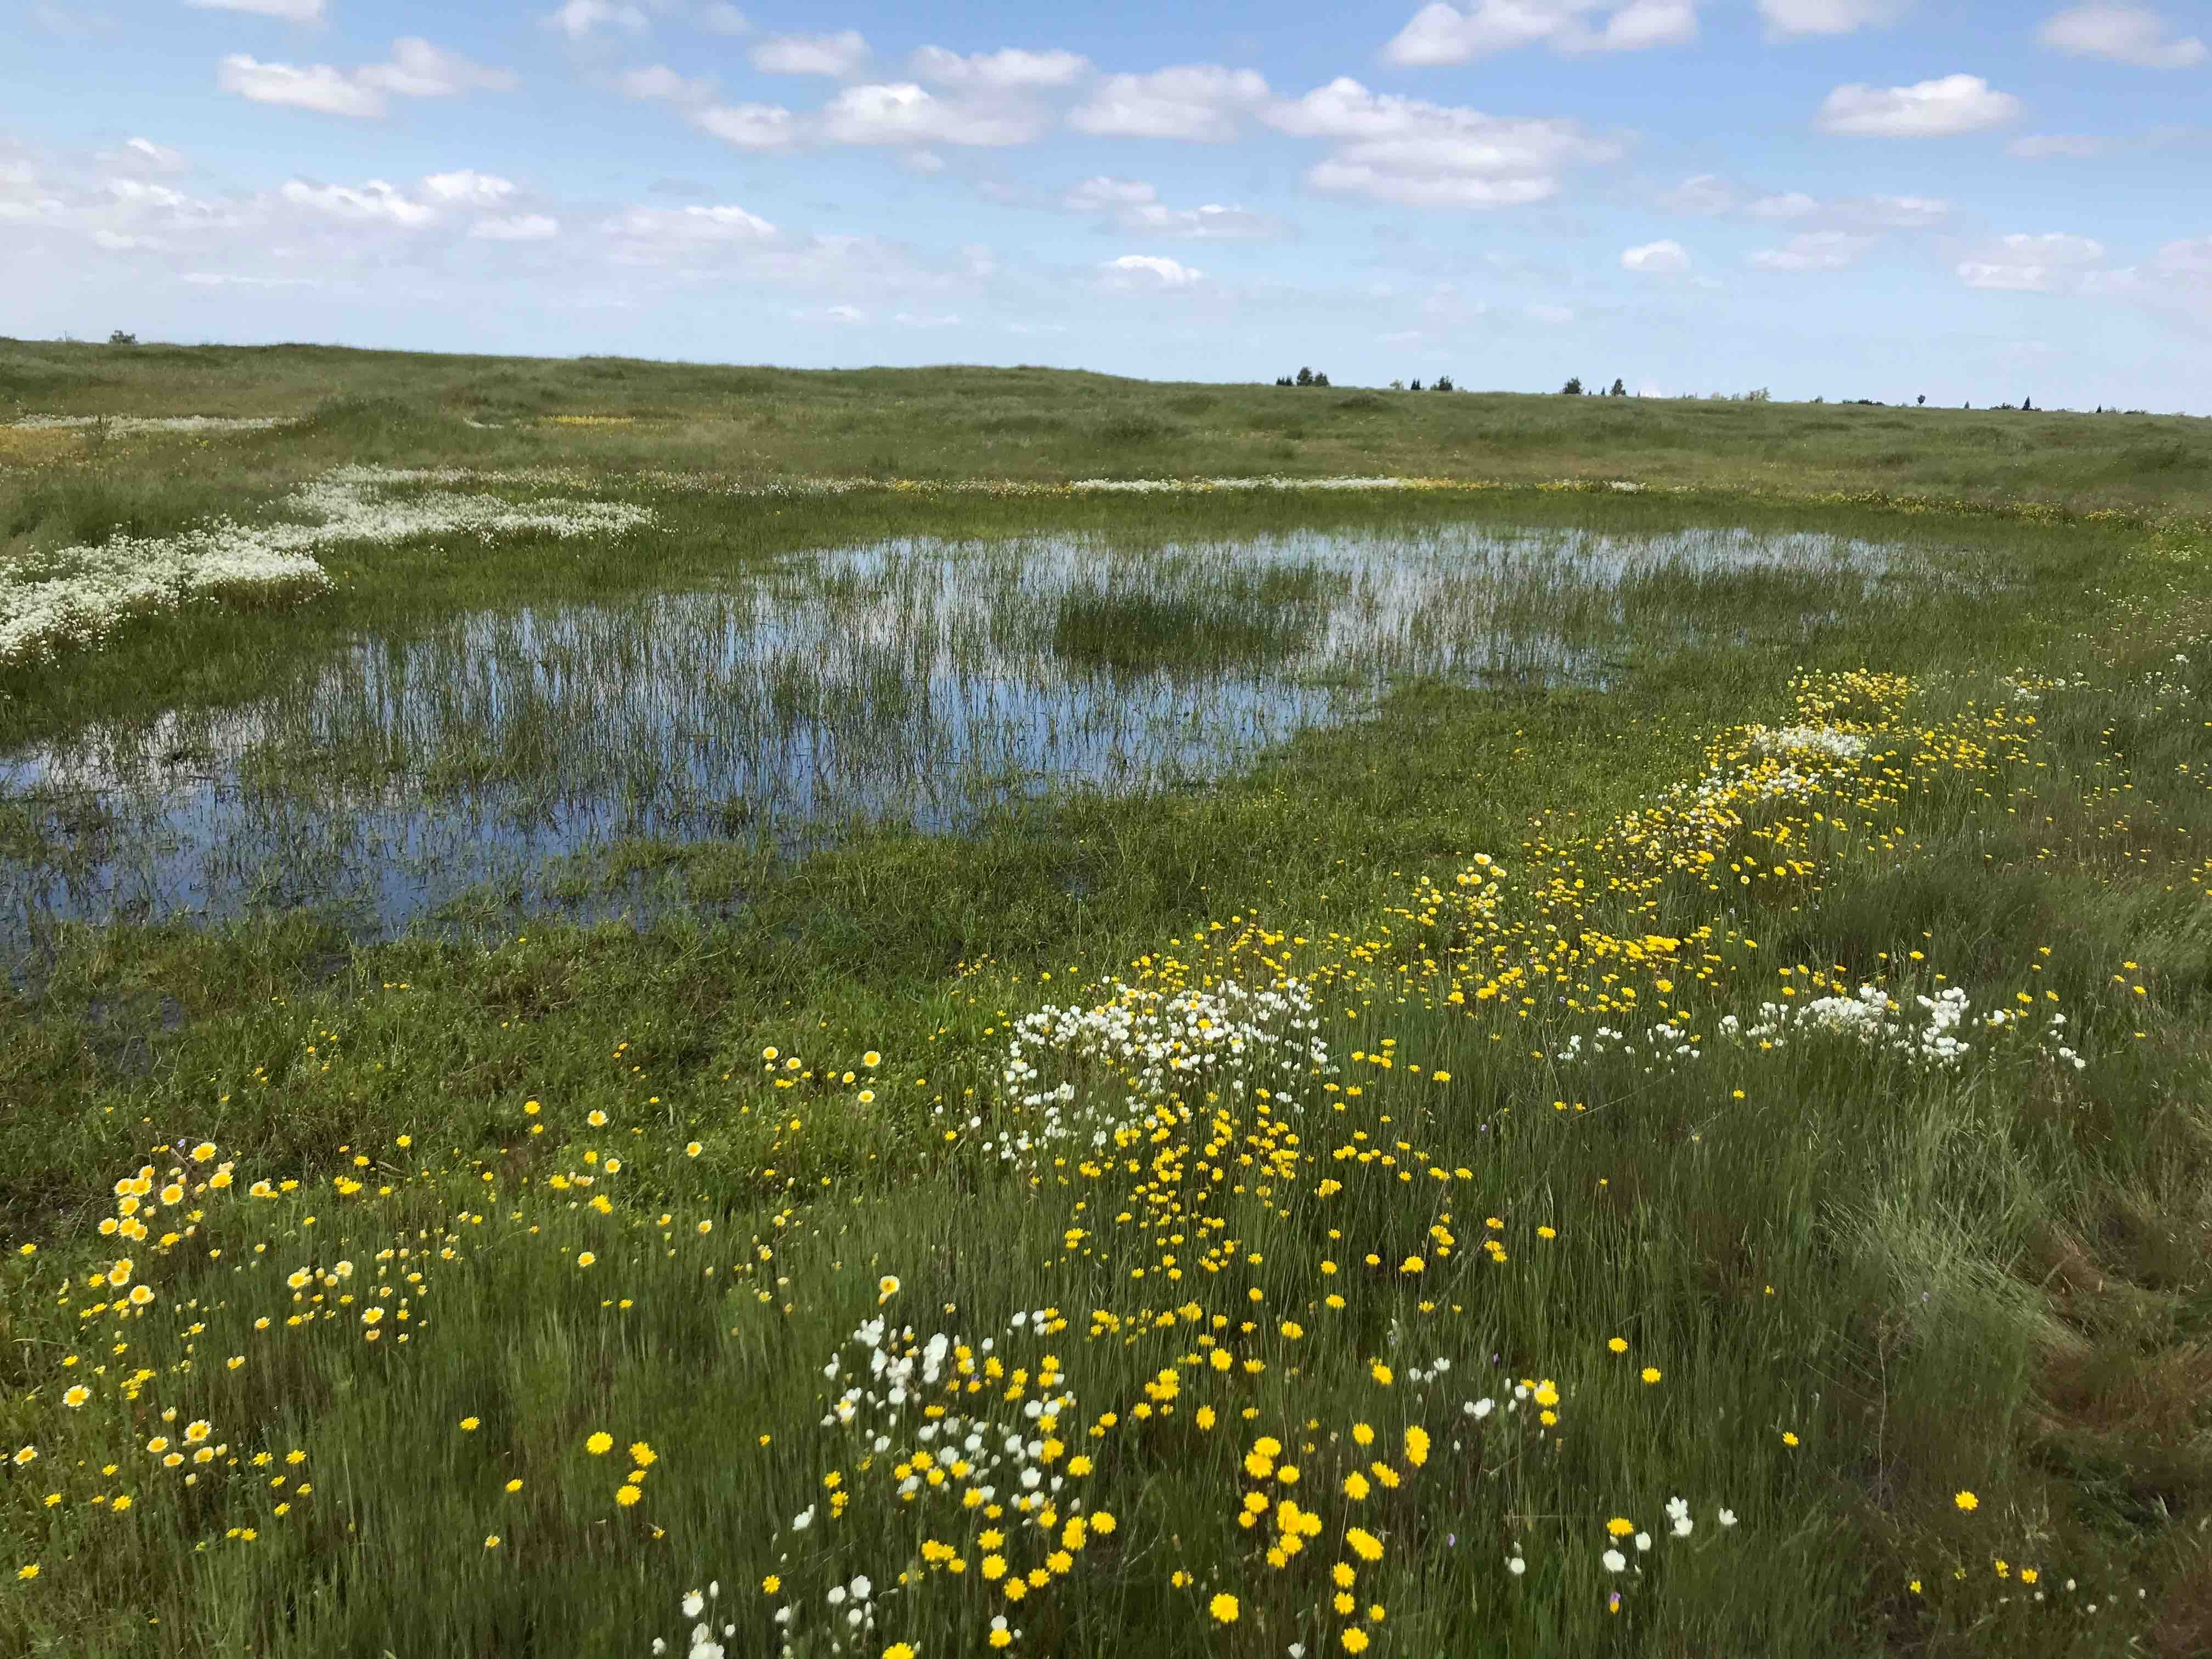
Seasonal Wetlands
Consistent dry phase
High biodiversity
High productivity & carbon sequestration
More common in landscape- less studied!

Slide 7
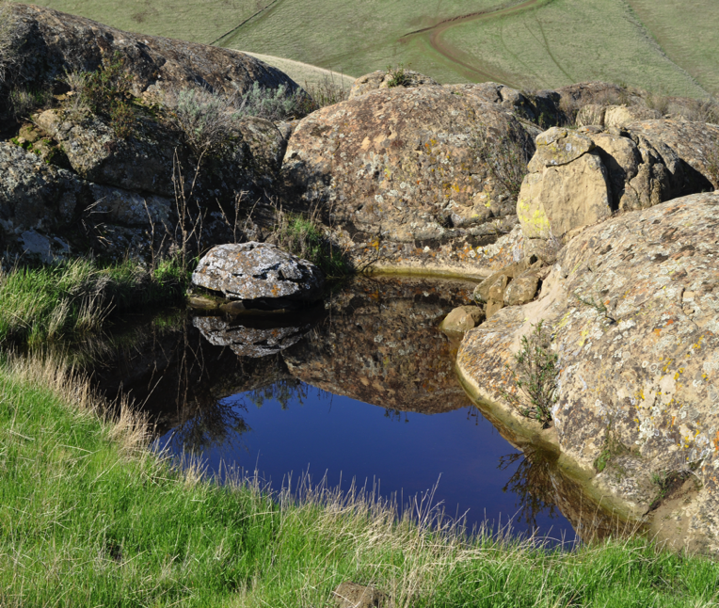
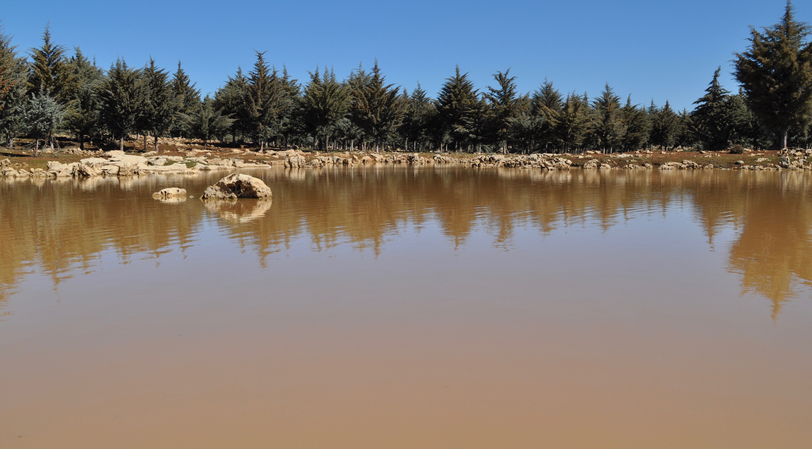
Calhoun et al. (2017)

Slide 8
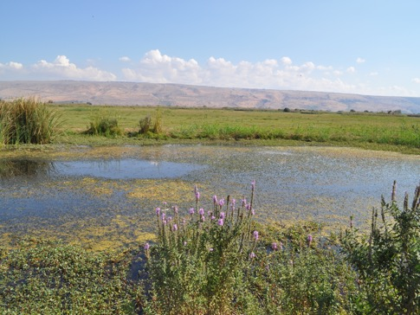
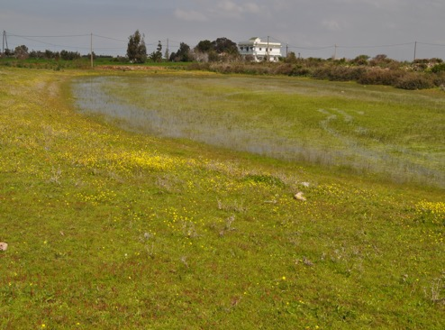
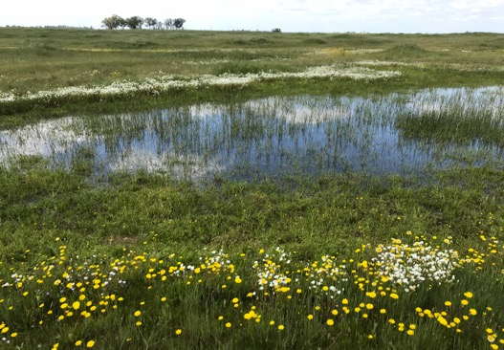
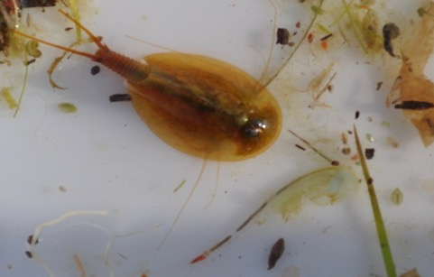
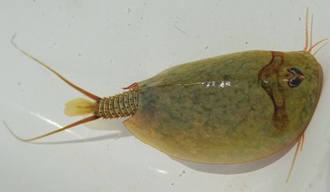
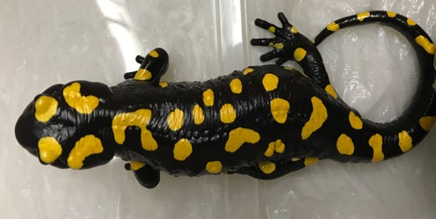
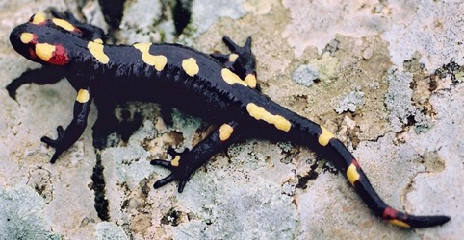
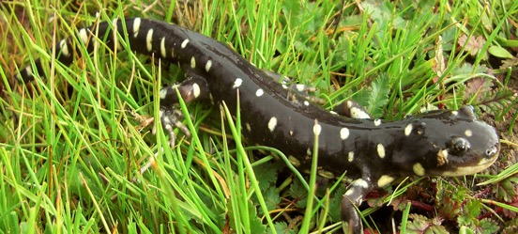
Mediterranean Temporary Ponds
Israel
Morocco
California
Notes:
African fire sal
Near eastern fire sal

Slide 9
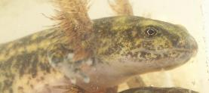
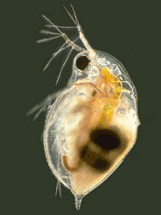
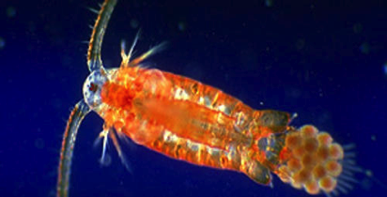
Aquatic Food Web
Notes:
The aquatic community consists of a few trophic levels ,Algae (periphyton and phytoplankton- pelagic algae) take the roll of the primary producers. Many aquatic invertebrates are the herbivores and the consumers.
As the top predator in temporary pools in Israel, near eastern fire slamader Salamandra infraimmaculatafeed on
invertebrate species, thus indirectly driving a trophic cascade, and has a indirect positive effect over algae

Slide 10
Aquatic Food Web
Bottom up
Notes:
The aquatic community consists of a few trophic levels ,Algae (periphyton and phytoplankton- pelagic algae) take the roll of the primary producers. Many aquatic invertebrates are the herbivores and the consumers.
As the top predator in temporary pools in Israel, S. infraimmaculata feed on
invertebrate species, thus indirectly driving a trophic cascade, and has a indirect positive effect over algae

Slide 11
Aquatic Food Web
Top down
Bottom up
Notes:
The aquatic community consists of a few trophic levels ,Algae (periphyton and phytoplankton- pelagic algae) take the roll of the primary producers. Many aquatic invertebrates are the herbivores and the consumers.
As the top predator in temporary pools in Israel, S. infraimmaculata feed on
invertebrate species, thus indirectly driving a trophic cascade, and has a indirect positive effect over algae

Slide 12
Aquatic Food Web
Top down
(-)
(+)
(-)
Bottom up
Notes:
The aquatic community consists of a few trophic levels ,Algae (periphyton and phytoplankton- pelagic algae) take the roll of the primary producers. Many aquatic invertebrates are the herbivores and the consumers.
As the top predator in temporary pools in Israel, S. infraimmaculata feed on
invertebrate species, thus indirectly driving a trophic cascade, and has a indirect positive effect over algae

Slide 13
Aquatic Food Web
FIRE
RETARDANTS
Notes:
The aquatic community consists of a few trophic levels ,Algae (periphyton and phytoplankton- pelagic algae) take the roll of the primary producers. Many aquatic invertebrates are the herbivores and the consumers.
As the top predator in temporary pools in Israel, S. infraimmaculata feed on
invertebrate species, thus indirectly driving a trophic cascade, and has a indirect positive effect over algae

Slide 14
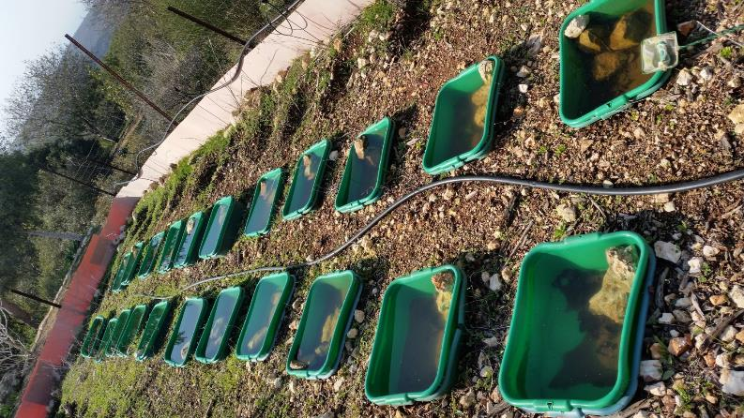
Mesocosm Study
Hai-Bar Nature Reserve (Mount Carmel, Haifa, Israel)
FR concentrations: Control:$0{mg}/L$, Low: ${3.805∗10}^{2}{mg}/L$ Med: ${7.611∗10}^{2}{mg}/L$ High:${11.14∗10}^{2}{mg}/L$
Sampling every 3 weeks
Notes:
40 L mesocosma, 75, 50 and 25 percent (3.8x10², 7.6x10² and 11.4x10² mgL⁻¹ respectively) of the LC50 is the lethal concentration required to kill 50% of the population

Slide 15
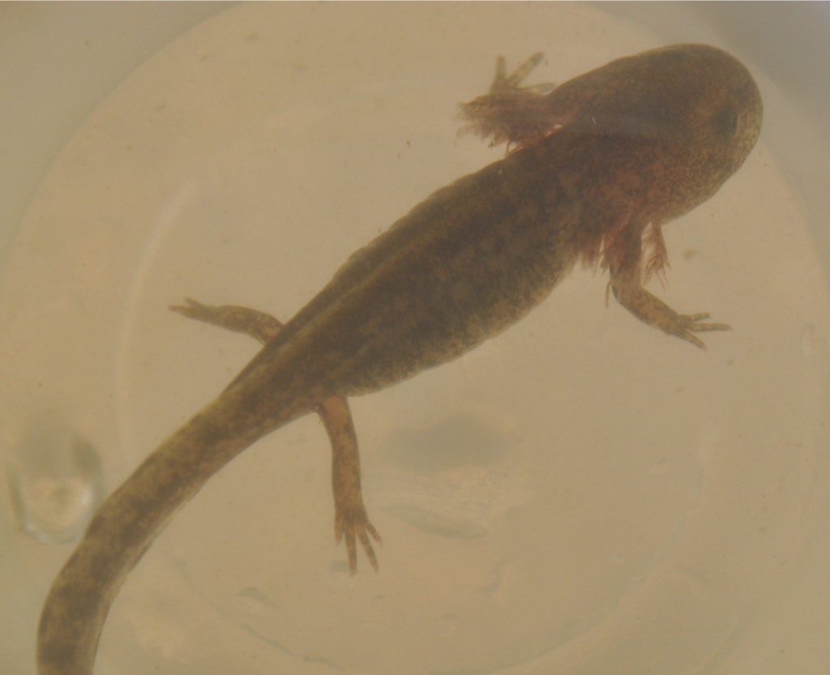
Top Predator: Survival
y = 1.22 - 0.25*x, p = 0.001, R² = .38
Control Low Medium High
Notes:
Decrease in feeding

Slide 16
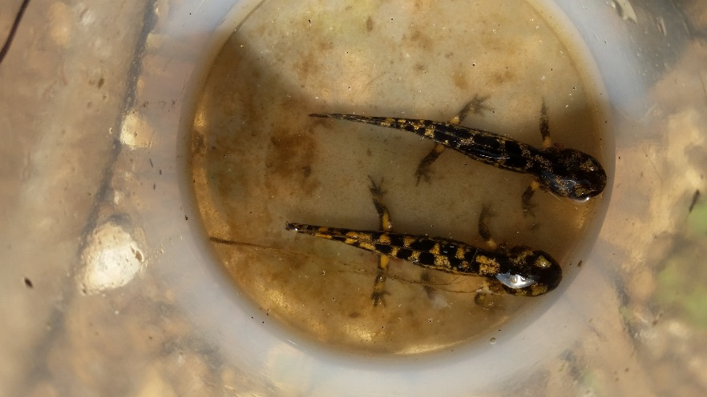
Top Predator: Development
Control Low Medium High

Slide 17
Invertebrate Species
Variation in species responses
Notes:
And mosquitos choose high FR treatments

Slide 18
Invertebrate Species
Species composition varied across treatments
Most middle consumers
Few insects
Mosquitos oviposit in highest FR treatments
A
B
C

Slide 19
Basal Trophic Level
Consistent increases in autotrophic and heterotrophic organisms

Slide 20
Aquatic Food web
(-)
(+)
(+/-)
FIRE
RETARDANTS
(+)
Notes:
The aquatic community consists of a few trophic levels ,Algae (periphyton and phytoplankton- pelagic algae) take the roll of the primary producers. Many aquatic invertebrates are the herbivores and the consumers.
As the top predator in temporary pools in Israel, S. infraimmaculata feed on
invertebrate species, thus indirectly driving a trophic cascade, and has a indirect positive effect over algae

Slide 21
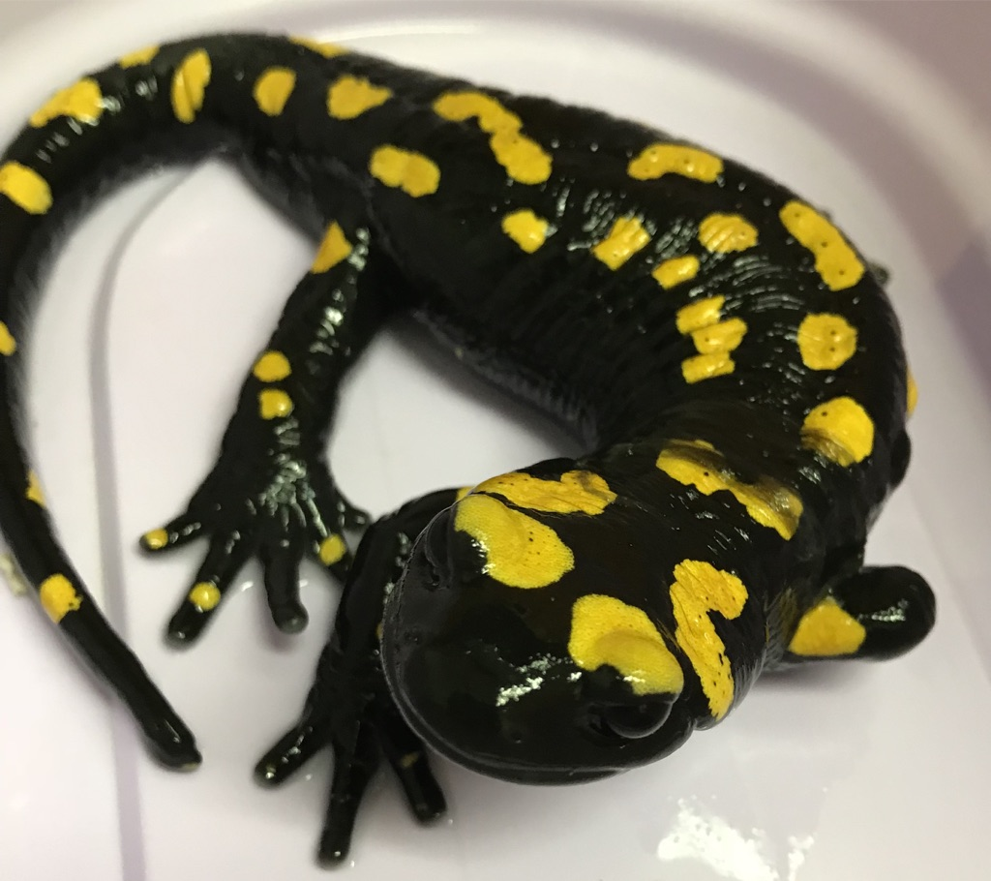
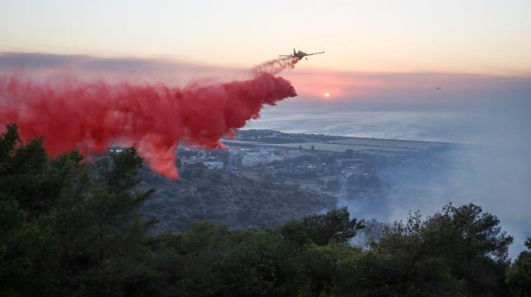
Conclusions
Whole community effects
Direct and indirect
Increased potential for eutrophication & vector increase
Consistent with previous studies
More studies on mechanisms of FR effects
Environmental risk assessment in firefighting
Notes:
global changes are altering the distribution and frequency of the largest, most destructive, extreme wildfires (EW) in different regions of the world

Slide 22
