Slide 1
Evaluating and enhancing groundwater recharge in the Sacramento area
Amelia Vankeuren
Assistant Professor of Geology
CSU Water Resources and Policy Initiatives Annual Conference
19 April 2019

Slide 2
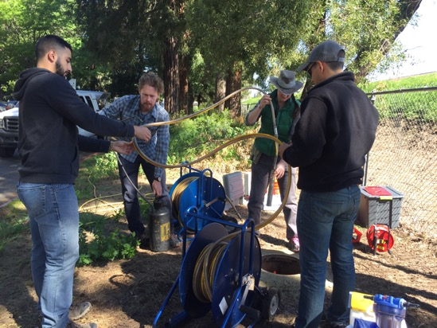
Acknowledgements
Collaborators:
Ate Visser, Lawrence Livermore National Lab
Sacramento State Geology students:
Marissa Loustale, Amber Ginorio, Austin George, Adelia McGregor, Jack Shafer, Brian Clark, Nick Rice
Support for this work was provided by:
UC California Institute for Water Resources through a grant agreement with the United States Geological Survey
Sacramento State Research and Creative Scholarly Activity Faculty Awards program
Lawrence Livermore National Laboratory Glenn T. Seaborg Institute Nuclear Forensics Summer Internship Program
Sacramento County Water Agency
The Nature Conservancy
City of Sacramento Water Forum

Slide 3
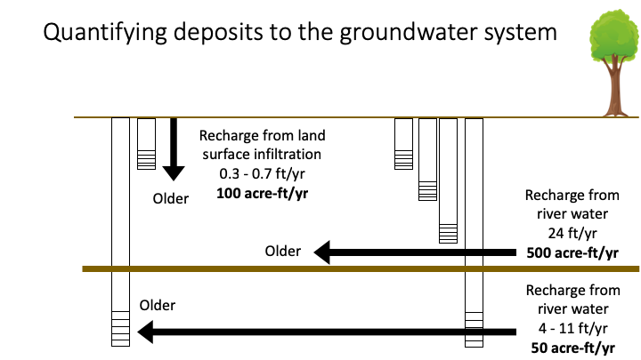
Road map
Part 1
Quantifying natural groundwater recharge with climate change
Part 2
Enhancing recharge through off-season irrigation

Slide 4
California’s groundwater bank account

Slide 5
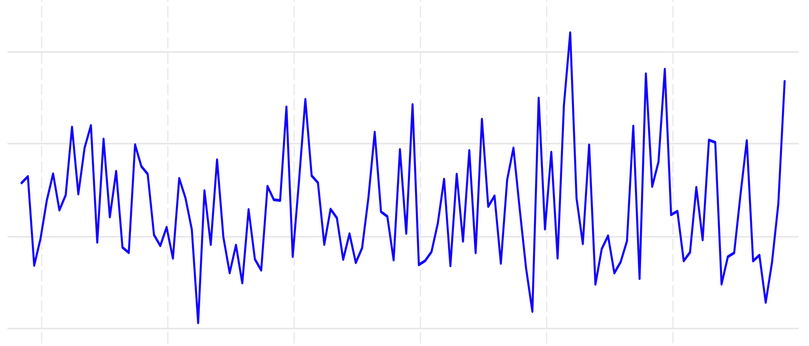
Precipitation- and surface water availability- is highly variable
4 fold difference between
minimum and maximum annual inflows
maximum
40
30
Statewide water year precipitation (in)
average
20
10
minimum
1900
1940
Year
1980
2020
WestMap Climate Analysis and Mapping Toolbox. Desert Research Institute. Accessed 2/25/18.

Slide 6
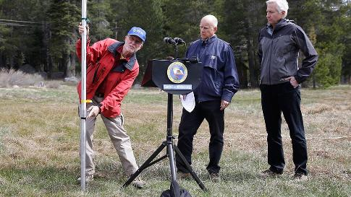
Climate change is predicted to shift snowpack and cause more extreme weather events
Lake Oroville
2015
2014
2017
Photos from Rich Pedroncelli/AP; Justin Sullivan/Getty Images

Slide 7
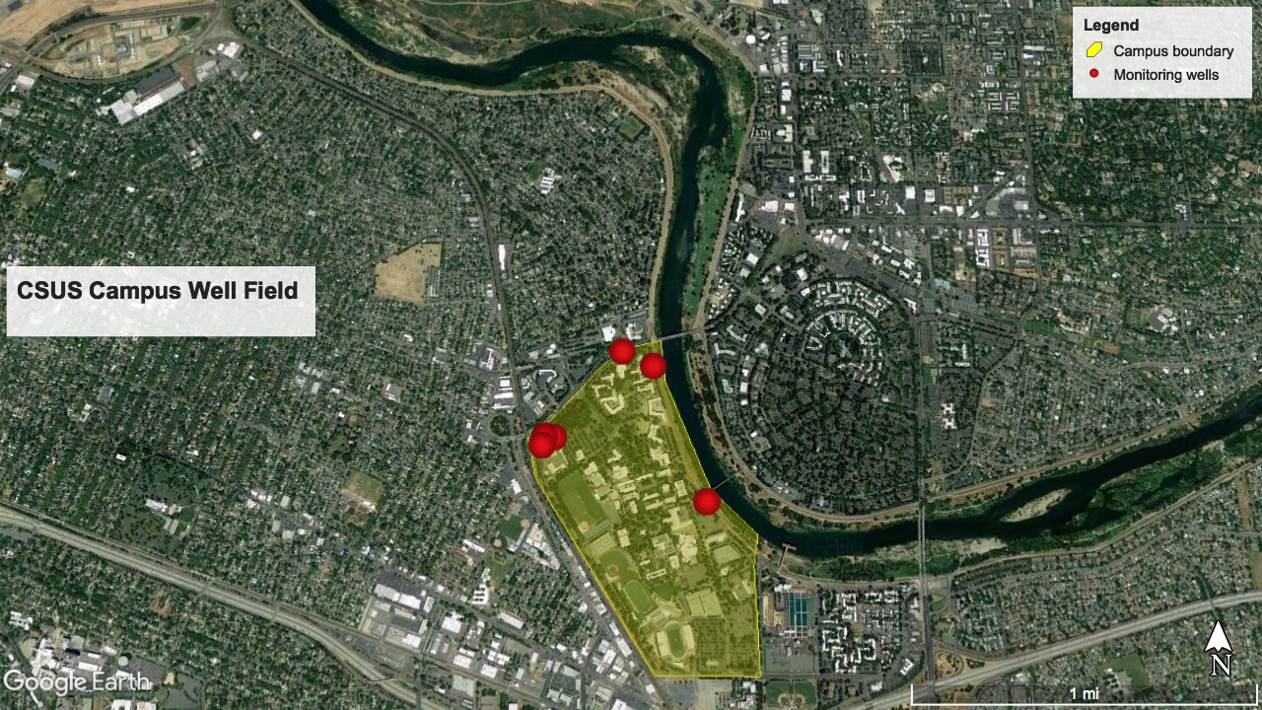
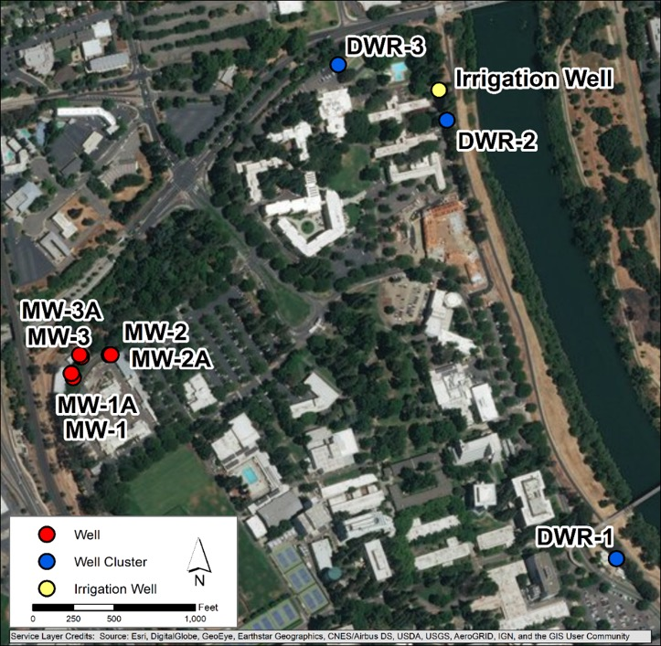
Quantifying natural groundwater recharge at the Sacramento State Campus Well Field
Monitoring wells
13 in unconfined aquifer
6 in confined aquifer
1 Extraction well
American River
Figure 2. Map created in GIS to indicate location of well on campus.
Figure 2. Map created in GIS to indicate location of well on campus.

Slide 8
Sacramento State Campus Well Field
Levee with slurry wall
200 ft
2200 ft
S
Lower American River
D
S
M
D
Unconfined Aquifer
Confining Layer
Confined Aquifer
Modified from image provided by Adelia McGregor, CSUS Geology student

Slide 9
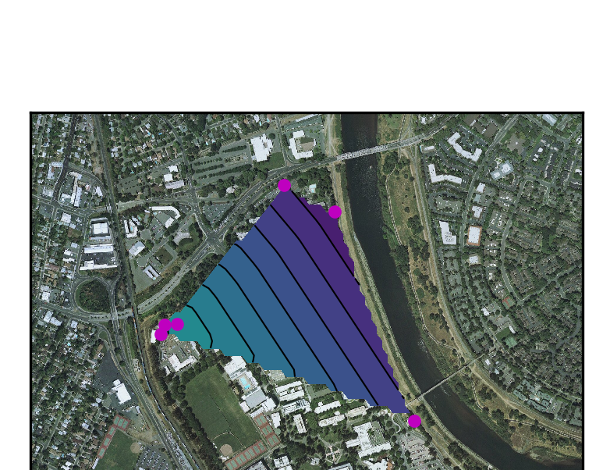
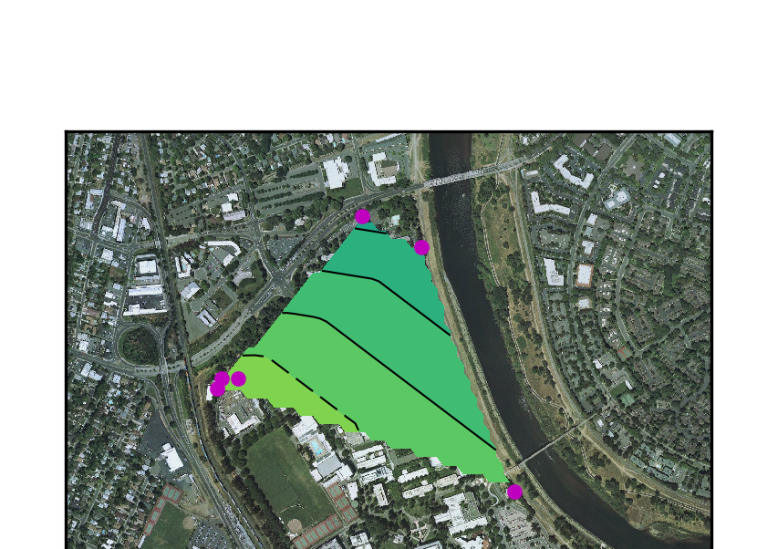
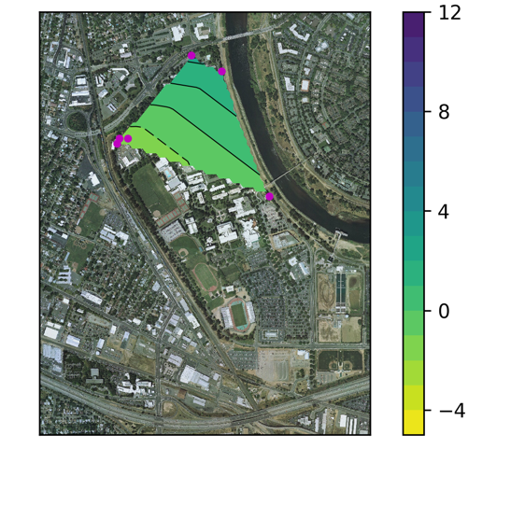
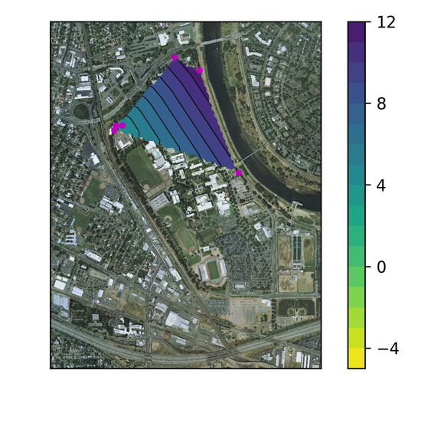
Groundwater in both aquifers flows southwest away from the Lower American River
Unconfined aquifer
Confined aquifer
Water level (ft) above sea level
Figure 2. Map created in GIS to indicate location of well on campus.
Figure 2. Map created in GIS to indicate location of well on campus.
Figure 9: 2016 Confined groundwater surface contours
Figure 10: 2016 Unconfined groundwater surface contours
Figure 9: 2016 Confined groundwater surface contours
Figure 10: 2016 Unconfined groundwater surface contours

Slide 10
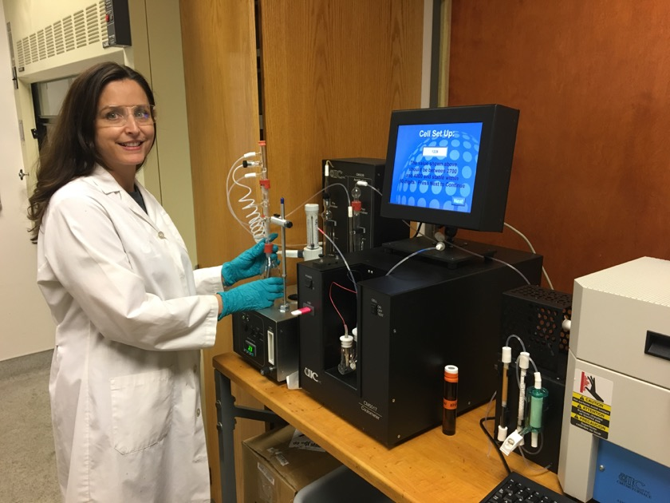
Groundwater sampling and geochemical characterization
Left: Photo by Fatima Burhan. CSUS Geology undergraduate students and faculty, and LLNL scientist sample groundwater from monitoring wells.
Above: CSUS Geology undergraduate student performing groundwater chemical analyses

Slide 11
Most water in campus aquifers is from the American River
Wells with mixed river water and local precipitation
Stable isotopes ∂²H (‰)
Wells with mostly river water
Stable isotopes ∂¹⁸O (‰)
Modified from Loustale et al. (2017), American Geophysical Union Fall Meeting
Figure 2. Map created in GIS to indicate location of well on campus.

Slide 12
In the shallow aquifer, groundwater age increases along vertical flowpath
water table
Recharge from land surface infiltration
0.3 -0.7 ft/yr
Older
Recharge from American River
24 ft/yr
Older

Slide 13
In the deeper confined aquifer, groundwater age increases along horizontal flowpath
All wells at ~200 ft depth
Older
Recharge from river water
11 ft/yr
Older

Slide 14
Quantifying recharge to the groundwater system
Recharge from land surface infiltration
0.3 - 0.7 ft/yr
100 acre-ft/yr
Older
Recharge from river water
24 ft/yr
500 acre-ft/yr
Older
Recharge from river water
4 - 11 ft/yr
50 acre-ft/yr
Older

Slide 15
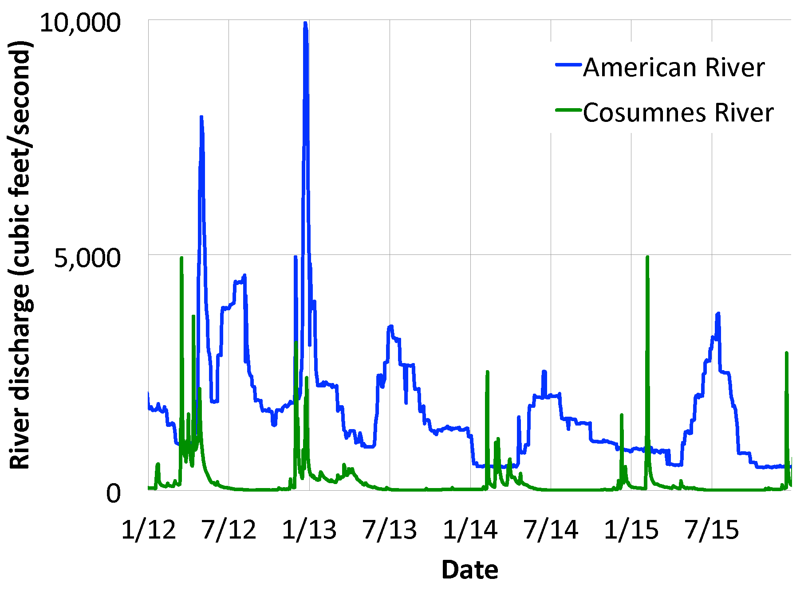
In this dam-controlled system, groundwater recharge will occur even in drought years
Summer flows for Central Valley Project

Slide 16
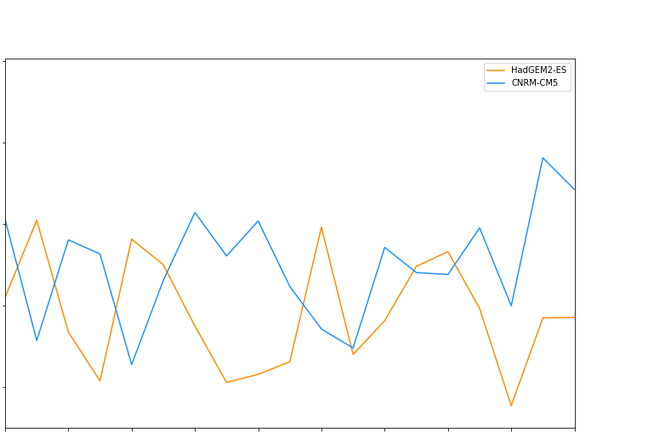
Precipitation will vary depending on how the climate changes
40
Less warm/
Less dry
30
Annual precipitation (in)
average
20
Warmer/
Drier
10
2020
2025
2030
2035
Data from Cal-Adapt.org

Slide 17
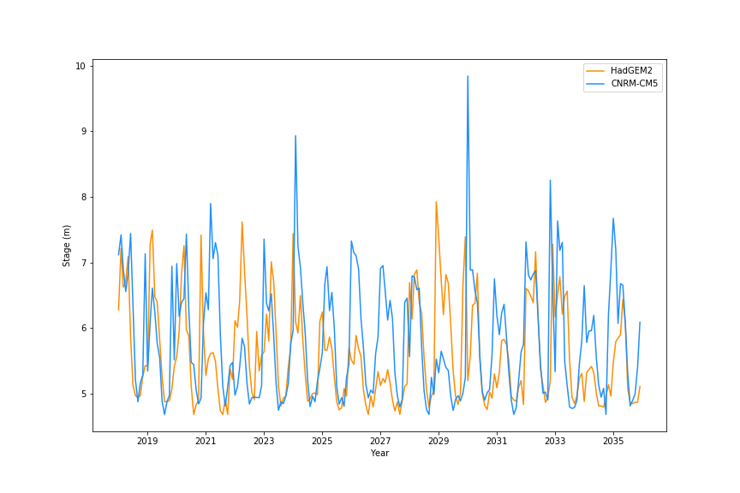
American River discharge will vary depending on how the climate changes
10
9
8
American River Stage (m)
7
Cooler/
Wetter
6
Warmer/
Drier
5
2020
2025
2030
2035

Slide 18
So how much will recharge vary with climate change?

Slide 19
So how much will recharge vary with climate change? Modeling predicted recharge in Sacramento
Sacramento River
American River
Sacramento State campus
Model area

Slide 20
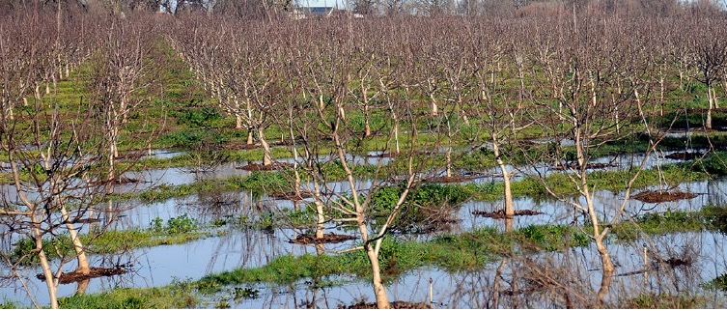
Enhancing recharge: Off-season irrigation of crops for managed aquifer recharge
Water table
Photo by Josh Viers, in O’Geen et al. (2015), California Agriculture (69)2

Slide 21
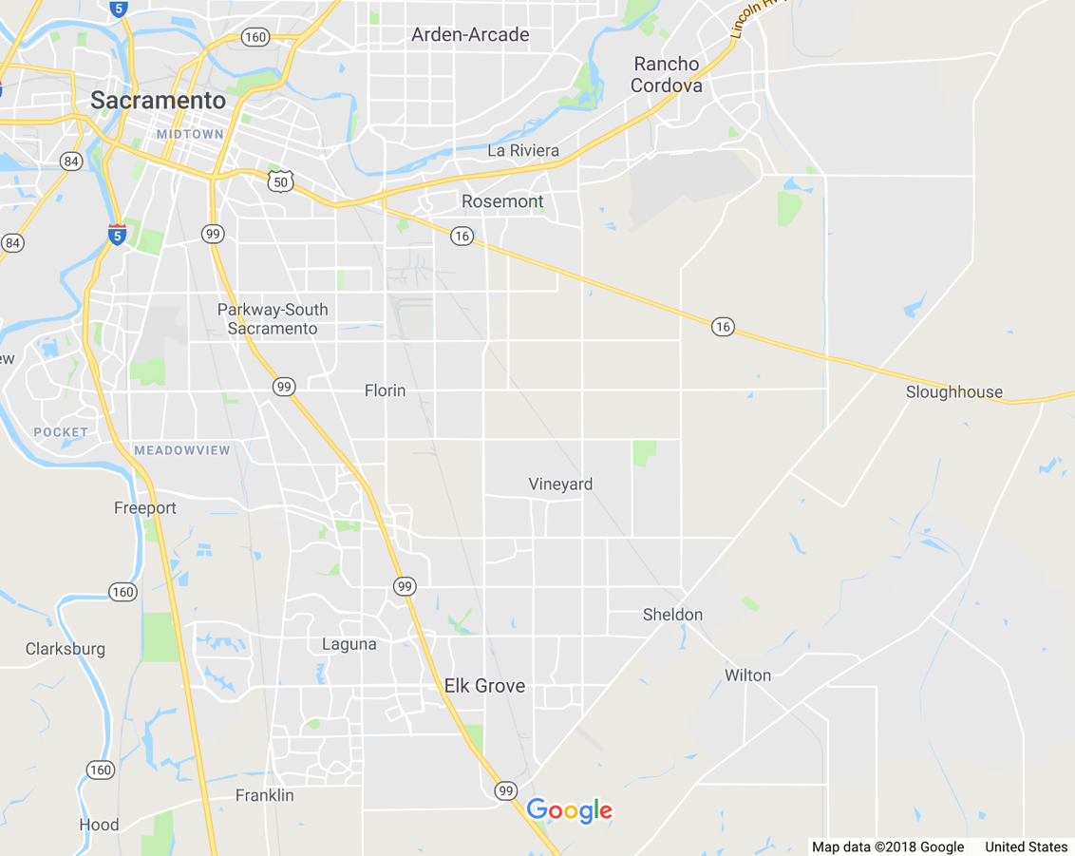
Off-season irrigation of vineyards along the Cosumnes River corridor
376 acres
Collaborators
Omochumnee-Hartnell Water District/ Larry Walker Assoc.
UC Davis Hydrology
Cosumnes Coalition
89 acres
785 acres
Google Earth
Notes:
1250 acres

Slide 22
Off-season irrigation of vineyards along the Cosumnes River corridor
Plan to recharge 4,000 – 6,000 acre-ft/year for 10 years
Irrigation will occur November– March when excess water flows in Cosumnes River
Actual amount will depend on water availability
Photo by Paul Verdegaal, in O’Geen et al. (2015), California Agriculture (69)2

Slide 23
Monitoring groundwater quality and flow direction
Water quality
Do fertilizers and pesticides get washed down with the recharge water?
Photo by Melinda Frost-Hurzel. CSUS Geology graduate student and faculty test wells at Teichert Ranch for groundwater sampling

Slide 24
Monitoring groundwater quality and flow direction
Water quality
Do fertilizers and pesticides get washed down with the recharge water?
Where does the groundwater go from here?
?
?
https://gis.water.ca.gov/app/gicima/

Slide 25
Background sampling

Slide 26
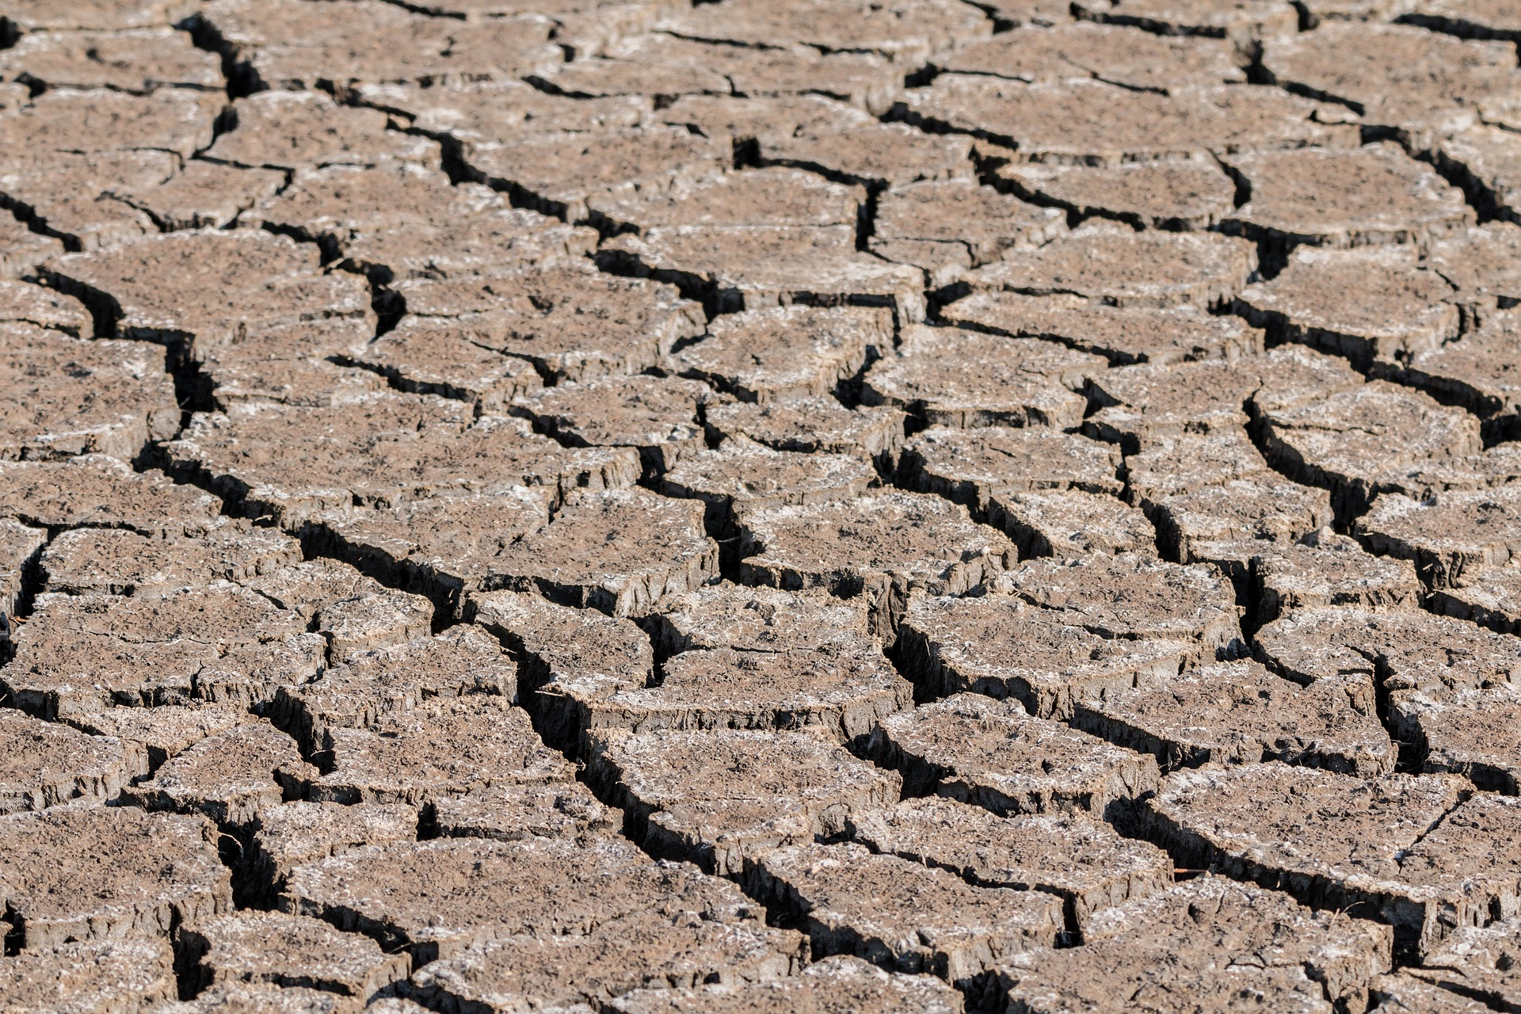
Can we do enough managed aquifer recharge to offset overdraft?
2.7 million acre ft/yr of river water high flows in the Central Valley that could be harvested and stored
Could add 6% to the annual water supply
That’s about the same volume as annual groundwater overdraft
Would need to store every drop of extra river water to offset overdraft
Kocis and Dahlke (2017), Environmental Research Letters
Notes:
Is it realistic to think we can harvest all excess flows? Probably not.

Slide 27
Can we do enough managed aquifer recharge to offset groundwater overdraft?
Statewide:
Areas in California with good managed aquifer recharge potential are mostly in the south
But available water is mostly in the north
Would need infrastructure to bring the water to the appropriate locations
California Precipitation, US Geological Survey National Atlas
O’Geen et al. (2015), California Agriculture (69)2
Notes:
Is it realistic to think we can harvest all excess flows? Probably not.

Slide 28
Conclusions
Lower American River supplies 85% of campus groundwater
East Sacramento unconfined aquifer is recharged by a mixture of American River water and local precipitation
Confined aquifer is recharged by American River water
Climate change will alter natural recharge, but by how much?
Enhancing recharge through off-season irrigation will help achieve groundwater sustainability, but is no silver bullet

Slide 29
Questions?
Lower American River supplies 85% of campus groundwater
East Sacramento unconfined aquifer is recharged by a mixture of American River water and local precipitation
Confined aquifer is recharged by American River water
Climate change will alter natural recharge, but by how much?
Enhancing recharge through off-season irrigation will help achieve groundwater sustainability, but is no silver bullet

