Slide 1
Agricultural Water Transfers in Northern California and Implications for Sustainable Management of Groundwater Storage
Steffen Mehl & Eric Houk
Kyle Morgado, Kevin Anderson, and Jeff Davids
CSU Chico
Funding by:
USBR, USDA, & CSU Agricultural Research Institute

Slide 2
Outline
Overview of CA water
Water transfers to balance CA’s water budget
  Effects of water transfers on groundwater
Compare surface vs. groundwater storage
Concepts of capture and groundwater management
  Lake Tahoe Analogy

Slide 3
CA has a lot of water, right?

Slide 4
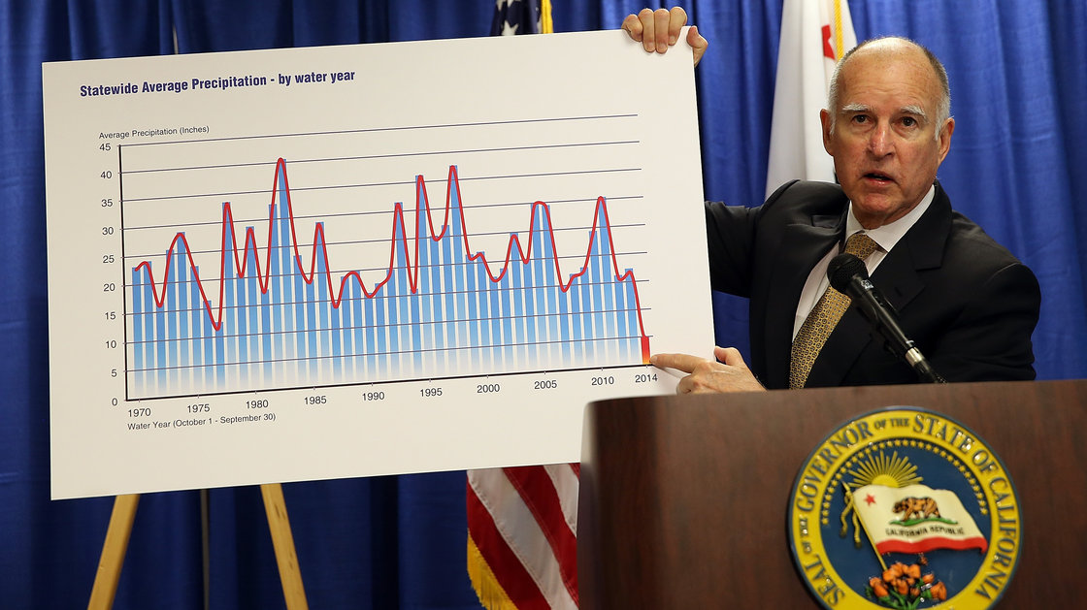
California Water
Source: Justin Sullivan/Getty Images
Notes:
Governor Brown showing statewide precipitation by water year from 1970 through 2014. Shows the extreme variability in precipitation which highlights the importance of sufficient storage.

Slide 5
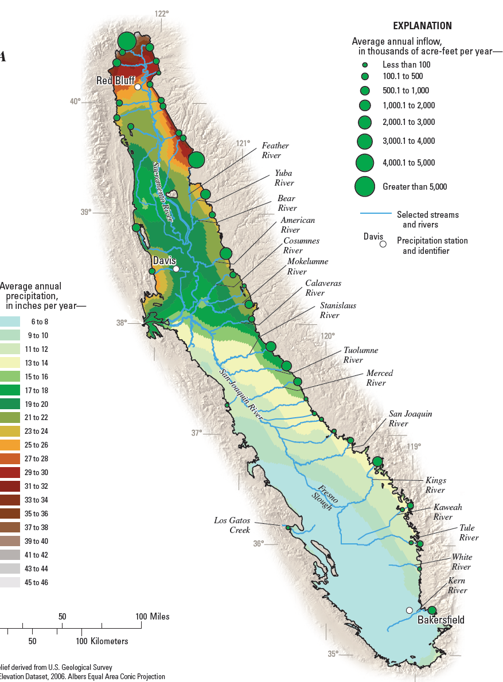
Precipitation
  North vs. South
Stream flows
  North vs. South

Slide 6
California Water
California’s climate is characterized by extremes
Mismatch between supply and demand (spatially and temporally)
  2/3 of demand in the south
  2/3 of supply in the north
  Peak precipitation from November to April
  Peak demand from May to October

Slide 7
Drought Management

Slide 8
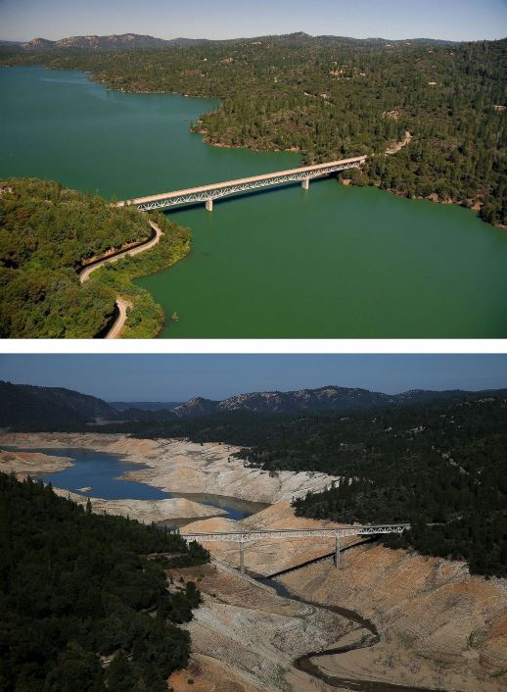
Lake Oroville
July 20, 2011
August 20, 2014

Slide 9
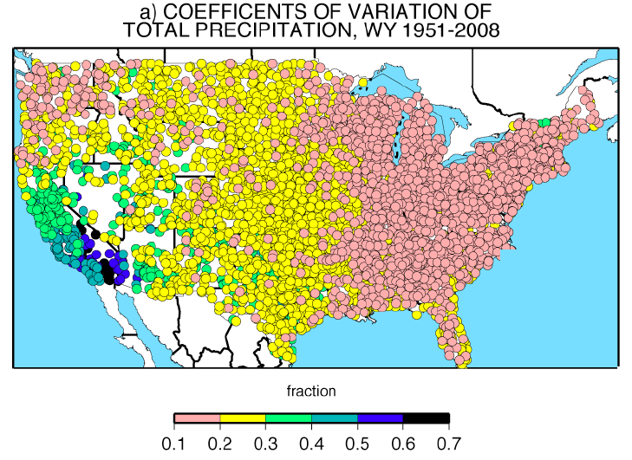
Variability in Precipitation
Coefficients of variation of Total Precipitation, 1951-2008;
Dettinger et al. 2011
Notes:
Coefficients of Variation of Total Precipitation, 1951-2008 (Dettinger et al. 2011)

Slide 10
Timing of Precipitation
Number of days to accumulate 67% of annual total precipitation;
Dettinger et al. 2011
Notes:
CA accumulates 2/3 of its total precipitation in less time than any other state (<125 days), indicating a far shorter wet season

Slide 11
California’s Water Supply Issues
High variability = high uncertainty = low reliability
In times of drought we turn to groundwater
Groundwater pumping was unregulated
  Unlike surface water which is highly regulated
    Prior appropriations (senior water rights)
  Pre-SGMA legal framework for managing groundwater:
    Whoever has the biggest/deepest well wins!

Slide 12
Types of Water Transfers Considered
Groundwater Substitution
  Farmers sell (transfer) their surface water
  Pump groundwater to offset loss of surface water
  Controversial because pumping can affect other users
Land Fallowing with Surface Water Transfer
  Rice acreage is fallowed
  No additional groundwater is pumped
  No application of surface water to land
  Does lack of excess irrigation affect aquifer recharge?

Slide 13
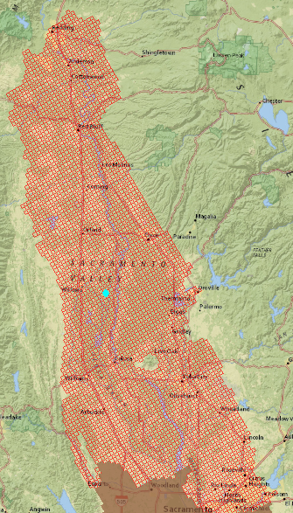
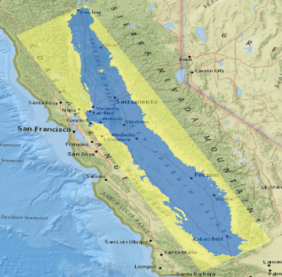
Groundwater Substitution Scenarios
Pumping for transfers
  75,000 acre-ft/yr up to
  600,000 acre-ft/yr
  1 year of pumping, 9 years recovery

Slide 14
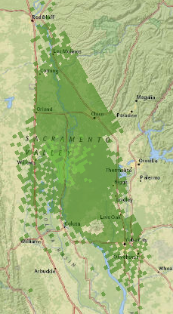
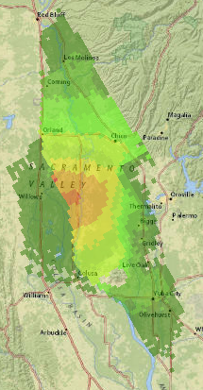
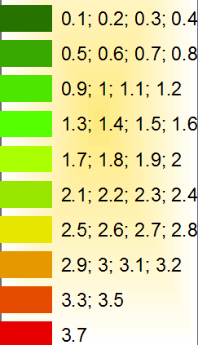
Aquifer Decline
75,000 AF scenario
600,000 AF scenario
Drawdown in Feet

Slide 15
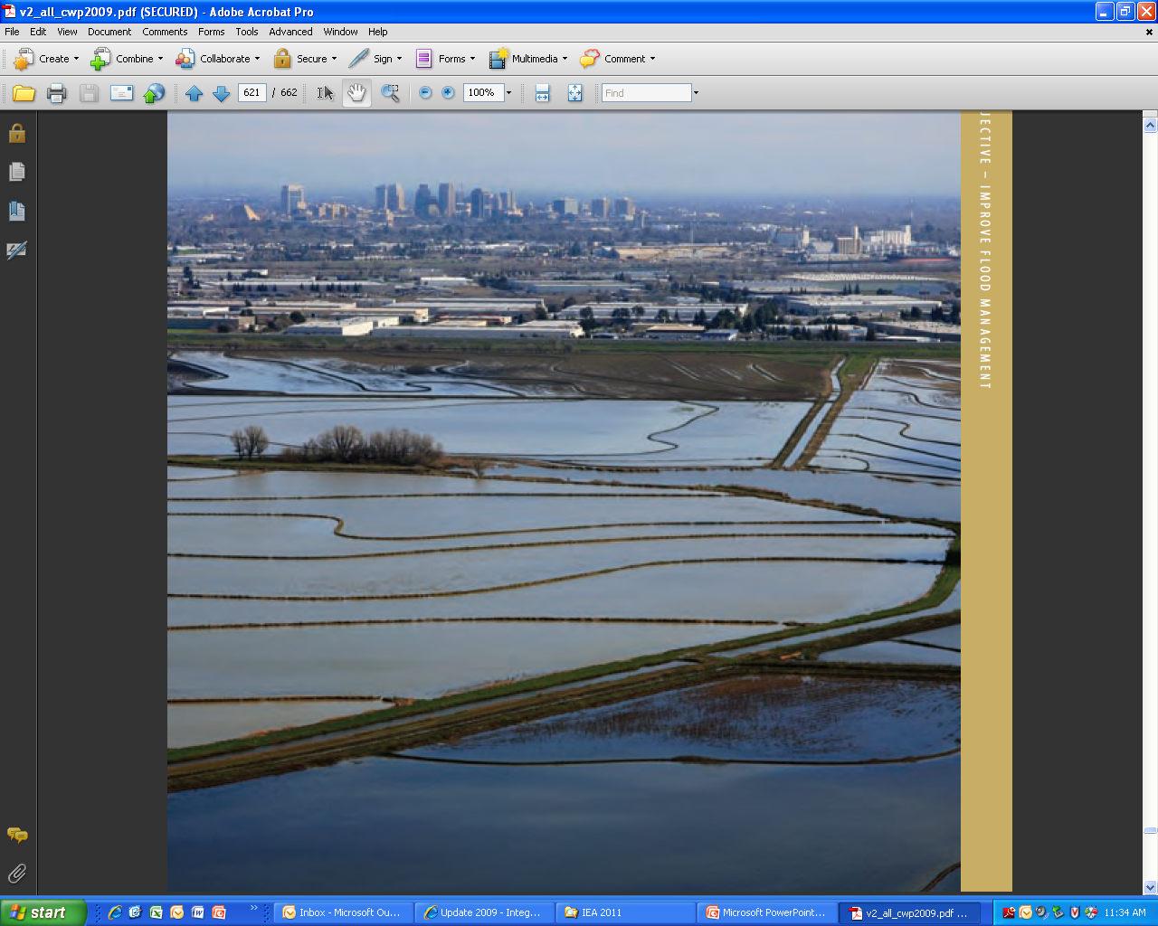
Land Fallowing of Rice Fields
Rice is flood irrigated with surface water
  ~5 ft of water per acre of rice
Rice field is fallowed and water is transferred
Effect on recharge?
Notes:
Figure from CA water plan

Slide 16
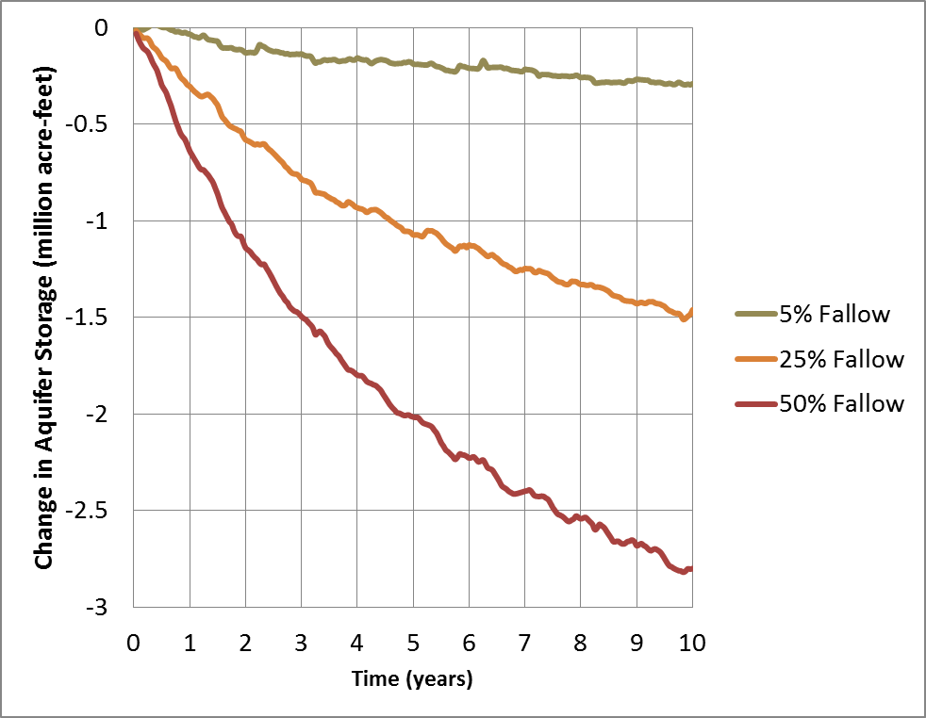
10 Years of Rice Land Fallowing
Folsom Lake

Slide 17
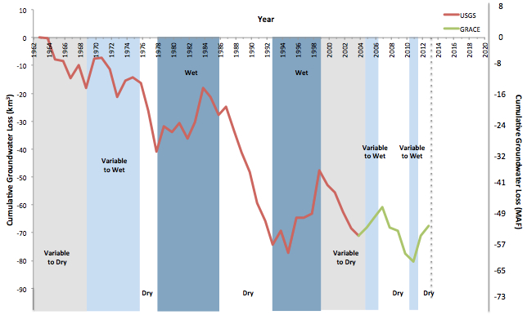
Groundwater Depletion & Sustainability
Measured from space by GRACE (Gravity Recovery and Climate Experiment)
  Good news: this method works!
  Bad news: indicates we are running out of groundwater!
Cumulative GW loss in California’s Central Valley
Notes:
Figure from Famgalletti. http://newswatch.nationalgeographic.com/2014/02/04/epic-california-drought-and-groundwater-where-do-we-go-from-here/
From Sandra Postel:
http://newswatch.nationalgeographic.com/2014/07/30/groundwater-depletion-in-colorado-river-basin-adds-big-risks-to-water-security/
Imagine having a bank account for which you don’t know (1) how much money is in the account, (2) how much gets withdrawn, or (3) how much will get deposited, or when.
Figure from UCCHM Water Advisory #1. Cumulative groundwater losses (cubic km and million acre-ft) in California’s Central Valley since 1962. The red line shows data from USGS calibrated groundwater model simulations from 1962-2003. The green line shows satellite-based estimates of groundwater storage losses produced by the UCCHM at UC Irvine. Background colors represent periods of drought (white), of variable to dry conditions (grey), of variable to wet conditions (light blue) and wet conditions (blue). Groundwater depletion mostly occurs during drought; and progressive droughts are lowering groundwater storage to unsustainable levels. After Figure B9 from USGS Professional Paper 1766. USGS data courtesy of Claudia Faunt. Satellite data courtesy of NASA and the National Center for Atmospheric Research.

Slide 18
2014 Sustainable Groundwater Management Act (SGMA)
Motivations for passage of SGMA
  Increasing agricultural, municipal, and environmental demands for water
  Persistent overdraft and land subsidence
  Rising concerns over the impending effects of climate change on California’s water supply
  Increasing evidence of the interconnections between surface water and groundwater
  Ongoing severe drought conditions

Slide 19
Relative Merits of Groundwater vs. Surface Water (adapted from Harvey)
Surface Reservoirs
Subsurface Reservoirs
Disadvantages
Advantages
Few new sites available
(USA
)
Many large capacity sites available
Need
large areas of land
Need very small areas of land
High evaporative losses
Practically
no evaporative loss
May fail catastrophically
Practically
no danger of failure
Easily
polluted
Usually high biological purity,
although pollution can occur
Water
must be conveyed
Internal conveyance (no need
for
canals)
Notes:
Adapted from Harvey

Slide 20
Management of Groundwater vs. Surface Water
Surface Reservoirs
Subsurface Reservoirs
Advantages
Disadvantages
Well
defined boundaries
Boundaries often unknown
High
rates of flow possible
Limited rates of extraction/injection
Only 1 measurement needed
Need many measurements in space
Responds
as a level pool
Response
depends on location and
can be nonlinear
Response time is relatively fast
Response time is relatively
slow
Well defined
conveyance
Internal
conveyance
system

Slide 21
Theis Concept of Capture
“All water discharged by wells is balanced by a loss somewhere.” – Theis, 1941
  Storage, induced recharge, reduced discharge (capture)
Notes:
From a USGS Circular – Surface – Groundwater a single resource
Recent work (Konikow and Leake) indicate that most of the water from wells is not from storage (15%), but rather capture (85%)

Slide 22
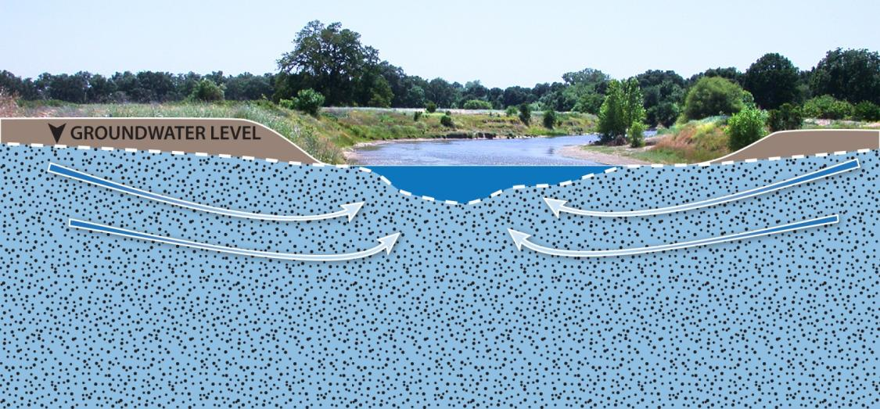
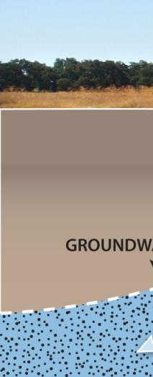
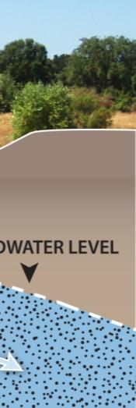
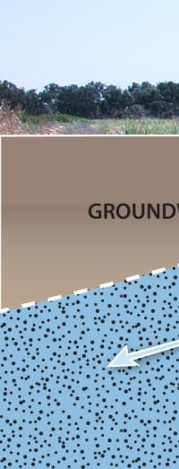
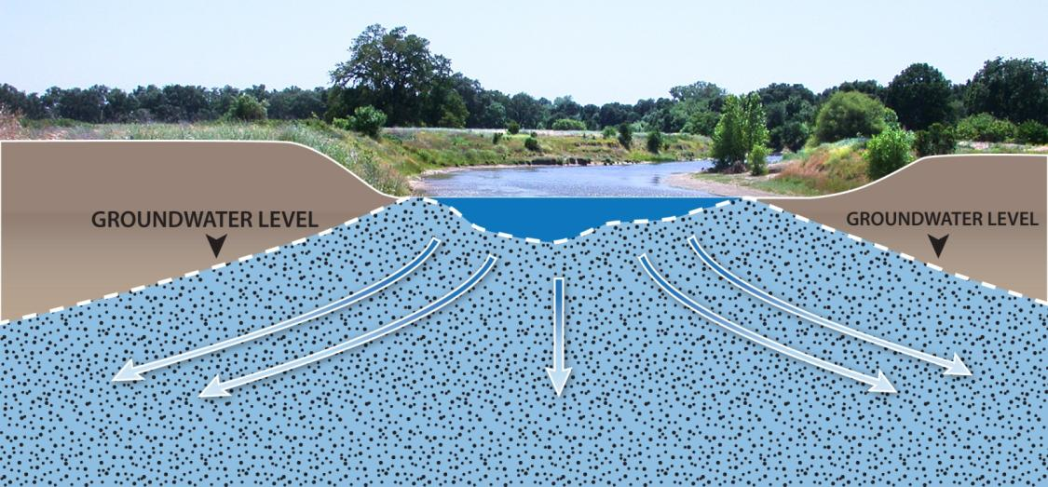
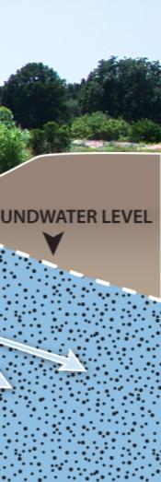
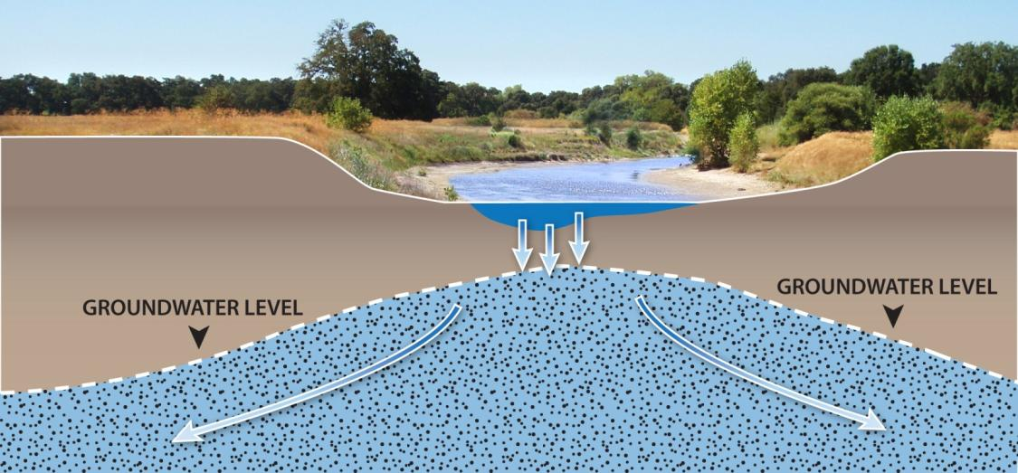





Stream/Aquifer Interactions
Source: The Nature Conservancy

Slide 23
Sustainable Management Metrics
Adverse impacts Subsidence:
  Extremely important
    By the time it is measured, it’s too late (if inelastic)

Slide 24
Sustainable Capture Concepts
Apply concepts of capture to each discharge flow path
SCF = Sustainable Capture Fraction
  Stakeholder driven process
    Fraction of flow path that can be “sustainably” captured?
    Ranges between 0 and 1
SCT = Σ (SCF*discharge)= rate of sustainable extraction
Capture Efficiency: Ratio of the actual amount of discharge captured over the SCT

Slide 25
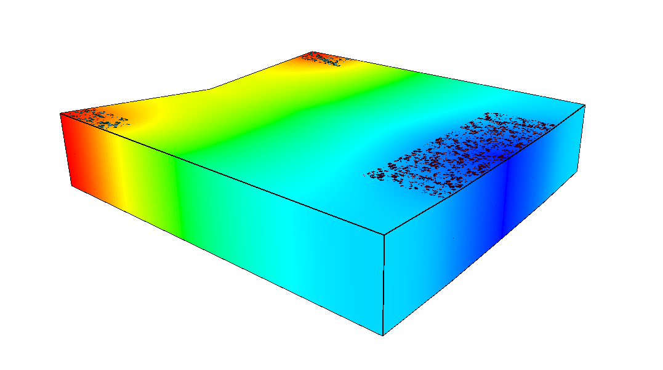
Example
0.14 m³/s
0.14 m³/s
0.28 m³/s
0.2035 m³/s
0.2035 m³/s
??
m³/s
Phreatophytes 0.26 m³/s
??
m³/s
Stream outflow 0.30 m³/s
Given the discharge, stakeholders decide:
  Need to keep at least 0.15 m³/s in the stream
  Okay to deplete phreatophytes
Proposed GW pumping
= 0.407 m³/s

Slide 26
Management After Overdraft
Consider 15 years of over pumping
How should pumping be changed for sustainability?
  Adaptive management based on:
    Water budget over draft
    Capture

Slide 27
Adapt after 5 years
Reduce pumping by 0.067 m³/s
Pumping reduced by 0.14 m³/s
Threshold exceeded
by 0.14 m³/s
Threshold exceeded
Halt Pumping
>1.5 year residual effect
Pumping reduced considering capture

Slide 28
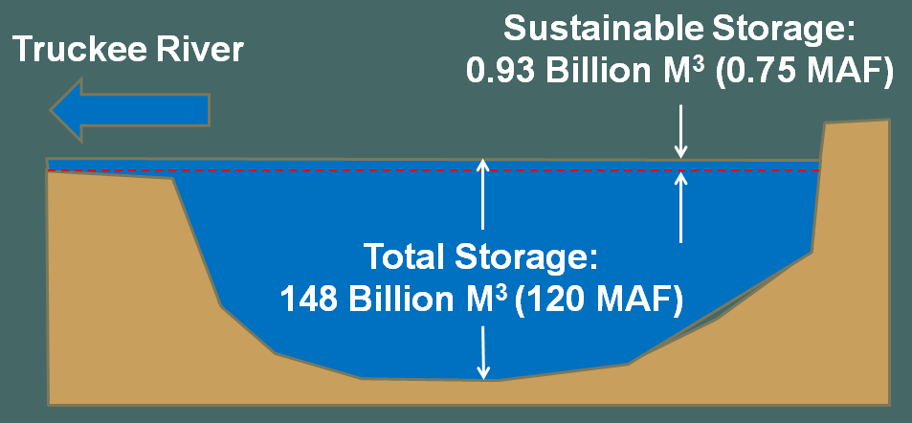
Sustainable Groundwater Storage vs. Surface Storage
Storage depleted less than 1% of total groundwater storage
  Unlike reservoirs
Lake Tahoe
  Only upper few
  feet can be
  sustainably
  exercised
  Advantage that changes in lake levels are easily observed and impacts to outlet flows are immediate

Slide 29
Sustainable Management Metrics
Need metrics that are:
  Flexible
    SW/GW interactions are complex, integrated systems
    Spatial/temporal variability in SW/GW interactions
  Meaningful
    Represent effects on SW/GW in a hydraulically correct way
    Can be incorporated into a management framework
  Easily Understood
    Many stakeholder with varied technical knowledge

Slide 30
Conclusions
Storage, Capture, and Sustainable Yield
Managing groundwater storage requires a different framework than surface water storage
    Need to manage effects of capture on streams
Sustainable yield in stream/aquifer systems
  Sustainable groundwater storage often is a small % of total groundwater storage
  Stream/spring flows are the “canaries in the coalmine”
Notes:
Maybe save some of this for conclusions.

