Slide 1
Building and Fostering a Culture of Success through the Program for Academic and Career Excellence (PACE)
California State University, Stanislaus
James T. Strong, Suzanne Espinoza,
J. Martyn Gunn, Shawna Young, Stuart Sims

Slide 2
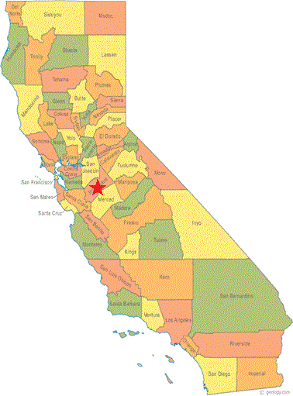
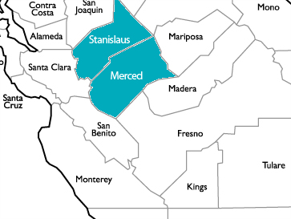
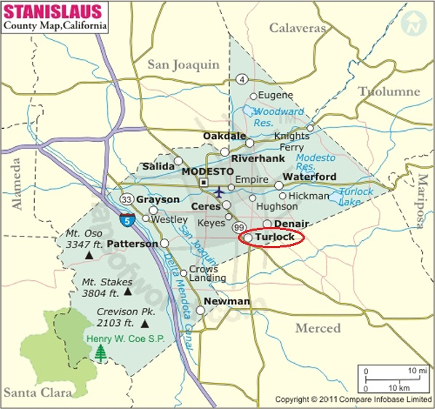
Our Region
Turlock, CA – Central Valley
66.5% of Stan State’s students come from Stanislaus and Merced Counties

Slide 3
Our Population
Stanislaus and Merced Region
California
72.4% of K-12 students in the region are eligible for free/reduced meals (CA Dept. of Ed, 2015)
22.9% of people in the region fall below poverty level (U.S. Census Bureau, 2013)
90.2% people age 25+ have education completion below the bachelor’s degree (U.S. Census Bureau, 2014)
59.2% students in CA are eligible for free/reduced meals (US Dept. of Ed, 2014)
15.9% people in CA fall below poverty level (U.S. Census Bureau, 2013)
80.4% people age 25+ have education completion below the bachelor’s (U.S. Census Bureau, 2014)

Slide 4
Our Students
Total Headcount = 9,282 (Fall 2015)
Undergraduate = 8,099 (87.3%); Graduate = 1,183 (12.7%)
First Time Freshmen = 1,270; First-Time Transfers = 922
First Time Freshmen Characteristics (Fall 2015)
76% first-generation
61.8% Pell-eligible
55.4% first-generation and Pell-eligible
44.8% require developmental education courses in English
50.7% require developmental education courses in math

Slide 5
Our Students
Ethnic Distribution
Hispanic/Latino = 47.8%
White = 25.9%
Asian = 10.2%
Black/African American = 2.4%
Pacific Islander = .5%
American Indian or Alaska Native = .4%
Other = 12.8%
Designated as a Hispanic-Serving Institution

Slide 6
Identified Need - 2010
Freshmen 4-year graduation rate = 20%
Freshmen 6-year graduation rate = 50%
A 5.6% gap in second-year retention between Hispanic students and White students (64.1% for Hispanic students; 69.7% for White students)
A 10.6% gap in 4-year graduation rates between Hispanic and White students (16.5% for Hispanic students; 27.1% for White Students)

Slide 7
Program for Academic and Career Excellence (PACE)
PACE: Established in 2010 through a 5-year, $3,063,567 U.S. Department of Education Title V grant (Project Director, Jill Tiemann-Gonzalez)
Designed to increase engagement, retention, and graduation rates of first-generation and Pell-eligible college students

Slide 8
Two Essential Program Components
1. First Year Experience (FYE):
The University’s previous pilot FYE program was refined and expanded by embedding it in a two-semester English stretch course; the second course in the series meets the general education written communication requirement
43.1% of PACE students took this stretch course
Lead: Dr. Susan Marshall, Professor of English

Slide 9
Two Essential Program Components
2. Check In, Check Up, Check Out (C³):
A comprehensive student success program was developed to provide targeted services and an environment that, from admission to graduation, enhances students’ academic success and results in increased engagement, retention, and completion.
Central space, intrusive advising, peer mentoring, workshops, events, and more.

Slide 10
Project Goals
1. First Year Experience
Increase engagement
Increase second-year retention rate
Decrease second-year retention rate gaps
Increase the WPST first-attempt pass rate

Slide 11
Project Goals
2. Check In, Check Up, Check Out
Increase engagement
Increase second-year retention rate
Decrease gap in second-year retention rates
Increase 4-year and 6-year graduation rates
Decrease gaps in 4-year and 6-year graduation rates

Slide 12
Participants: Numbers
Freshmen cohorts averaging 136 students each year (714 students in total) were directly served by the grant-funded project.

Slide 13
Participants: Selection
Students were identified through outreach efforts made at regional high schools.
Through collaboration with high school counselors, PACE program personnel delivered information sessions to high school seniors who had been accepted to Stan State.
During these sessions, an overview of PACE program services were provided, and program applications were distributed and collected.

Slide 14
Participants: Demographics
PACE
Gender: 32% Male, 68% Female
First-gen: 98%
Pell-eligible: 76%
Ethnicity:
Hispanic/Latino = 76.62%
Asian = 14.11%
White = 2.26%
Pacific Islander = .70%
Black = .48%
American Indian = .11%
University
Gender: 35% Male, 65% Female
First-gen: 79%
Pell-eligible: 63%
Ethnicity:
Hispanic/Latino = 53.06%
Asian = 10.43%
White = 22.03%
Pacific Islander = .73%
Black = 2.54%
American Indian = .29%

Slide 15
Program: Design
Welcome Events
FYE English Stretch Class Learning Community
Intrusive Advising
Space & Amenities
Peer Mentors
Workshops
Events
Service Learning
Career Services

Slide 16
Program: Resources
Space
Personnel
Equipment and Supplies

Slide 17
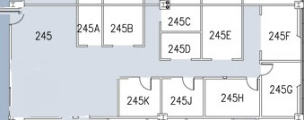
Space
A modest beginning.
1,920 square feet.

Slide 18
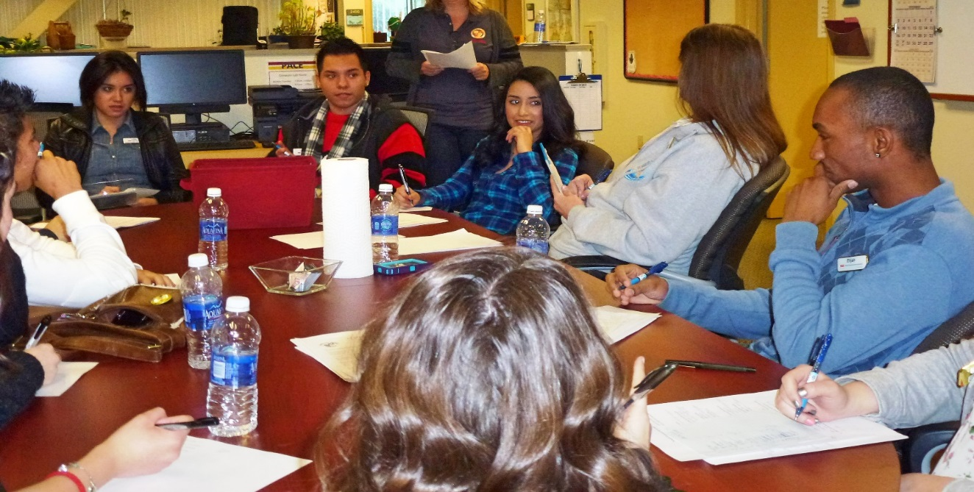
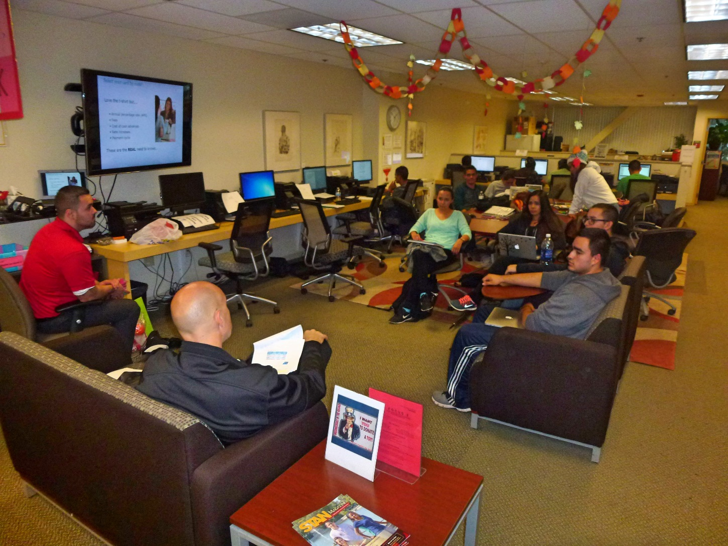
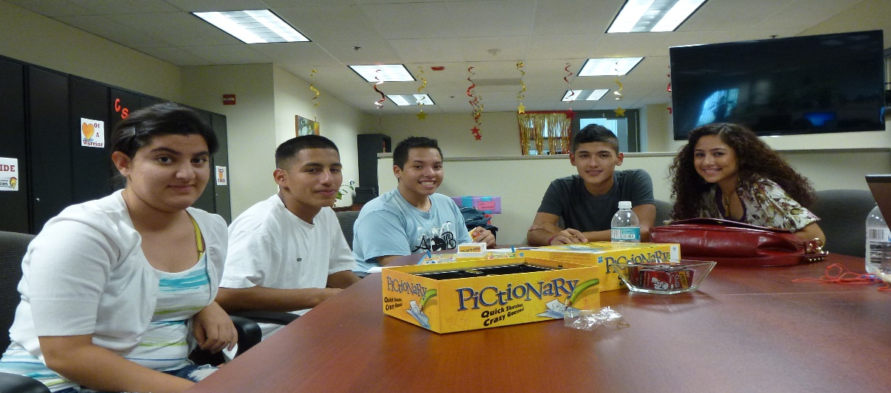

Slide 19
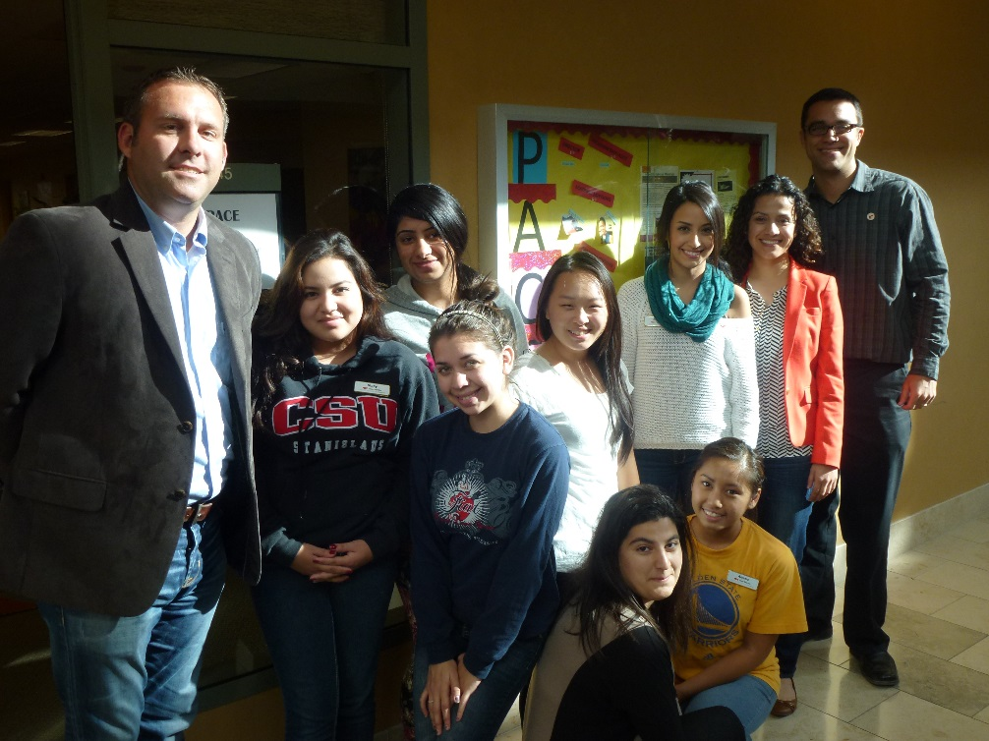
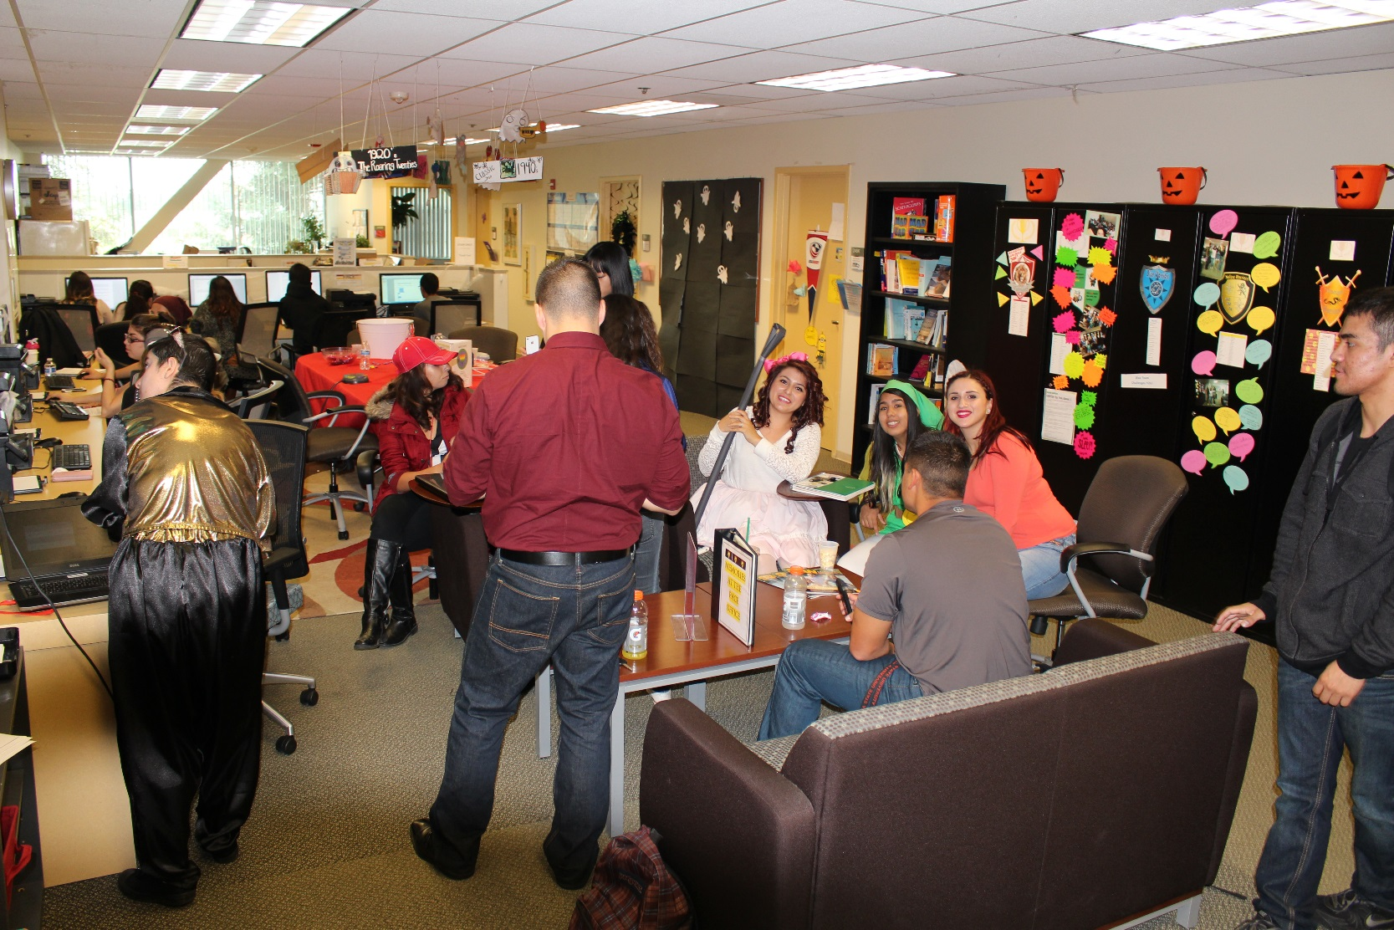

Slide 20
Program: Personnel
Director
3 Academic Advisors (ratio of 1:238)
10 Peer Mentors
Administrative Analyst

Slide 21
Program: Equipment and Supplies
Computer lab with 8 desktop computers and printers
55 laptops available for check-out
Presentation equipment and space (automated screen and projector)

Slide 22
Transitioning and Scaling
PACE Workgroup
Established in December of the last year of the grant project
Co-chairs: Provost & VP for Academic Affairs; VP for Enrollment & Student Affairs
Other members: faculty, students, other administrator representatives
Charge from Provost:
Recommend a transition plan to the President regarding the PACE program
Identify, institutionalize, and scale best practices, and recommend other funding sources to replace the grant when it ends

Slide 23
Data Examined
PACE 2011 Cohort study, including descriptive analyses, logistic regression and multiple regression analyses
2011-2015 comparison study of PACE students and students in other support programs from 2011-2015, using binomial comparisons
Comparison of PACE students 4-year graduation rate and other groups
Three forums and one focus group, generating qualitative data
Limitations
Self-selected program participants
Correlational in nature
Post hoc analyses; no control for confounding variables
Not designed to imply cause and effect

Slide 24
2011 Cohort Study
Sample: 1,251 first time freshmen who enrolled at Stan State Fall 2011
122 of the 1,251 enrolled in PACE
68% female; 32% male (compared to University: 64% female; 36% male)
98.4% first-generation college students (compared to University: 77%) (Federal TRIO definition)
77% Pell-eligible (compared to University: 59%)
Conducted by Brandon Price (2014)

Slide 25
FINDINGS

Slide 26
Descriptive Analyses
First Term Enrollment: Students in the PACE cohort (n=122) were census enrolled in an average of 13.08 units in their first term, while peers who were not participating in PACE (n=1,129) were census enrolled in an average of 13.00 units in their first term.
Persistence to Second Year: 93% (113/122) of the students in the PACE cohort persisted to the second year, compared to 79% (893/1129) of the students in the non-PACE cohort. Additionally, 92% (81/88) of the Hispanic students in the PACE cohort persisted to the second year, compared to 78% (394/502) of the Hispanic students in the non-PACE cohort.

Slide 27
Logistic Regression Analyses
Results of the logistic regressions examining the effect of PACE participation on student persistence included the following:
Persistence to Second Year: Participation in PACE was positively correlated with persistence to the second year (β=1.014, SE=.423, p=.017, Exp (β)=2.757).
Persistence to Fourth Year: Participation in PACE was positively correlated with persistence to the fourth year (β=.823, SE=.297, p=.006, Exp (β)=2.277).

Slide 28
Results of Logistic Regression Model Predicting Student Persistence to Second Year
Covariates | B | S.E. | Sig. | Exp(B)
Ethnicity code (White) |  |  | .638
Asian | .419 | .381 | .270 | 1.521
Black | .396 | .489 | .418 | 1.485
Hispanic | .404 | .293 | .168 | 1.497
Other | .533 | .436 | .222 | 1.704
Gender(Female) | .133 | .236 | .571 | 1.143
EOP Participant | -.261 | .345 | .449 | .770
PACE Participant | 1.014 | .423 | .017 | 2.757
CSUS Athlete | .440 | .588 | .454 | 1.553
High School GPA | .809 | .297 | .006 | 2.245
ELM Score | .013 | .011 | .244 | 1.013
EPT Score | .040 | .016 | .011 | 1.041
Pell Recipient | .369 | .244 | .130 | 1.447
Units Enrolled First Term | .185 | .065 | .004 | 1.203
First Generation Student | .130 | .303 | .668 | 1.139
Age | -.122 | .192 | .526 | .885
Constant | -8.187 | 4.413 | .064 | .000

Slide 29
Results of Logistic Regression Model Predicting Student Persistence to Fourth Year
Covariates | B | S.E. | Sig. | Exp(B)
Ethnicity code (White) |  |  | .129
Asian | .506 | .323 | .117 | 1.658
Black | .314 | .412 | .445 | 1.369
Hispanic | .580 | .251 | .021 | 1.787
Other | .006 | .343 | .985 | 1.006
Gender (Female) | -.079 | .192 | .681 | .924
EOPS Participant | -.097 | .303 | .748 | .907
PACE Participant | .823 | .297 | .006 | 2.277
CSUS Athlete | .094 | .431 | .828 | 1.098
High School GPA | .611 | .242 | .011 | 1.843
ELM Score | .005 | .009 | .547 | 1.005
EPT Score | .012 | .013 | .357 | 1.012
Pell Recipient | .063 | .204 | .760 | 1.065
Units Enrolled First Term | .130 | .057 | .022 | 1.139
First Generation Student | .249 | .249 | .317 | 1.283
Age | -.150 | .165 | .365 | .861
Constant | -2.966 | 3.735 | .427 | .052

Slide 30
Multiple Regression Analyses
Results of the multiple regression analyses examining the effect of participation in PACE on cumulative units earned and cumulative GPA included the following:
Cumulative Units Earned: PACE was not a statistically significant factor in the regression model predicting cumulative units earned (β=1.121, SE=1.719, p=.515).
Cumulative GPA: PACE was a statistically significant factor in the regression model predicting cumulative GPA (β=.113, SE=.057, p=.049).

Slide 31
Results of Regression Model Predicting Cumulative Units Earned by Students Who Persisted to Fourth Year
 | B | Std. Error | Beta | t | Sig.
(Constant) | 26.887 | 30.040 |  | .895 | .371
PACE (Fall 2011) | 1.121 | 1.719 | .032 | .652 | .515
High School GPA | 10.210 | 1.860 | .272 | 5.491 | .000
EPT Total | .146 | .098 | .076 | 1.490 | .137
ELM Total | .194 | .067 | .151 | 2.886 | .004
Pell Recipient (2011-2012) | -.666 | 1.528 | -.022 | -.436 | .663
First Generation Student Federal TRIO Definition | -.625 | 2.062 | -.016 | -.303 | .762
Gender Code | .004 | 1.433 | .000 | .003 | .998
Age | -.620 | 1.370 | -.022 | -.452 | .651
Ethnicity code | -.649 | .546 | -.058 | -1.188 | .236

Slide 32
Results of Regression Model Predicting Cumulative GPA for Students Who Persisted to Fourth Year
 | B | Std. Error | Beta | t | Sig.
(Constant) | 1.129 | 1.000 |  | 1.128 | .260
PACE (Fall 2011) | .113 | .057 | .095 | 1.975 | .049
High School GPA | .451 | .062 | .356 | 7.278 | .000
EPT Total | .003 | .003 | .047 | .925 | .356
ELM Total | .002 | .002 | .038 | .738 | .461
Pell Recipient (2011-2012) | .040 | .051 | .039 | .785 | .433
First Generation Student Federal TRIO Definition | -.111 | .069 | -.084 | -1.620 | .106
Gender Code | .013 | .048 | .013 | .277 | .782
Age | -.007 | .046 | -.007 | -.150 | .881
Ethnicity code | -.002 | .018 | -.005 | -.111 | .912

Slide 33
2011-2015 Comparison Study
PACE students were compared to five other student groups (PACE Eligible, Non-PACE, SSS, EOP, and CVMSA) on the following student success indicators over the 5-year period:
GPA
Units Earned
Retention
WPST Performance
Conducted by John Tillman (2015)

Slide 34
FINDINGS

Slide 35
GPA
Out of 19 observations of cohort average Term GPA scores, 14 of the 19 were higher for the PACE Students in comparison to PACE Eligible Students.
Out of 19 observations of cohort average Term GPA scores, 16 of the 19 were higher for the PACE Students in comparison to EOP Students.
In comparison to Non-PACE, SSS, and CVMSA Students, PACE Students did not score higher in average Term GPA.

Slide 36
Units Earned
Out of 20 observations of cohort units earned, 14 of the 20 observations were greater for PACE Students in comparison to EOP Students.
In comparison to PACE Eligible, Non-PACE, SSS, and CVMSA Students, PACE Students did not earn a greater number of units.

Slide 37
Retention
Out of 10 observations of cohort retention percentages:
9 of the 10 observations were greater for PACE Students in comparison to PACE Eligible Students.
10 of the 10 were greater for PACE Students in comparison to Non-PACE Students.
9 of the 10 were greater for PACE Students in comparison to EOP Students.
Compared to SSS and CVMSA Students, PACE Students did not retain at greater rates.

Slide 38
WPST Performance
PACE Students demonstrated greater overall WPST pass rates compared to EOP, but not any of the other four student groups.
PACE Students did demonstrate better pass rates on first-attempts than all other student groups except CVMSA.
PACE Students have the lowest rate of students who have not taken the WPST by their last year, compared to all the other students groups except CVMSA.

Slide 39
4-Year Graduation Rates
PACE students: 13%
PACE Eligible: 13%
Non-PACE: 11%
SSS: 10%
EOP: 3%
CVMSA: 18%
University: 12%

Slide 40
Forum and Focus Group Data
Three forums and one focus group
Overarching emergent theme that unifies the recorded narrative of PACE: the culture of familia within the program
Familia was cultivated by all services provided by PACE in combination, delivered in a way that was unique to other support programs on campus.

Slide 41
Take-Home Points
PACE impacted student engagement, retention, and quality of the college experience in a very positive way.
Impacts retention and GPA, and cultivates a critical sense of familia
But we still need to find effective ways to increase average unit load and improve time to degree while maintaining this culture of access, engagement, quality, and familia.
Results demonstrate that these practices provide a robust and sustainable foundation for student success, and are the bedrock on which to build practices to improve time to degree completion.

Slide 42
Taking to Scale
The Critical Question:
How do we translate what we have learned from PACE to help achieve our 2025 Goals?

Slide 43
Moving Forward: Looking toward 2025
Graduation Rate Excellence and Assessment Team (GREAT)
Membership: faculty, staff, students, and administrators from across the university

Slide 44
Moving Forward: Looking toward 2025
GREAT Team Charge: Provide recommendations for strategies that, while maintaining student access to an engaging, high-quality education, will position the University to accomplish the following priority goals:
Improve Freshmen 4-year graduation rate;
Eliminate the achievement gaps in graduation rates for underrepresented minority and Pell-eligible students; and
Improve Transfer 2-year graduation rate.

Slide 45
GREAT: Team Details
Membership is a grass roots effort, intended to bring together programs and groups to examine practices across the university.
The GREAT Team members will:
Identify and examine barriers to increasing graduation rates
Examine evidence of effectiveness in multiple existing programs that improve student success on our campus (e.g., CVMSA, PACE, Early Start)
Make recommendations based on this examination
Recommendations will be used to further shape and refine our long-term student success plan and its implementation to reach our Graduation Initiative 2025 Goals.

Slide 46
15 to Finish
Fall 2016 incoming freshmen pose for group photo after convocation.

Slide 47
Discussion Questions
How do we replicate defining characteristics and best practices of
small, intimate programs while scaling-up to serve all students?
How do we encourage increased unit load while maintaining a
quality experience?
3. What are some challenges to, as well as tips for, institutionalizing
large, multi-year, multi-million dollar grant projects?

Slide 48
Discussion Questions
How do we replicate defining characteristics and best practices of
small, intimate programs while scaling-up to serve all students?

Slide 49
Discussion Questions
How do we encourage increased unit load while maintaining a
quality experience?

Slide 50
Discussion Questions
3. What are some challenges to, as well as tips for, institutionalizing
large, multi-year, multi-million dollar grant projects?

