Slide 1
Cougar Care Network
Involving the Whole University
in Targeted Student Support
Notes:
Both:
Start off with introduction of role at university – include title, responsibilities, and how long you have been with CSUSM
This presentation will provide an overview of the California State University San Marcos (CSUSM) Cougar Care Network, which is a campus-wide early support initiative to improve student success, retention, and persistence.
Through early alert referrals from campus community members, the Cougar Care Network serves as a "safety net" to assist students who may be experiencing challenges inside or outside the classroom.
This presentation will cover the development, implementation, and evaluation of the ongoing success of the initiative.
The Cougar Care Network truly involves the whole university in targeted student support, and we hope our presentation and experiences will assist as you consider implementing similar initiatives at your university.

Slide 2
History and Development
Graduation Initiative Discovery Café
SOAR - First Stop Shop for All Things Student
Faculty Focus Groups
Software Development (Maxient)
CARE Manager Position
Soft Launched CCN - Spring 2015
Launched CCN - Fall 2015
Notes:
History and Development of SOAR and the Cougar Care Network
As part of the CSUSM Graduation Initiative, our campus hosted a multi-disciplinary Discovery Café in September 2010 that identified steps that would increase student success and graduation rates by implementing:
(1) a student “concierge” service - a centralized service for all members of the university community seeking to assist students in finding answers, resolving concerns, accessing resources, and seeking support - later became known as Student Outreach And Referral (SOAR)
(2) an early warning system for faculty and staff to identify and refer students of concern to receive the information, resources, and support needed to ensure their personal and academic success - now known as the Cougar Care Network
Launched Student Outreach And Referral (SOAR) in Fall 2011 - First Stop Shop for All Things Student - start with SOAR to get connected to the correct department - built significant momentum for the Cougar Care Network by successfully rolling out SOAR
As we were building toward launching the Cougar Care Network, we held Faculty Focus Groups to receive feedback on the referral process - focused on access and simplifying the process
Software Development (Maxient) - centralized database - software of choice for managing behavior records at colleges and universities across North America. The centralized reporting and recordkeeping of students engaged with the Cougar Care Network helps connect the dots and prevent students from falling through the cracks.
CARE Manager Position - oversee day-to-day operations of the Cougar Care Network and SOAR - Licensed Clinical Social Worker (LCSW) who can provide long-term support for students with complex needs and connection to off-campus resources as needed
Soft Launch for CCN (Spring 2015) with select faculty and staff to address any successes and challenges with the workflow
Launched CCN (Fall 2015) - Academic Year 2015-16 demonstrated that the Cougar Care Network is working, which we will elaborate on moving forward

Slide 3
Student Outreach and Referral
First Stop Shop for All Things Student
Centralized Service and Support
Outreach to First Generation Students
Personalized On-Campus Referrals
SOAR Coordinator
Notes:
As the "first stop shop for all things student," the Cougar Care Network assists CSUSM students with decreasing barriers, navigating campus policies and procedures, and connecting them with the appropriate department.
By providing centralized services and an early support network, students are able to decrease barriers to success and access resources on and off campus.
Since launching in Fall 2011, the Cougar Care Network and particularly SOAR has emphasized reaching out to first generation college students and their families in order to create a sense of membership in the university community and build awareness of campus resources.
Example: Spanish Family Orientation – Create a welcoming environment – families feel comfortable and feel at home on campus
We used to refer to SOAR as the “4-1-1” on campus, and now we are calling SOAR the “Google of Cal State San Marcos” – Since most students “start” with google these days, we encourage students to “start with SOAR” to get the information, resources, and support needed to ensure their personal and academic success
Our SOAR Coordinator, Patty Diaz, was intentionally selected for her position. Patty has been with CSUSM for 15 years and she maintains excellent relationships with nearly every department on campus. Over the years, Patty has learned about the many policies and procedures at CSUSM, and how to coach students to successfully navigate the processes. Patty’s role is viewed as “air traffic control” and her job is to make sure students are connected to the correct department on campus through a personalized on-campus referral process. This involves connecting students to people, not places.
Case Example: Student is experiencing significant stress due to confusion with their Financial Aid refund. They are concerned they are not going to be able to afford their rent and food for their young child. After exhausting their options with Cougar Central front desk, the student comes to the SOAR Coordinator. The SOAR Coordinator coaches the student on how to ask questions and raise concerns about the process. The SOAR Coordinator then connects the student to a Senior Financial Aid Counselor, who supports the student in obtaining their refund and getting their questions answered.

Slide 4
Cougar Care Network
Early Warning (Support) Initiative
Faculty and Staff - Online Referral Form
Academic and Behavioral Concerns
Based in the Dean of Students Office
Network of Department Contacts
Maxient Database
Notes:
While the Cougar Care Network was initially conceptualized as an early warning or early alert initiative, we have started to refer to it as an early support initiative, especially when discussing the initiative with students.
In addition to students seeking support on their own through SOAR, faculty and staff are able to refer students who demonstrate early warning signs of academic concerns and behavioral concerns. (We will elaborate on this and give examples on the next slide.)
All referrals are sent to the Student Outreach and Referral (SOAR) Coordinator in the Dean of Students Office, who then connects students to a specific member of the Cougar Care Network.
Depending on the area of concern, most referrals are addressed by the CARE Manager in the Dean of Students Office, Personalized Academic Success Services (PASS), Housing and Residential Education, Financial Aid and Scholarships, Student Conduct, Title IX, and the University Police Department.
Elaborate on PASS services, which shows that the Cougar Care Network involves both academic and behavioral support
As was mentioned, all cases are carefully tracked in the Maxient Database to assist with the flow of communication between members of the Cougar Care Network.

Slide 5
Early Support Needs
Academic Concerns
Attendance
Poor Performance (e.g. Assignments)
At Risk of Failing Course
Behavioral Concerns
Disruptive Behavior
Financial Concerns
Safety / Threats
Mental Health
Notes:
As we discussed, Faculty and Staff are the “eyes and ears” of our campus.
When we share about the Cougar Care Network with our students, we tell them that our Faculty and Staff CARE about their success, and many of our Faculty and Staff will notice if they are struggling personally or academically.
This includes both Behavioral and Academic Concerns. Their “first stop shop for all things student” is the Cougar Care Network to make sure all these students get connected to the information, resources, and support needed to ensure their academic and personal success.
The most common concern for students engaged with the Cougar Care Network is personal issues impacting academic success.
This can range from students experiencing financial difficulties, emotional difficulties, death in the family, sexual assault, and much more.
While it might appear as simple lack of motivation with academics, we are often finding behavioral concerns that are causing academic concerns. This means there needs to be an excellent connection between academic support services (e.g. Personalized Academic Success Services) and behavioral support (e.g. CARE Manager, SHCS, etc.)

Slide 6
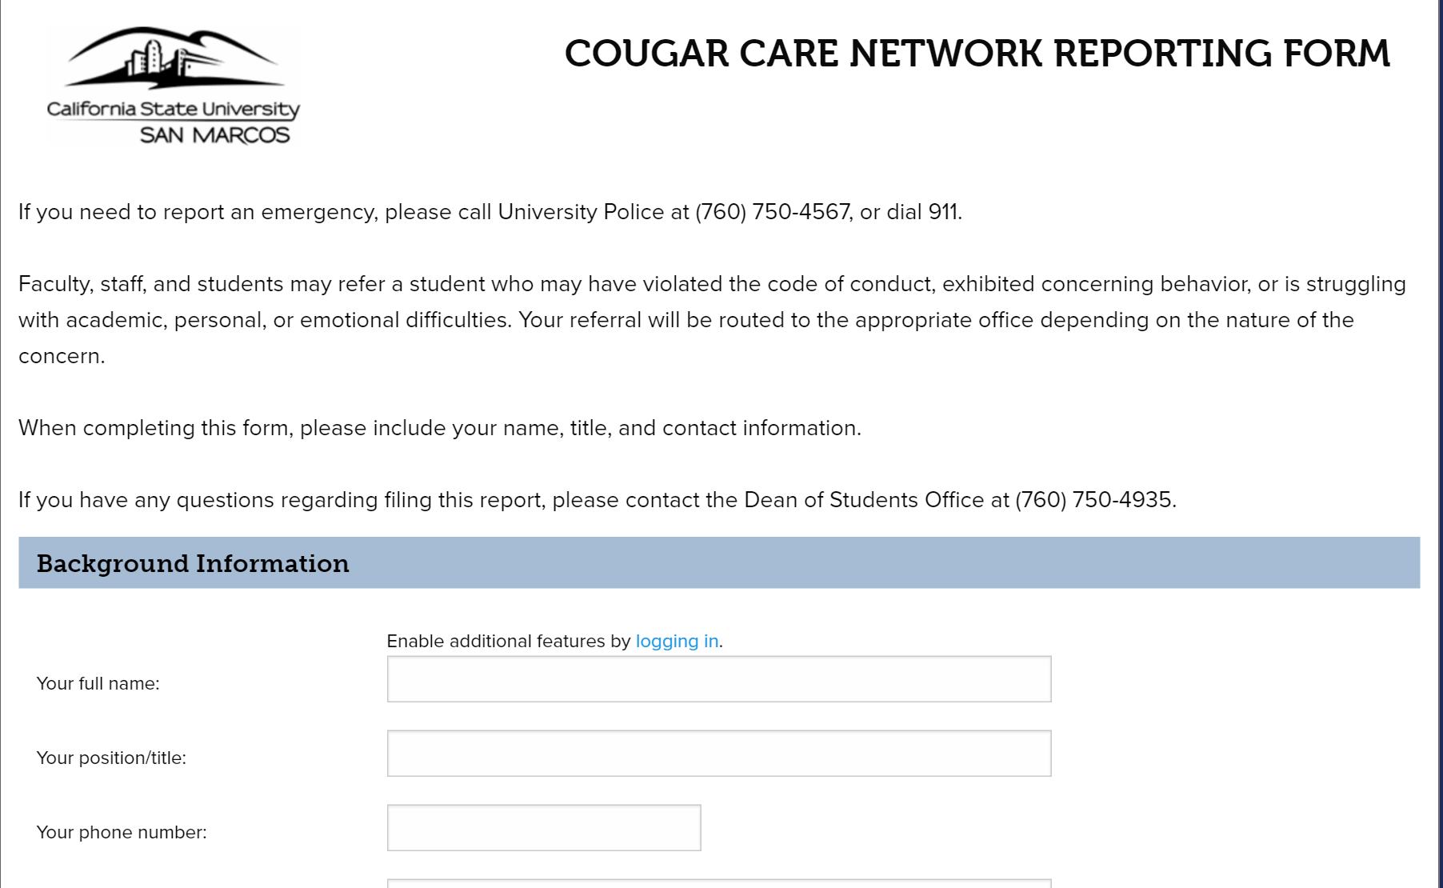
Cougar Care Network Referrals
Website: http://www.csusm.edu/ccn
Maxient Reporting Form
Notes:
For Faculty and Staff to make an online referral, they can view the Cougar Care Network website to fill out the Cougar Care Network Reporting Form.
Easy to use, important to have boxes and drop-down menus as much as possible.
Recently, Maxient made their referral forms more mobile friendly, which helps with accessibility, especially for part-time Faculty members.
*** Open Reporting Form to demonstrate ease of use for Faculty/Staff. ***

Slide 7
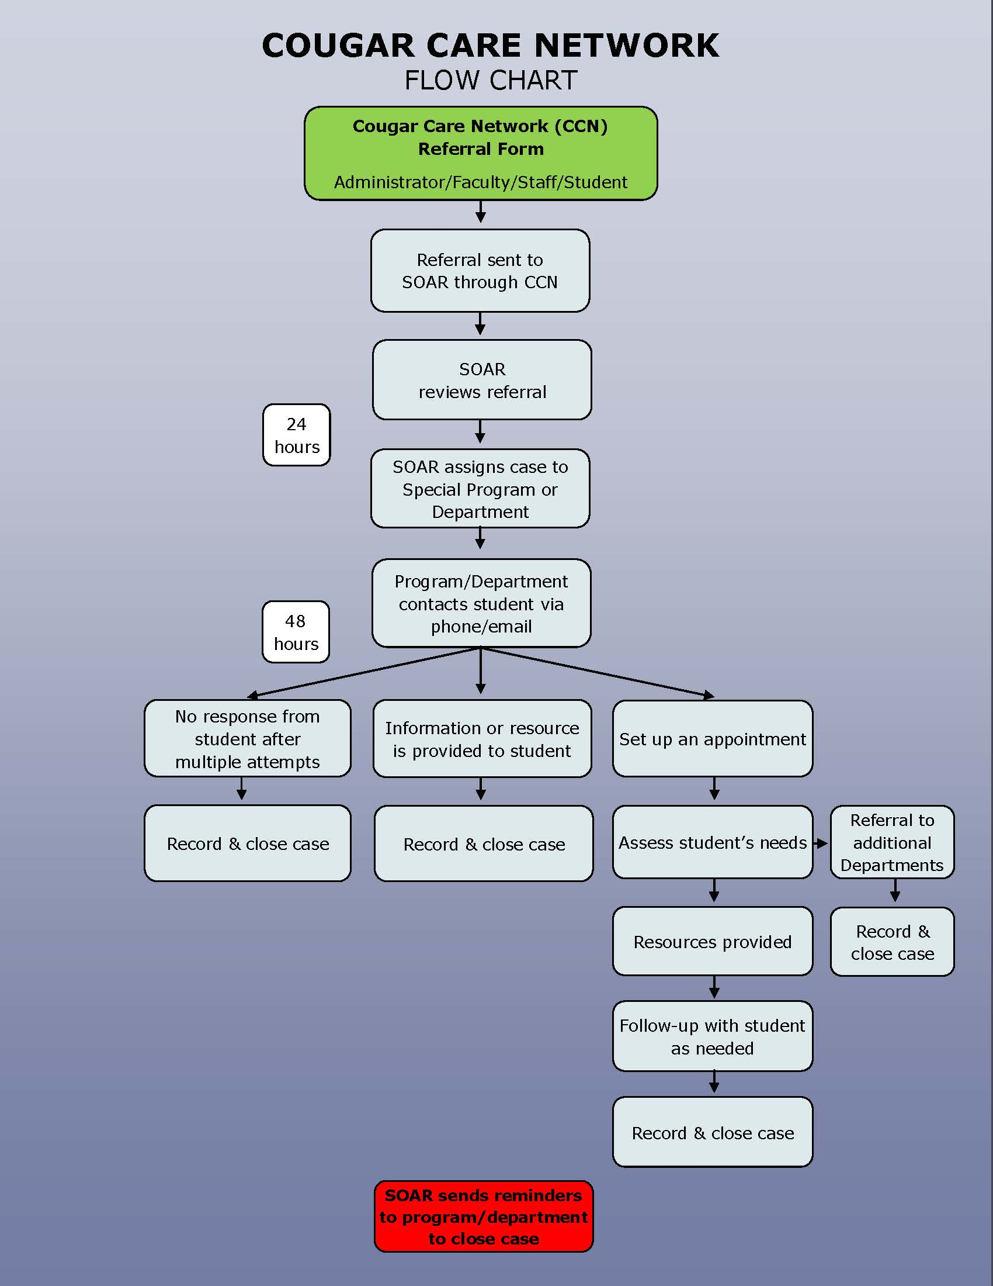
Cougar Care Network
Flow Chart Handout
Notes:
The Cougar Care Network is based in the Dean of Students Office, which provides leadership for the campus-wide initiative to improve student success, retention, and persistence. The full-time CARE Manager provides day-to-day oversight of the Cougar Care Network, while also providing students of concern with information, resources, and support to ensure their personal and academic success.
Faculty and staff across all campus divisions participate by alerting and referring students for additional support and resources. All referrals are sent to the full-time Student Outreach and Referral Coordinator in the Dean of Students Office, who then connects students to a specific member of the Cougar Care Network in departments across campus. Depending on the area of concern, most referrals are addressed by the CARE Manager, Personalized Academic Success Services (PASS), Housing and Residential Education, Financial Aid and Scholarships, Student Conduct, Title IX, and the University Police Department.

Slide 8
Student Vignettes
“Tracy”
“Juan”
Where would Faculty or Staff refer the student on your campus?
Notes:
Provide participants with handouts of two student scenarios. Think about what actions the Faculty or Staff member would take, and the on-campus or off-campus resources available to the students. Get into small groups and discuss, “Where would the Faculty or Staff refer the student on your campus?”
Scenario #1:
1) “Tracy” is struggling to attend class and is not performing well on exams and assignments. She is on Academic Probation and is concerned about being academically disqualified if she does not do well this semester. When her part-time Faculty member entered the classroom, she noticed that Tracy was crying while talking to another student. The Faculty member spoke briefly with Tracy, who admitted she was struggling, but was not specific about her concerns. During the Faculty member’s Office Hours, Tracy came to speak with the Faculty and disclosed that she was living in her car with her 11 year old son, did not have food or resources to meet her family’s basic needs, and was on the verge of giving up on school.
Connected student to various resources, including Financial Aid Office to maximize her financial aid package, temporary homeless shelter, case management services, rental assistance, etc. Student is now doing much better and is on her way toward graduation. She recently shared that she wants to start a support group for students experiencing homelessness!
2) “Juan” has been struggling academically this semester and has had contact with several on-campus departments such as the Registrar’s Office, Financial Aid and Scholarships, Writing Center, and Academic Advising. Juan’s behavior is “all over the place,” and he seems distracted when speaking with the staff members. The staff member cannot quite figure out what is wrong with him, but it seems like Juan is nervous and struggling to focus. When the staff asked if he is okay, Juan says he is fine, but the staff member is worried that something seems “off” about his behavior.
In this case, we actually received 3 Cougar Care Network referrals about this student within 72 hours! It turned out that student was having a serious mental health crisis. CARE Team coordinated efforts by various offices across campus to support student. Student was hospitalized, as there were serious concerns about his safety. Assisted him with the medical withdrawal process to focus on his mental health with minimal impact on his record. CARE Team was able to engage student’s family and support system through the process of providing long-term support. Student was able to get stabilized on medication and is now back on campus, enrolled in classes, and doing MUCH better.
*** The answer for both students at CSUSM was making a Cougar Care Network referral ***

Slide 9
2015-16 Objectives
Increase the number of students served from academic year 2014-15 to 2015-16 by 20%
At least 25% of Cougar Care Network referrals submitted by Faculty
Students served will closely reflect the diverse CSUSM student population based on gender, ethnicity, and academic major by college
Notes:
In alignment with the system-wide CSU Graduation Initiative, California State University San Marcos (CSUSM) seeks to increase the graduation rate and reduce the achievement gap between students from underrepresented minorities and those from non-underrepresented minority backgrounds.
To accomplish this overall goal, the Cougar Care Network's specific objectives and desired outcomes have been the following:
(1) The Cougar Care Network will increase the number of students served from academic year 2014-15 to 2015-16 by at least 20%.
(2) For Cougar Care Network Referrals submitted using the online form in 2015-16, faculty members will submit at least 25% of the total number of referrals.
(3) The students served by the Cougar Care Network in 2015-16 will closely reflect the diverse student population at CSUSM based on campus-wide demographic information in the areas of gender, ethnicity, and academic major by college.

Slide 10
2015-16 Findings
Increase the number of students served from academic year 2014-15 to 2015-16 by 20%
Increased by 43.5%
584
838
Notes:
Objective #1: The Cougar Care Network will increase the number of students served from academic year 2014-15 to 2015-16 by at least 20%.
There were a total of 838 student cases in 2015-16, compared to 584 student cases in 2014-15.
This is an increase of 254 student cases or 43.5%, which more than doubled this strategic objective.

Slide 11
2015-16 Findings
At least 25% of Cougar Care Network referrals submitted by Faculty
#1 Referral Source
Notes:
(2) For Cougar Care Network Referrals submitted using the online form in 2015-16, faculty members will submit at least 25% of the total number of referrals.
In 2015-16, Faculty were the #1 referral source for the Cougar Care Network at 47.3%, which nearly doubled this strategic objective.
Faculty (47.3%), Staff (33.5%), Administrator (14.0%), and Other (see below).
Other includes referrals from our President’s Office (3.6%), University Police Department (1.4%), and Other (0.3%).

Slide 12
2015-16 Findings
Students served will closely reflect the diverse CSUSM student population based on gender
Notes:
(3) The students served by the Cougar Care Network in 2015-16 will closely reflect the diverse student population at CSUSM based on campus-wide demographic information in the areas of gender, ethnicity, and academic major by college.
In the area of gender, 59.7% of the students served in 2015-16 identified as female and 38.1% of students served identified as male.
Unknown, Not Applicable, or Transgender = 2.0%
This is nearly exactly in line with campus-wide enrollment numbers of 61% female and 39% male.

Slide 13
2015-16 Findings
Students served will closely reflect the diverse CSUSM student population based on ethnicity
Notes:
(3) The students served by the Cougar Care Network in 2015-16 will closely reflect the diverse student population at CSUSM based on campus-wide demographic information in the areas of gender, ethnicity, and academic major by college.
In the area of ethnicity, students served identified as follows: 34.4% Hispanic or Latino, 33.3% White or Caucasian, 9.9% Asian or Pacific Islander, 7.9% Black or African American, 6.4% Two or More Ethnicities, and 8.2% Other.
These data were compared to campus-wide enrollment numbers as follows: 41% Hispanic or Latino, 31% White or Caucasian, 10% Asian or Pacific Islander, 3% Black or African American, 6% Two or More Ethnicities, and 8% Other.
Slight under-representation of Hispanic or Latino students and over-representation of Black or African American students ---- Hypothesis: Hispanic/Latino students may be served elsewhere (e.g. Latin@ Center, EOP, TRIO SSS)
Continue to monitor and consider outreach efforts needed

Slide 14
2015-16 Findings
Students served will closely reflect the diverse CSUSM student population based on college
Notes:
(3) The students served by the Cougar Care Network in 2015-16 will closely reflect the diverse student population at CSUSM based on campus-wide demographic information in the areas of gender, ethnicity, and academic major by college.
In the area of academic major by college, students served were categorized as follows: 38.4% College of Humanities, Arts, Behavioral and Social Sciences (CHABSS); 22.0% College of Education, Health and Human Services (CEHHS); 16.1% College of Science and Mathematics (CSM); 13.0% College of Business Administration (COBA); 4.8% Undeclared.
These data were compared to campus-wide enrollment numbers as follows: 39% CHABSS, 23% CEHHS, 17% CSM, 18% COBA, and 3% Undeclared.
Felt especially proud of College of Science and Math (CSM) being relatively similar.
Slight under-representation of College of Business Administration (COBA) and over-representation of Undeclared (which is expected).
While these findings clearly met the strategic objective of closely reflecting the diverse student population at CSUSM based on campus-wide demographic information, the data also provided opportunities for outreach to specific populations in 2016-17.

Slide 15
2015-16 Findings
Students served based on classification
Notes:
In addition to the demographic information described in the previous response, the program has had interesting results in regard to student classification.
While the top classification served is Freshmen at 33.9%, the second highest classification is Seniors at 24.5%.
These groups are followed by Juniors at 19.6% and Sophomores at 13.5%.
Other (8.5%) includes individuals who are not enrolled yet (e.g. incoming students, 3.7%), Post-Baccalaureate (3.2%) and Graduate Students (1.7%)
These demographics demonstrate the importance of assisting students with getting started in their college career, but also making sure to provide the needed information, resources and support for students who are nearing the finish line of graduation.

Slide 16
Scaling Initiative at Other Campuses
Keys to Success
Administrative Support
Strong Relationships Across Campus
Intentional Staffing Decisions
Creative Use of Resources
Notes:
The Cougar Care Network could certainly be replicated and scaled to other CSU campus populations.
The keys to success for this process would require the campus to obtain administration support and maintain strong relationships across divisions to create a centralized service that focuses on the common goal of improving student success, retention, and persistence.
Since both Student Affairs and Academic Affairs are involved in the referral and support processes, intentional staffing decisions are made to engage individuals with collaborative and engaging roles on campus.
Additionally, for campuses with higher student populations, there would also likely need to be increased staffing to manage incoming student cases and faculty/staff referrals, especially as the initiative builds momentum and demonstrates success on campus.
The “creative use of resources” could include use of MSW Interns for CARE Management needs, especially if the CARE Manager is an LCSW and can supervise them appropriately.

Slide 17
Small Group Discussions
Discuss implementation of a centralized support network on your campus.
What are some possible implementation barriers?
What are ideas for overcoming those challenges?
Notes:
Encourage participants to get into small groups to discuss implementation of a centralized support network on your campus.
During the discussion, what are some possible implementation barriers? What are ideas for overcoming those challenges?
Discuss as small groups and then come back to the larger group to share out.
Provide an opportunity for questions and answers.

Slide 18
Contact Information
Lorena Checa, Ph.D
Vice President, Student Affairs
lcheca@csusm.edu
760-750-4056
Nick Mortaloni, LCSW
CARE Manager, Dean of Students Office
nmortaloni@csusm.edu
760-750-4935
Notes:
Any questions, comments or concerns?
Thank you for attending and for your time!

