Slide 1


Slide 2
A Comprehensive Campus Strategy to
Remove Hurdles to Degree Completion
Presented by:
Cem Sunata
University Registrar
California Polytechnic State University
Brian Tietje
Vice Provost, International, Graduate and Extended Education
California Polytechnic State University

Slide 3

20,944 students
1411 faculty
65 bachelor’s and 33 master’s degrees
Students have to declare a major upon admission
  “Upside down”curriculum:
  Students start taking major related classes during their first term

Slide 4

“Mille viae ducunt homines per saecula Romam”
(“A thousand roads lead men forever to Rome”)
Alanus de Insulis, French Philosopher
From ‘Doctrinale altum seu Liber Parabolarum’

Slide 5
Our Overarching Goal
“Improve the success of our entire
undergraduate student body”
Reduce time to degree by eliminating hurdles and bottlenecks
Identify “mechanical” and “developmental” barriers
  What can we do better?
  What are we not doing?
Increase student engagement (i.e., social, academic)
Increase retention rates

Slide 6
Plan to Meet our Goal
Established guiding principles for student success
Implemented timely transfer articulation
Enforced all course requisites through enrollment system
Established 4-year degree flowcharts for every major
Implemented block scheduling for first time freshmen
Developed course demand analysis through
PolyPlanner

Slide 7
Plan to Meet our Goal
Established the Expected Academic Progress (EAP) policy
Implemented the Freshmen Success Program
Established EAP-based registration priority system
Implemented quarterly retention effort
Proactively set graduation terms
Audited expected graduates during their last term

Slide 8
The Necessary Ingredients For Success
Define the problem
Know your institution; students and faculty
Set institutional priorities
Assess needed vs. available resources
Administrative buy in
Shared governance – buy in and input

Slide 9
The Necessary Ingredients For Success
The invaluable role of academic advising
Pick and enable the right people
The importance of IT
Solid degree audit
Collaboration and communication
Establishing sustainability

Slide 10
Student Success Guiding Principles

Slide 11
Student Success Guiding Principles
Students’ path to graduation should be transparent, flexible, and as simple as possible
Students should be treated equitably through the consistent application of policy
Students should have university-wide support in reaching graduation
Students deserve timely service and communication, thereby allowing them to make any necessary adjustments to their academic plans

Slide 12
Student Success Guiding Principles
Upon admission, students should have a clear understanding of the expectations being placed upon them
Policies and procedures should support the students’ learning experience
Continuously review, assess, and improve policies and practices
Policies and practices should promote quality programs and efficient use of resources.

Slide 13

Clearing The Path to Graduation
Transfer Articulation for Freshmen & Transfers
Big problem in higher ed! Allowing new students to start classes without articulating the course work they bring
Each summer, Cal Poly fully articulates all transfer coursework
Competing demands during summer – degree posting vs. transfer articulation
”Students deserve timely service and communication, thereby allowing them to make any necessary adjustments to their academic plans”

Slide 14
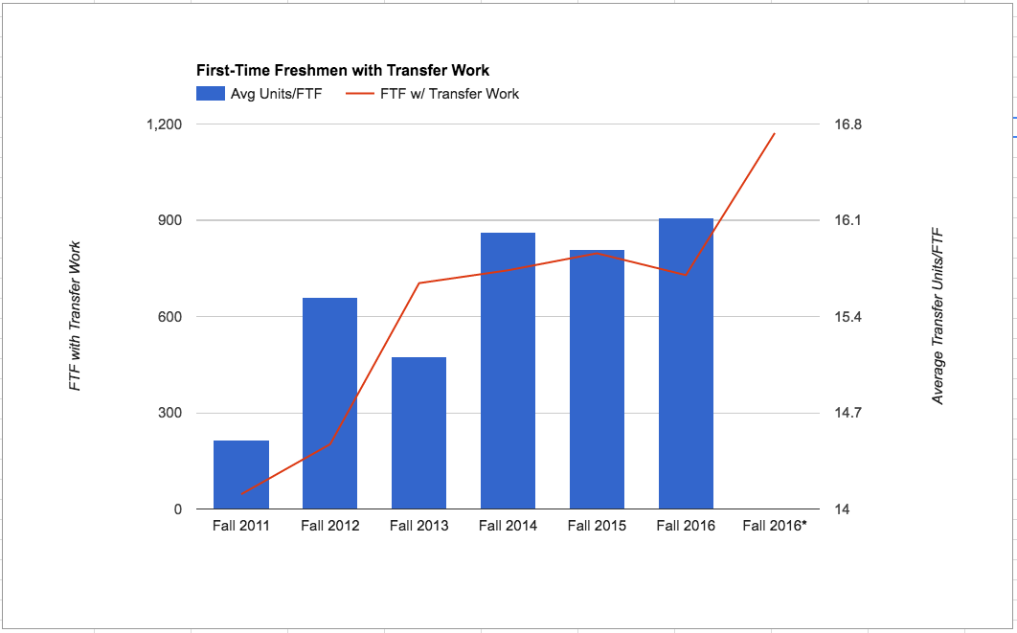
Average Transfer Units New Freshmen Bring is Increasing
Notes:
I am not sure the Fall 2011 data is reliable. I used the same query for each term, so I don't have particular reason to doubt, but it is so much lower than Fall 2012.
Phenomenon we've noticed in 2015 and 2016: increasing number of CA resident students with out-of-state work (online). One example: 12 students in 2016 with work from Colorado Christian University. OOS work takes more time.
*Projected figure for 2016: Based on 2015, we do not have all FTF transcript received yet. I calculated my projection based on the following: total number of students for 2015, relative to # rec'd by 8/7/15. Then I extrapolated to the 1172 for 2016, based on # of transcripts received by 8/7/2016. This seemed logical, but it may also be flawed logic: more student may have been on time this year, due to messaging.
Average units/student are high in part due to programs like Washington State's Running Start program students. They earn an AA degree before graduating from high school. For 2016, we have 18 FTF with 60 quarter units or higher, an additional 8 students with 50-59 quarter units.

Slide 15
Clearing The Path to Graduation
The Hurdle of “Course Requisites”
Problem
Solution
19 month overhaul project.
AY 09-10: Faculty reviewed all requisites in the catalog to either confirm or revise
AY 10-11: Each requisite was coded into the registration system
AY 11-12: “Post Enrollment
Requisite Checking”
activated
In 2009, only 25% of all class requisites were being enforced.
Students missing requisites were being dropped during the first day of classes by faculty.
No “Post Enrollment Requisite Checking” in place.
“Students should be treated equitably through the consistent application of policy”

Slide 16
Clearing The Path to Graduation
Navigating the Curriculum
FLOWCHART: A convenient, tabular representation of all the courses that a student needs to take in any given major in order to graduate.
Accurate and up-to-date 4 year degree flowcharts.
Are the courses really available during terms stated in the flowcharts?
Do they communicate important milestones to students?
Interdependency of flowcharts.
  Ex: Are all the flowcharts telling the students to take ENG 101 during their first fall term?
Consistent look and feel.
”Students’ path to graduation should be transparent, flexible, and as simple as possible”

Slide 17
All required courses added in recommended sequence for graduation
Major, support, concentration, and GE courses color-coded
Important non-course requirements pointed out
Major specific “need to know” added

Slide 18
Setting The Expectations
Block Scheduling
Designed to start first-time freshmen on the right track.
Students are scheduled into their fall classes by Cal Poly.
Guaranteed full-time schedule (12-18 units) of all degree applicable courses.
“If you set the expectations for them, students will rise to the challenge.”
Dr. Robert Koob,
Former Provost of Cal Poly
”Upon admission, students should have a clear understanding of the expectations being placed upon them”

Slide 19
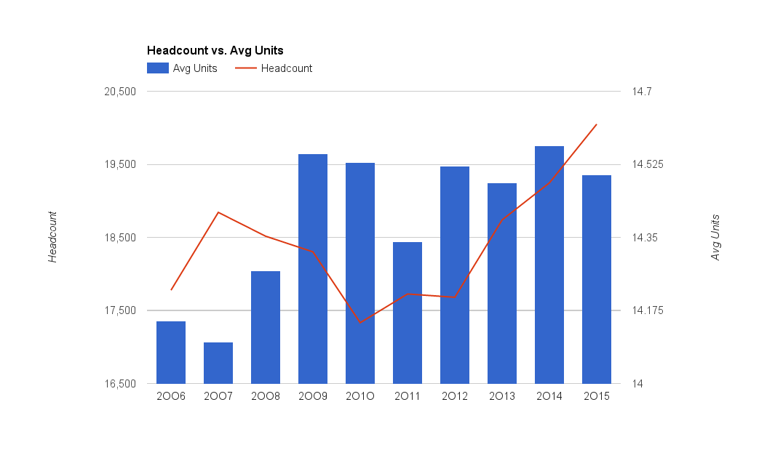
Average Units of Undergraduates at Cal Poly in Fall Terms*
The year block scheduling began
*Winter and Spring term averages follow a similar pattern

Slide 20
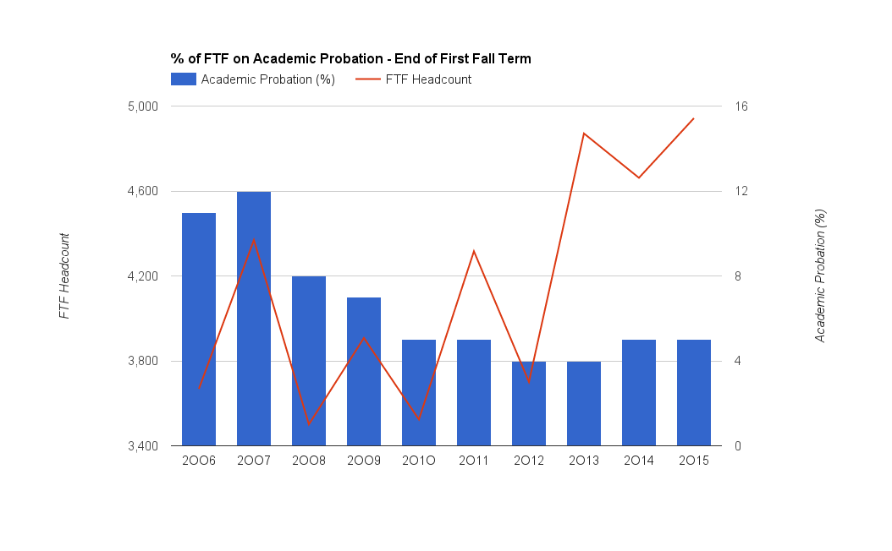
Dramatic Decrease in Academic Probation Rates Among Freshmen

Slide 21
Clearing The Path to Graduation
Course Demand Analysis
u.direct® by CollegeSource → “PolyPlanner”
  Each student builds their ideal future quarters
  Cal Poly’s class schedules are built based upon this “demand”
Prerequisites for implementation
  Administrative and faculty buy-in – a must have!
  Degree audit interface
  Strong technical and functional resources
  Mandatory use by students
“Students should have university-wide support in reaching graduation”

Slide 22
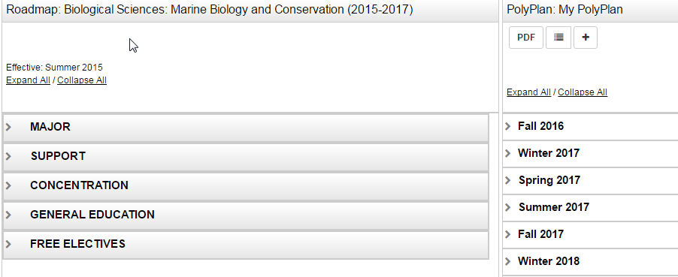
PolyPlanner
Required Courses
      Student Plan

Slide 23
PolyPlanner Demand Dashboards

Slide 24
Setting Expectations
Expected Academic Progress (EAP) Policy
A tool to monitor student’s progress to degree.
Requires students to make a predetermined level of progress towards their declared major each academic year.
Designed to help students graduate on time and to provide them with the support they need along the way.
Provides an “advising” opportunity.

Slide 25
Setting Expectations
Expected Academic Progress (EAP) Policy
FORMULA: the total number of degree applicable units completed and in-progress divided by the total number of units required for the major.
Freshmen
  1st year – 20%
  2nd year – 45%
  3rd year – 75%
  4th year – 100%
Transfer
  1st year – 55%
  2nd year – 80%
  3rd year – 100%

Slide 26
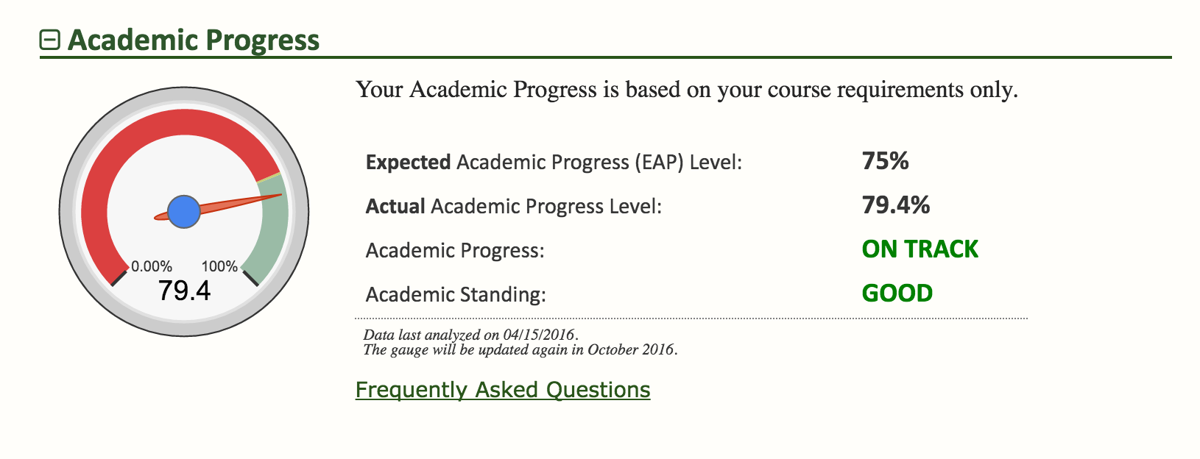
Setting Expectations
The “Expected Academic Progress Gauge”

Slide 27
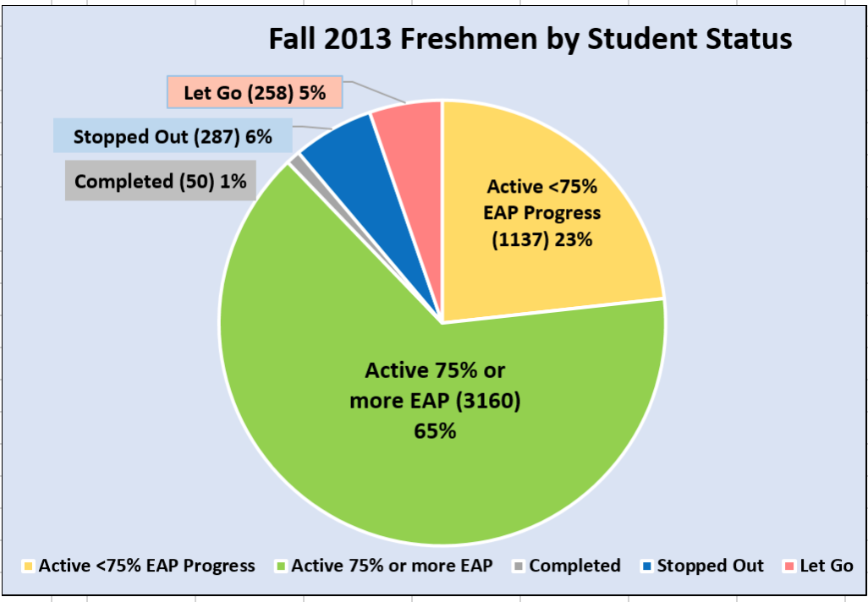
Goals for the 2013 Freshmen Cohort
Increase 4-yr graduation rates (2012 cohort is 47%)
65% of 2013 cohort could graduate in 4 years!
Proactive interventions

Slide 28
Number of Fall 2013 Cohort by % of Degree Completion

Slide 29
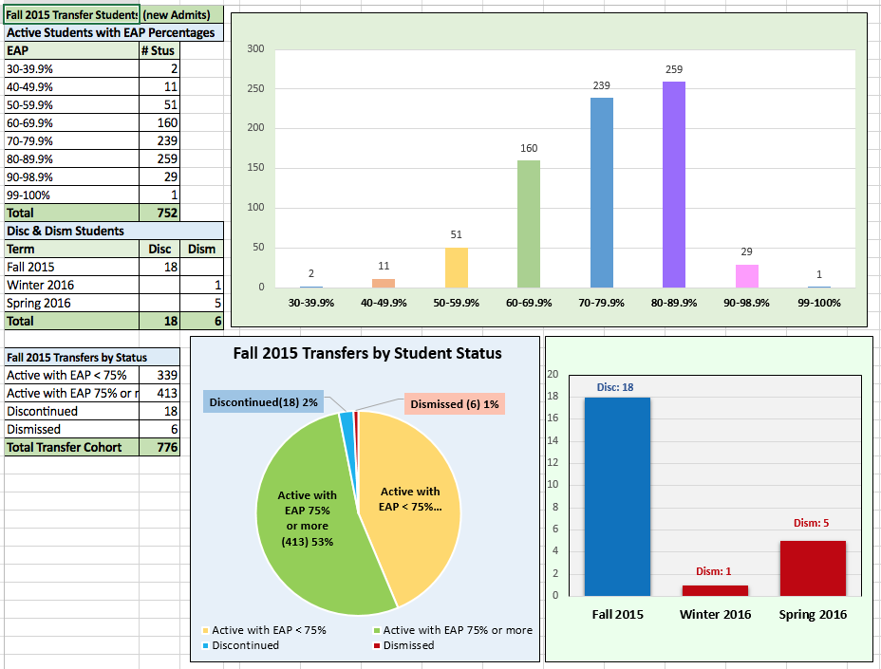
Goals for the 2015 Transfer Cohort
Increase 2-yr graduation rates (2013 transfer cohort is 34%)
53% of 2015 transfer cohort could graduate in 2 years!
Proactive interventions

Slide 30
Supporting Student Success
Example 1 - Freshmen Success Program
First introduced in Fall 2009
Required for all first time freshmen on AP at the end of their first term.
Focus on self-efficacy and identifying the unique obstacle(s) for each student.
“Students should have university-wide support in reaching graduation”

Slide 31
Supporting Student Success
“In order to be successful, a Cal Poly student needs to study 25 to 35 hours a week.”
Dr. Phil Bailey,
Dean, College of Science and Mathematics
“Students should have university-wide support in reaching graduation”

Slide 32
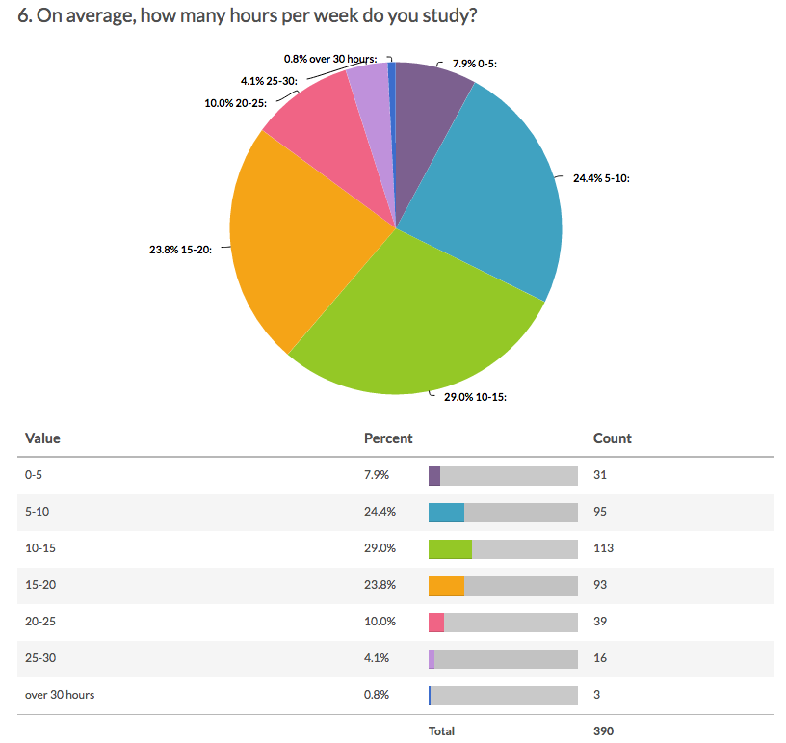
Hours Per Week First Time Freshmen Study
85% of First Time Freshmen on academic probation admit to studying less than 25 hours per week

Slide 33
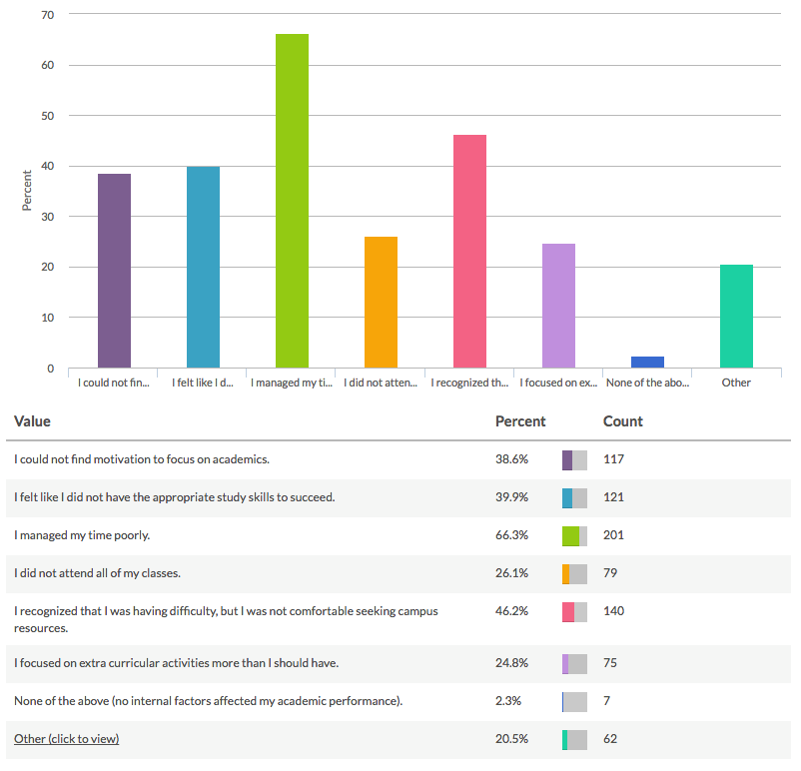
Question:
Looking back at Fall Quarter, were there internal factors affecting your academic performance?
Top Responses:
#1 “I managed my time poorly.”
#2 “I recognized that I was having difficulty, but I wan not comfortable seeking campus resources.”
#1
#2

Slide 34
Top 3 Realizations of Students Attending Freshmen Success Program
“It’s a relief to know that I am not alone in my struggles. There are others like me.”
“My time management skills weren’t adequate for college life. I will increase number of hours spent studying per week.”
“I am definitely more motivated to stay on track and achieve my academic goals.”
“Students should have university-wide support in reaching graduation”

Slide 35
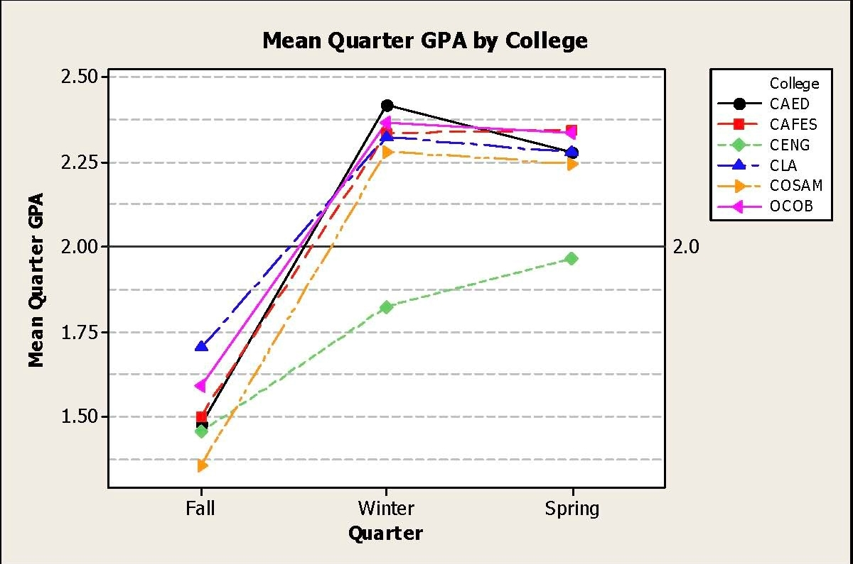
Mean Term GPA by College
after Freshman Success Program (2010-11)

Slide 36
Supporting Student Success
Example 2 - Multicultural Engineering Program
College of Engineering academic support program designed to recruit, retain, and graduate a diverse population of students, especially the underrepresented groups in engineering.
Already demonstrated success in closing the achievement gap.
Other colleges starting to follow suit.
“Students should have university-wide support in reaching graduation”

Slide 37
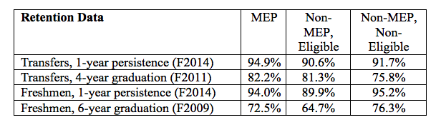
Supporting Student Success
Multicultural Engineering Program
MEP: Eligible students who participate in MEP (1st gen, low income, URM)
Non-MEP, Eligible: Those who are eligible but don’t participate
Non-MEP, Non-Eligible: Those who aren’t eligible and who don’t participate
Notes:
These data demonstrate a positive correlation between MEP membership and success. As shown, MEP appears to help close the achievement gap for freshmen. Furthermore with transfer students, the MEP students outperformed the non-MEP/non-eligible students. This may speak to the isolation that transfer students feel in general and to their special advising needs across all demographic groups.
The following table indicates that greater involvement in MEP was correlated with a better GPA. Here ‘greater involvement’ meant that the students attended three or more events, not including advising or tutoring.

Slide 38
Supporting Student Success
Example 3 – Mustang Success Center
GOALS
Understand University policies and procedures
Offer a full range of proactive academic services
Refer students to appropriate campus resources
Leadership in college and university programs that support student success.
“Students should have university-wide support in reaching graduation”

Slide 39
Supporting Student Success
Example 3 – Mustang Success Center
AUDIENCE & FUNCTIONS
First Year and Transfer students
Cal Poly scholar program
Student athletes
Workshops
First year and transfer success programs
Faculty and staff training
“Students should have university-wide support in reaching graduation”

Slide 40
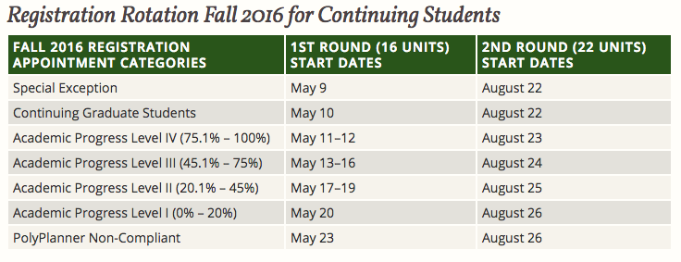
Encouraging Degree Progress
Academic Progress Based Registration
“Students should have university-wide support in reaching graduation”

Slide 41
Encouraging Degree Progress
Academic Progress Based Registration
Student Experience
Jane is motivated to make degree progress in order to have an earlier registration appointment, so she:
  Makes timely decision on declaring her concentration
  Makes sure any transfer work is submitted for timely evaluation and posting
  Makes sure any course substitutions are processed right away
  Is on top of her study abroad work to transfer on time
In the past, Jane used to wait until the end to attend to these matters
Small but significant factors that encourage students to be aware and keep up with their degree progress.

Slide 42
Encouraging Degree Progress
Quarterly Retention Effort
Students can be absent from Cal Poly for two consecutive quarters without getting “discontinued”
“Attrition” happening in front of our eyes
Quarterly report of all students who did not enroll for the next term
Colleges contact their “absent” students to find out why
Support offered, if needed (and wanted)
Attrition reasons tracked

Slide 43
Encouraging Degree Progress
Automatically Setting the Graduation Term
Cal Poly automatically sets the expected graduation term of all students who reach 75% or more degree progress
The expected grad term is set to be a year from the term they reach 75%
Consequence: Student cannot enroll in a term beyond their expected graduation term
Need educationally justifiable reason to extend the graduation term

Slide 44
Encouraging Degree Progress
Automatically Setting the Graduation Term
Student Experience
Jane is notified by email that she is expected to graduate in Spring 2018.
She is expected to complete all her remaining degree requirements within the following 4 terms.
Jane meets with her academic advisor:
  If Jane is planning to graduate earlier than Spring 2018, her expected grad term is merely updated.
  If Jane is planning to delay her graduation, she needs to provide an educationally justifiable reason.

Slide 45
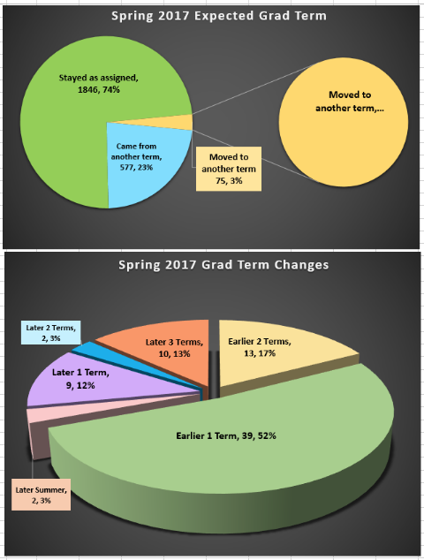
Monitoring Expected Graduates’ Plans (Fall 2013 Cohort)
1846 (74%) remain in their assigned graduation term
75, (3%) received approval to change their assigned graduation term

Slide 46
Documented Reasons for Changing Graduation Term
Moved to an earlier term (167)
Delaying to earn a minor (108)
Requesting delay for a lighter load (76)
Delaying to a course sequencing/senior project (57)
Number of Students
Reason of Delay

Slide 47
Encouraging Degree Progress
Assessment of Degree Audit for Graduating Seniors
Office of the Registrar runs degree audit reports for all graduating seniors:
Student is flagged if any requirement(s) are:
  Not completed
  Not in-progress
Student and their college is notified
Spring 2016 run yielded over 1000 such students among 2600+ expected graduates
Tremendous student response to the communication

Slide 48
Denied Reasons | Amount
GE | 49
GPA | 6
GWR | 22
Major/Support | 86
Other Unsatisfied | 16
Short 180 Units | 8
Snr. Proj. | 116
Short Upper Div Units | 8
USCP | 5
Grand Total | 316
8.5% of expected graduates were denied due to missing requirements
Down from 17% in 2009
These students were reported to their colleges for follow through

Slide 49
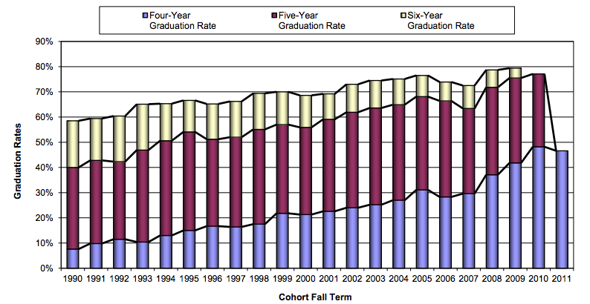
Cal Poly’s Graduation Rates

Slide 50
Cal Poly’s Graduation Rates
This fall, our 6-year graduation rate exceeded 80% for the first time
If we can reduce Fall 2013 cohort’s time to degree by only one term, our 4-year graduation rate would increase by 17-19%

Slide 51
Summary and Take Aways
Larger plan for the entire student body; specific, smaller plans for subpopulations.
  What are your “barriers”?
“Interconnectedness” of retention and graduation initiatives
“Direct” and “indirect” approaches to influence retention and graduation
There is a lot of room to grow in “direct” approaches (i.e., “low hanging fruit”)
Changing the campus culture is a must
Academic and student affairs can no longer afford to work alone
Advising has an irreplaceable role to play
IT infrastructure is key but it seems to be woefully lagging behind in public higher education and is an imminent threat to our efforts

