Slide 2

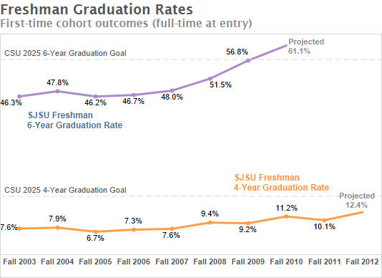
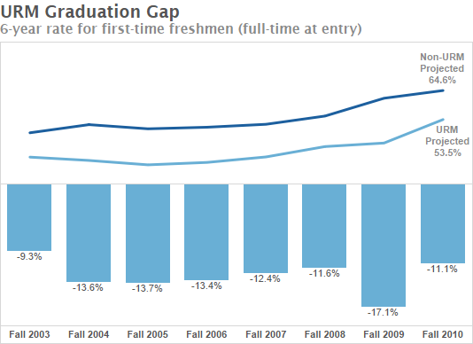
While our 6 year graduation rates have risen significantly, we have a relatively stagnant 4 year graduation rate and a persistent URM graduation gap.
Notes:
Speaker: Andy/ Reggie
While we have seen a steady increase in 6 year graduation rates, there has been a minimal change in our 4 year rate and the educational inequity has increased.
We need to change both what we are doing and how we are doing.
This led us to examine ourselves: our practices and how we work together

Slide 3
Student Success Program Inventory
Categorized more than 100 programs and support systems
Identified strengths, overlaps, and gaps
Why Students Leave
Campus Climate Survey
Home grown survey of faculty, students, and staff given every five years (last in 2015)
Identified needs to enhance engagement and community
National Survey of Student Engagement
Administered every 3 years (last in 2014)
Highlighted need to enhance engagement of students with faculty and advisors
Qualitative study of students who left SJSU
Brought to light issues with advising, course availability, and lack of community
We examined ourselves from different angles to understand the issues.
Notes:
Speaker: Andy/ Reggie
Stacy: Do an interactive exercise around Why Students Leave/ look at the university processes from a student’s perspective?

Slide 4
We engaged in broad conversations with the campus community.
Communication
Transparency
Collaboration
18 focus groups with faculty, students, and staff
Senate Executive Committee
University Council of Chairs and Directors
Student Affairs Leadership Team
Academic Affairs Leadership Team
President’s Cabinet
Notes:
Speaker: Andy/Reggie

Slide 5
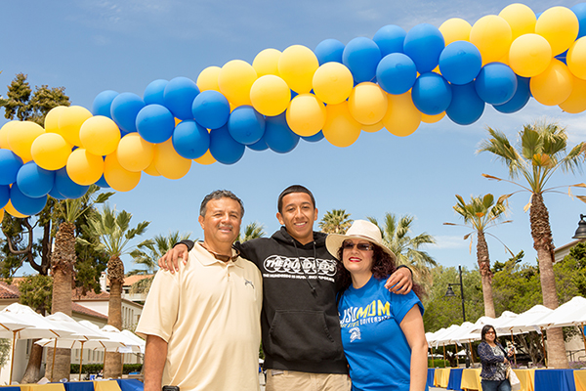
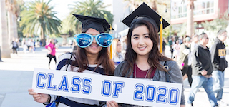
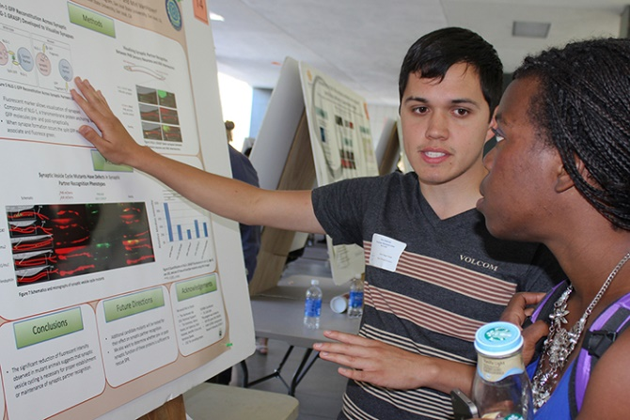

This resulted in a unified student success plan centered around four pillars.
Student Success
College Readiness
Advising
Student Engagement
Clearing Bottlenecks
SJSU’s Four Pillars of Student Success plan is available at www.sjsu.edu/provost
Notes:
Speaker: Andy/Reggie

Slide 6

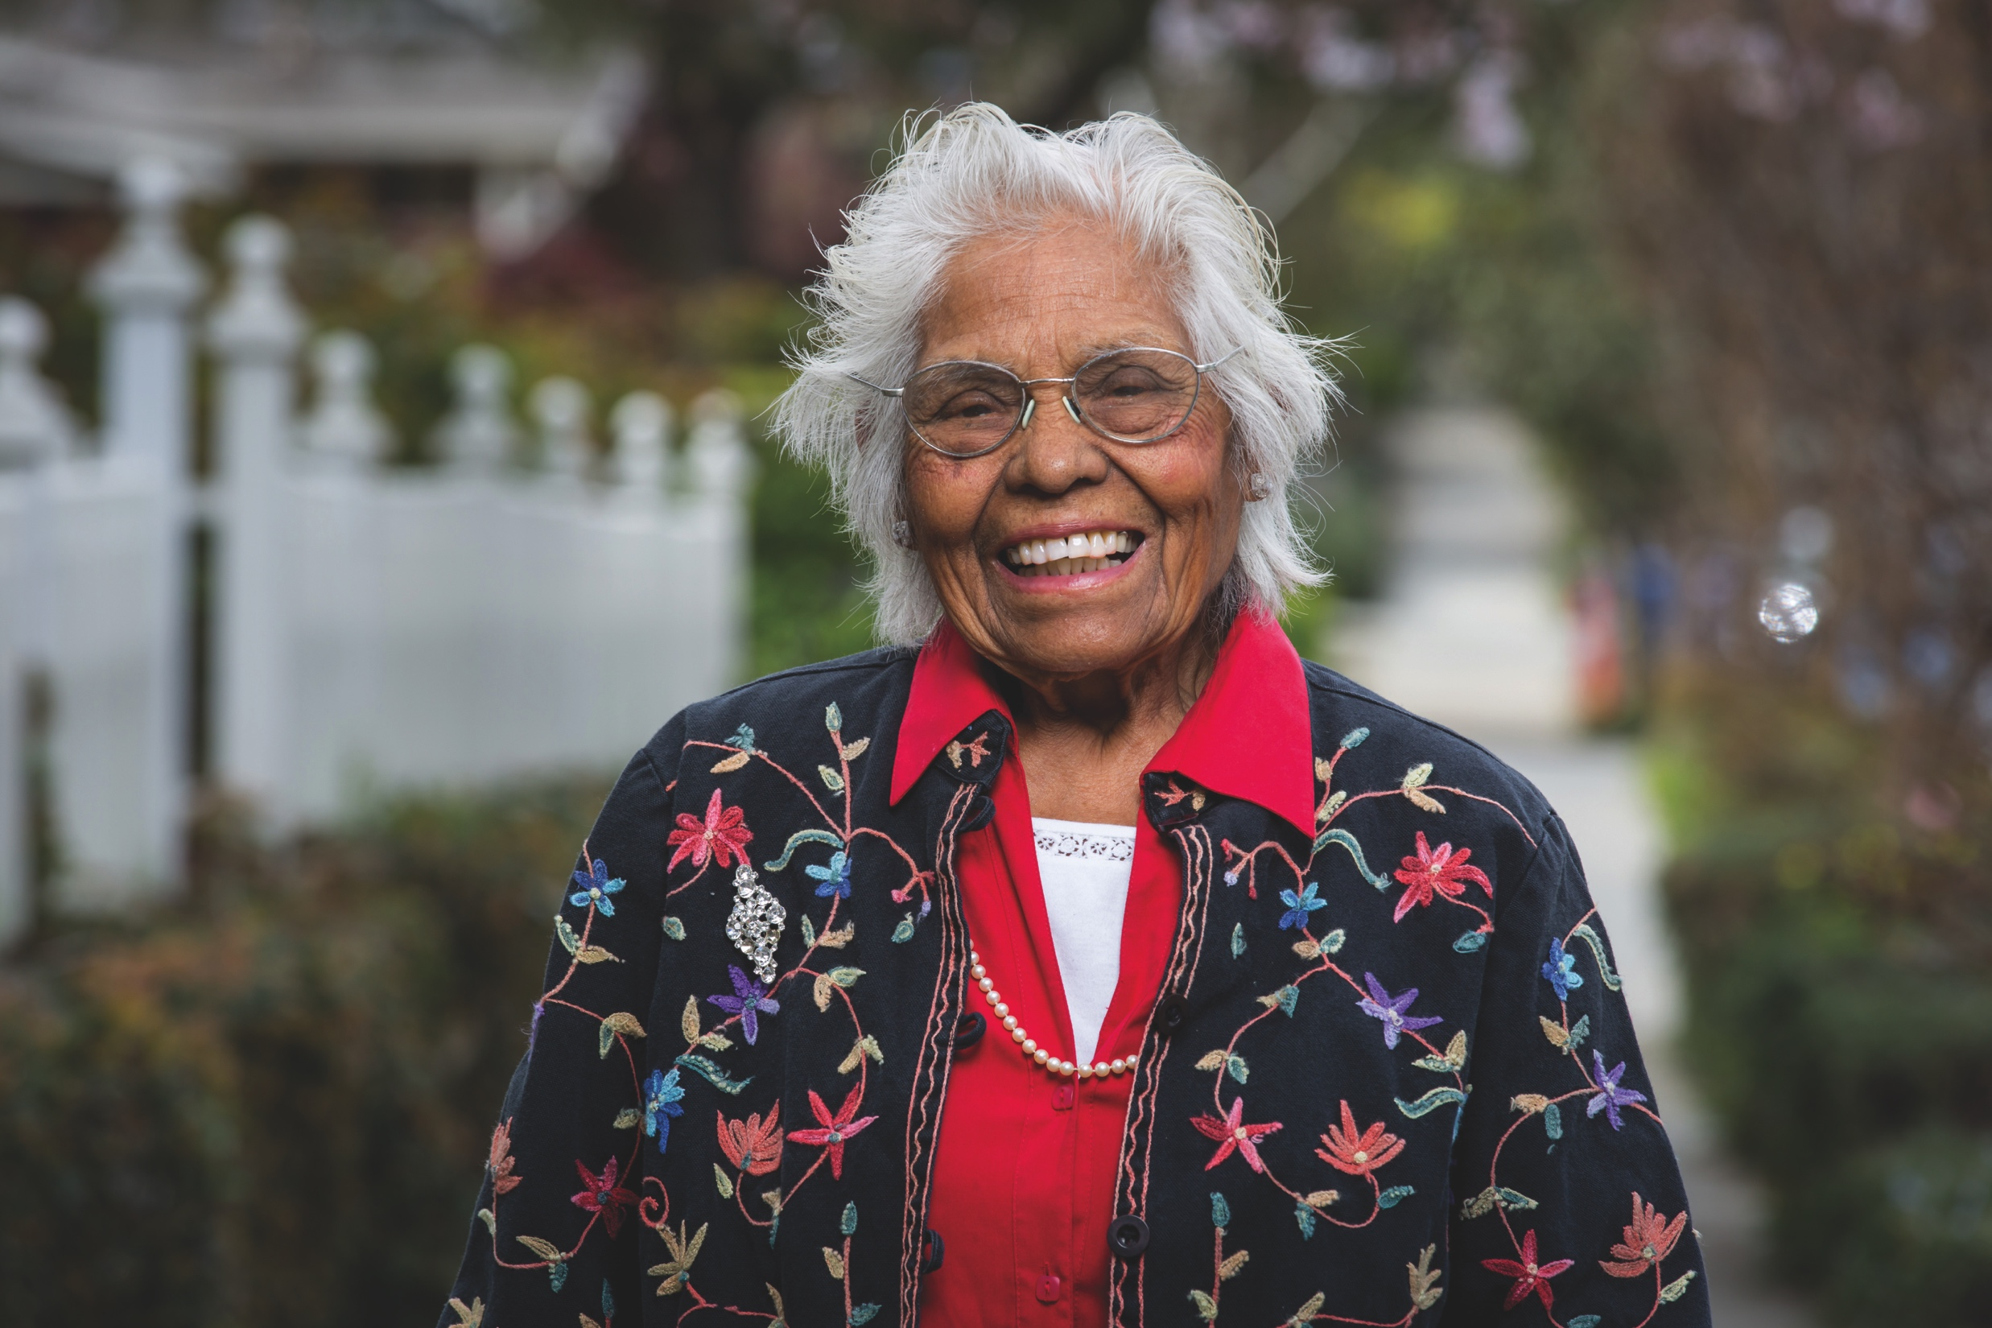
We have been successful at utilizing our unified student success plan to allocate and enhance resources.
$2M Koret Foundation support
$15M Compean Diaz donation
$5M First in the World grant
Student success development officer
Joint budget requests
Notes:
Speaker: Andy/Reggie

Slide 7

We are ensuring students have access to quality advice: both from connecting with advisors and utilizing technology.
Advising
Expand technology to support advising: Koret Foundation Support
Increase the number of staff and faculty advisors
Enhance college student success centers
Create a one stop shop for student success services
MyGPS: My Graduation Pathway to Success www.sjsu.edu/MyGPS
Notes:
Speaker: Stacy
Emphasize all 4 pillars have joint student affairs/ academic affairs teams

Slide 8

We are working to increase the average unit load and ensure students are successful in courses the first time.
Clearing Bottlenecks
Change culture around registration: Frosh Finish in 4 Campaign
Hire more faculty
Expand facilities
Build out support structures for high failure rate courses
Fa 15: 35%, 12.85
Fa 16: 56%, 13.73
2025 Here we come!
Percentage of Incoming Frosh
at 14+ units, average unit load
Notes:
Speaker: Stacy
Emphasize all 4 pillars have joint student affairs/ academic affairs teams

Slide 9

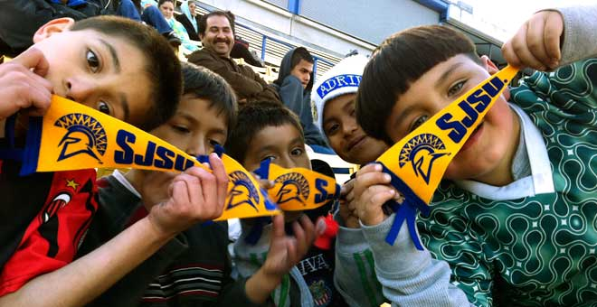
We are working with our K-12 partners to ensure students have the skills to succeed in college.
College Readiness
Expand partnerships with K-12 and CCs such as Spartan Promise
Build out more family and outreach programs
Create summer transition programs: Spartan Scholars
Provide academic support throughout their SJSU career
Some of SJSU's outreach programs are listed at
http://www.sjsu.edu/studentaffairs/about_us/initiatives_and_partnerships/
Notes:
Speaker: Stacy/Debra
Emphasize all 4 pillars have joint student affairs/ academic affairs teams
Discuss Spartan Scholars launch

Slide 10
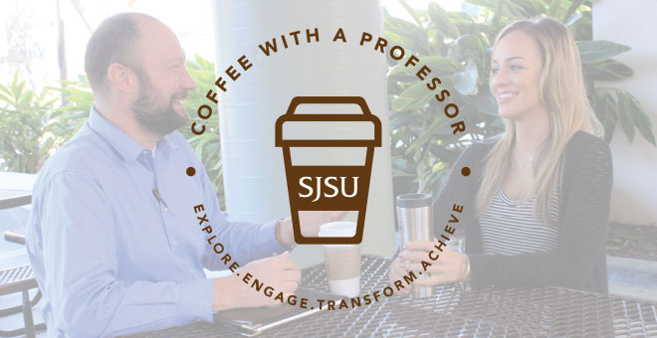
Student Affairs and Academic Affairs are working together to ensure students are connected to faculty and to campus.
Student Engagement
Create a safe and welcoming campus community for all
Expand the support for co-curricula
Engage students with the community and field of study
Implement high impact teaching practices
Example of engagement: Coffee with a Professor program www.sjsu.edu/studentaffairs/about_us/chatwithaprof/
Notes:
Speaker: Stacy/Debra
Emphasize all 4 pillars have joint student affairs/ academic affairs teams
Discuss Coffee with a professor launch
Use concept of student engagement to segway into work of Taksforces

Slide 11

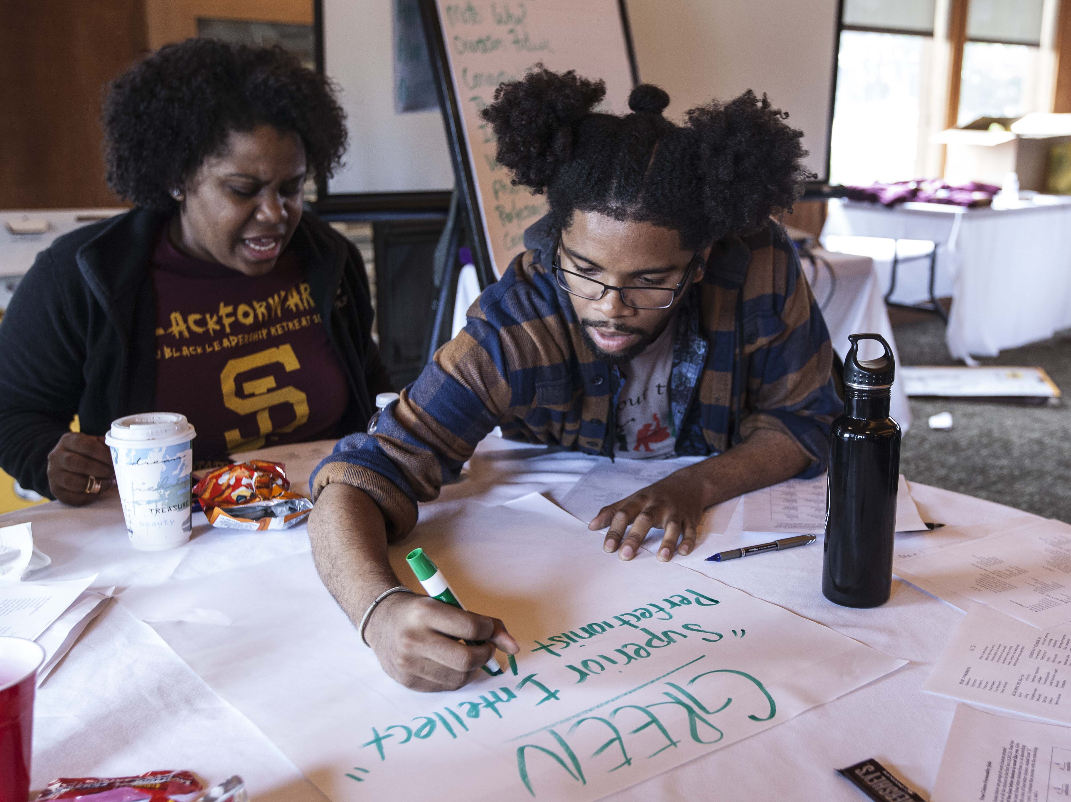
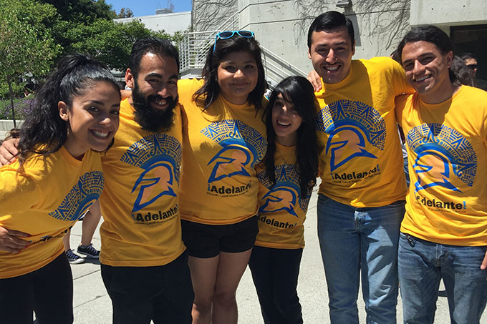
URM Student Success Taskforces were created with leadership from Student Affairs and Academic Affairs.
African American Student Success Taskforce
Each jointly led by a faculty and staff
Adelante: Chicanx/ Latinx Student Success Taskforce www.sjsu.edu/adelante/
Notes:
Speaker: Stacy/Debra
Emphasize all 4 pillars have joint student affairs/ academic affairs teams
Use concept of student engagement to segway into work of Taksforces

Slide 12
SJSU Washington Square
URM graduation gaps result when students emotionally regulate in response to the campus environment.
Students regulate a “racially hostile” environment with cognitive and behavioral responses.
An African American and Latin@ student may emotionally regulate by disengaging, not trying, avoiding class or dropping out.
Notes:
Speaker: Magdalena
Cognitive (e.g., motivation, goal setting) and behavioral responses (e.g., campus avoidance versus involvement) that students use to regulate a “racially hostile” environment
An African American and Latin@ student who associates campus experiences with anger, fear, worry due to racial discrimination/inequality may emotionally regulate by: disengaging, not trying, avoiding class or dropping out.
Co-Regulation is a critical way of addressing this, where students are offered support to make sense of this rather than internalizing it

Slide 13
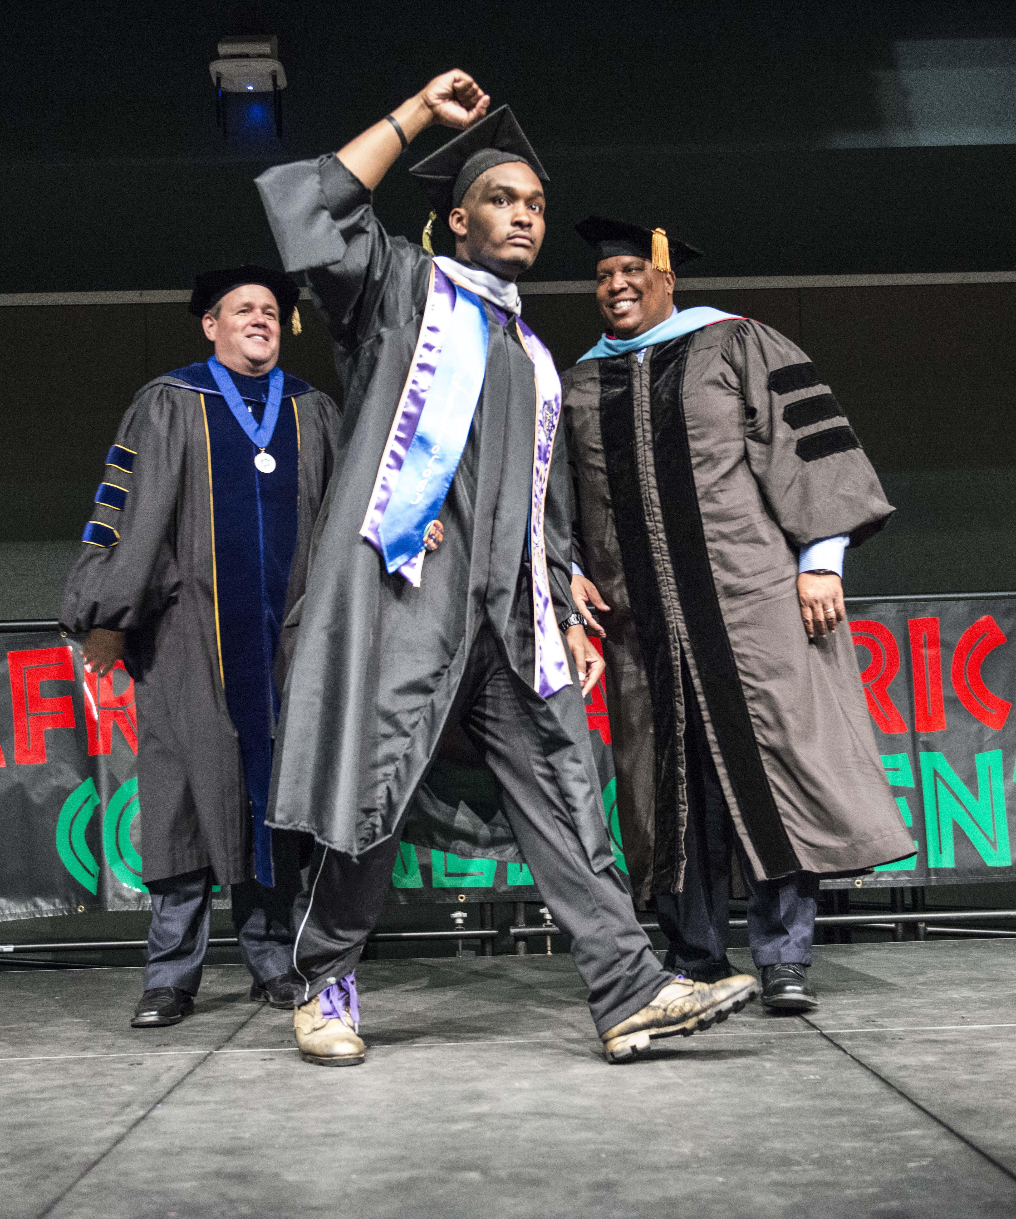
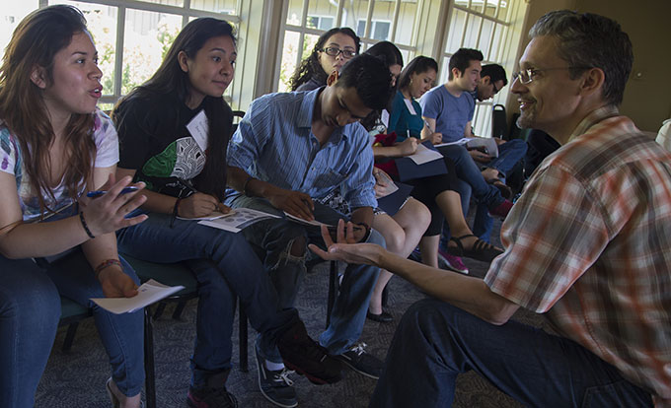
SJSU Washington Square
Differences in academic identity and cultural identity contribute to the URM graduation gap.
Intercultural effort consists of the additional, non-academic effort made by African American and Latin@ students to change themselves and their behaviors so as to better fit within the campus environment.
The tremendous amount of energy that African American and Latin@ students put into college is extremely draining, but rarely acknowledged or understood.
Notes:
Speaker: Magdalena
Activity: cultural identity and academic identity
If a substantial cultural gap exists between a student and his or her campus, the responsibility to make up this distance is generally placed on the student.
Intercultural effort consists of the additional, non-academic effort made by African American and Latin@ students to change themselves and their behaviors so as to better fit within the campus environment.
Intercultural effort is the tremendous amount of energy that African American and Latin@ students put into college that is extremely draining, but rarely acknowledged or understood because of the deficit approach colleges take to African American and Latin@ students.

Slide 14
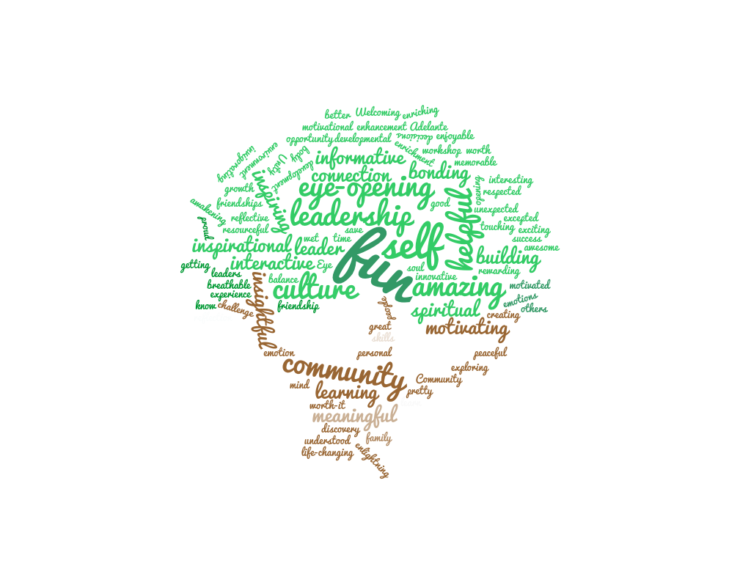
The African American and Chicanx/Latinx Student Success Taskforces were formed to create educational equity.
Academic support with co-regulation
Community building to bridge the gap between identities
Student Success
Notes:
Speaker: Magdalena

Slide 15
SJSU Washington Square
Academic support for the URM Taskforces are designed to specifically address emotional regulation.
Workshops
Advising
Study Halls
Support Staff
Student Success Interns
Leadership
0.2 for two faculty advisors
50% for staff advisor
Note: significant participation from other faculty and staff who are not compensated
10 students serve as liaisons
Taskforce activities have served approximately 900 different students per year!
Notes:
Speaker: Magdalena

Slide 16
SJSU Washington Square
Cultural and social events are designed to bridge the gap between academic and cultural identities.
Educating
Connecting
Faculty- student mixers
Orientations
Admitted Spartans Days
Transfer mixers
Essence of Blackness
Molcajete Festival
Leadership Retreats
Convocations
Black Cultural Showcase
Engaging
Raza Day
Nuestra Cultural Week
Notes:
Speaker: Magdalena
Emphasize research on importance of community building and student engagement to student success

Slide 17
SJSU Washington Square
Incoming Fall 2013 Frosh who participated in Taskforce activities had a higher retention rate than the general URM population and even all frosh.
Notes:
Speaker: Stacy
Served approximately 892 students with various events
We pulled 359 (40%) transcripts of the 892 served
Checked 1st retention rates against all frosh and URM frosh for Fall years 2014, 2013
Checked 2nd yr retention rates for class of 2013 frosh and URM frosh
Compared to frosh served by Task Forces
We looked at 2 classes to gage the effectiveness 2014 & 2013 interventions and engagements
2014 sample size
Freshmen n=80
Transfers n=41
2013 sample size
Freshmen n=57
Transfers n=35

Slide 18

Notes:
Adding TF photos
Speaker: Andy/Reggie

