Slide 1
Keeping an Eye on the Prize:
Graduation Success through Career Engagement
Notes:
Keeping an Eye on the Prize:
Graduation Success through Career Engagement

Slide 2
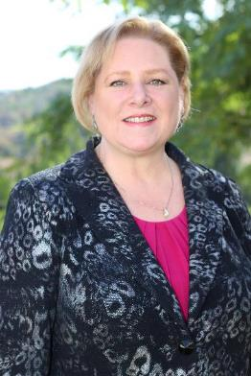
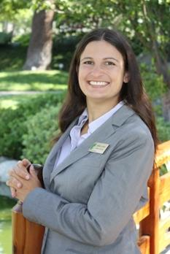
PRESENTERS
Dr. Lea Dopson
Dean and James A. Collins Distinguished Chair
Ann Lara
Career Services Coordinator
Notes:
Dr. Lea Dopson- Intro…
Ann Lara- Joined The Collins College in 2010 and is a joint position between The Collins College and Career Center. She coordinates career counseling services, employer relations, the annual Hospitality Career Expo, the college’s Mentor Program, serves as the Student Success Committee liaison to the Board of Advisors, and oversees the Disney College Program.

Slide 3
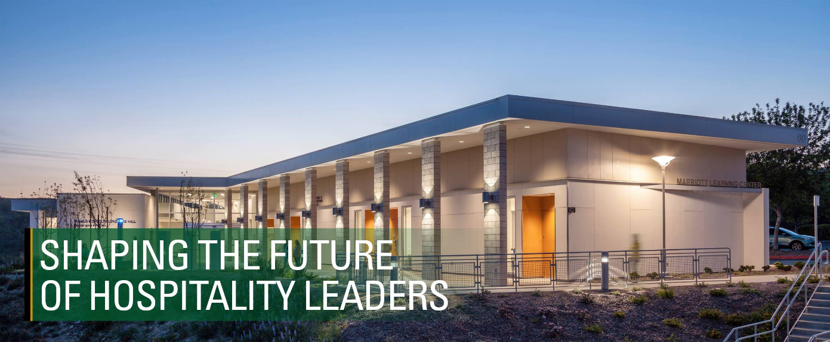
Notes:
Photo: The new Marriott Learning Center building at The Collins College at dusk
About The Collins College:
Founded in 1973 out of the College of business
We are the 4th largest Hospitality program in the country and oldest and largest four-year hospitality management program in California
Currently serving 1300 undergraduate students and 50 graduate students
We prepare students for careers in restaurant management, hotel/resort management, club management, culinary product development, tourism management, and special events/meeting planning.
4 state of the art buildings equipped with the latest technology, with a 55,000 square foot facility
Quote from business professor “You live and breathe polytechnic at Collins College”

Slide 4
Notes:
Incoming Students: First Time Freshman 28%, Transfer Students 62%
Ethnic Groups: Asian American 33%, Hispanic/Latino 28%, White 21%, Black/African American 2%, Two or more races 3%, International 10%, Other 3%
Gender: Female 71%, Male 29%

Slide 5
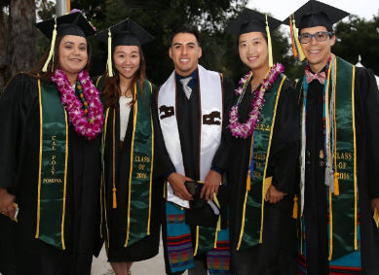
Freshman Graduation Data
Summary for First Time Freshmen:
The Collins College currently exceeds the CPP 6-year graduation rate by 19.7%.
The Collins College currently exceeds the CPP 4-year graduation rate by 20%.
The Collins College currently exceeds the CSU 6-year 2025 goal graduation rates by 8.2%.
The Collins College currently lags the CSU 4-year 2025 goal graduation rates by only 0.5%.
The graduation data suggests that The Collins College is quite successful at graduating students at both the 4-year and 6-year rates. The Collins College only lags the 4-year CSU 2025 goal by 0.5%. However, these rates need to be maintained at these levels consistently over time to remain successful, with an increased attention paid to 4-year graduation rates.
Notes:
Summary for First Time Freshmen:
The Collins College currently exceeds the CPP 6-year graduation rate by 19.7%.
The Collins College currently exceeds the CPP 4-year graduation rate by 20%.
The Collins College currently exceeds the CSU 6-year 2025 goal graduation rates by 8.2%.
The Collins College currently lags the CSU 4-year 2025 goal graduation rates by only 0.5%.
The graduation data suggest that that The Collins College is quite successful at graduating students at both the 4-year and 6-year rates. The Collins College only lags the 4-year CSU 2025 goal by 0.5%. However, these rates need to be maintained at these levels consistently over time to remain successful, with an increased attention paid to 4-year graduation rates.

Slide 6
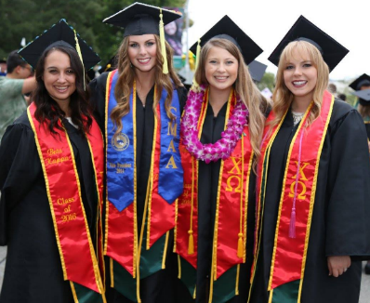
Transfer Graduation Data
Summary for Upper-Division Transfers:
The Collins College currently exceeds the CPP 2-year graduation rate by 6.4%.
The Collins College currently exceeds the CPP 4-year graduation rate by 8.2%.
The Collins College currently lags the 2-year CSU 2025 goal graduation rates by 5.3%.
The Collins College currently lags the 4-year CSU 2025 goal graduation rates by 2.2%.
The Collins College currently has closed the 2-year URM graduation gap.
The Collins College currently has closed the 4-year URM graduation gap.
The graduation data suggests that The Collins College is quite successful at graduating students at both the 2-year and 4-year rates as compared to CPP rates. The Collins College is challenged to improve its graduation rates over the next decade to meet the CSU 2025 graduation goals.
Notes:
Transfer Graduation Data
Summary for Upper-Division Transfers:
The Collins College currently exceeds the CPP 2-year graduation rate by 6.4%.
The Collins College currently exceeds the CPP 4-year graduation rate by 8.2%.
The Collins College currently lags the 2-year CSU 2025 goal graduation rates by 5.3%.
The Collins College currently lags the 4-year CSU 2025 goal graduation rates by 2.2%.
The Collins College currently has closed the 2-year URM graduation gap.
The Collins College currently has closed the 4-year URM graduation gap.
The graduation data suggest that that The Collins College is quite successful at graduating students at both the 2-year and 4-year rates as compared to CPP rates. The Collins College is challenged to improve its graduation rates over the next decade to meet the CSU 2025 graduation goals.

Slide 7
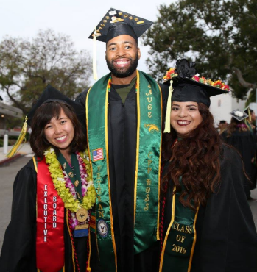
Under Represented Minorities Graduation Data
The Collins College 2-year and 4-year URM graduation gaps have been closed.
The Collins College URM student graduation rate for 2-year students exceeds non-URM students by 5.7%
The Collins College URM student graduation rate for 4-year students exceeds non-URM students by 1.6%
Notes:
URM Graduation Data
The Collins College 2-year and 4-year URM graduation gaps have been closed.
Specifically, the Collins College URM students for 2-year and 4-year graduation rates exceed non-URM students by 5.7% and 1.6%, respectively. This is very good news, as the URM gap has been eliminated for these students. This will be examined carefully for best practices for success so that similar efforts may be employed for first-time freshmen, where a URM gap still exists.

Slide 8
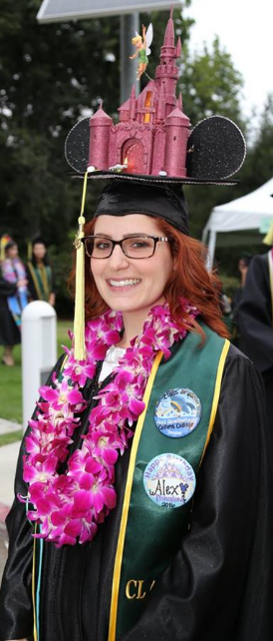
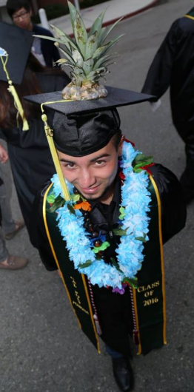
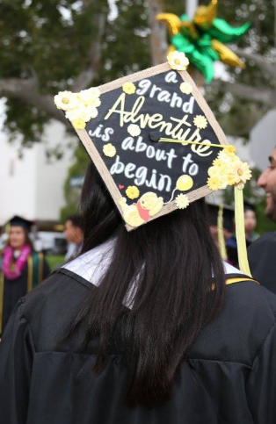
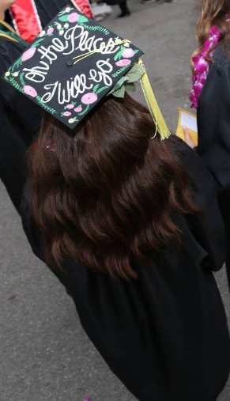
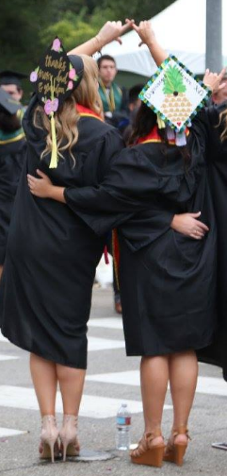
Career Engagement helps students
keep their eye on the prize
Notes:
Slide: Photos of students in graduation caps
Career Engagement helps students keep their eye on the prize

Slide 9
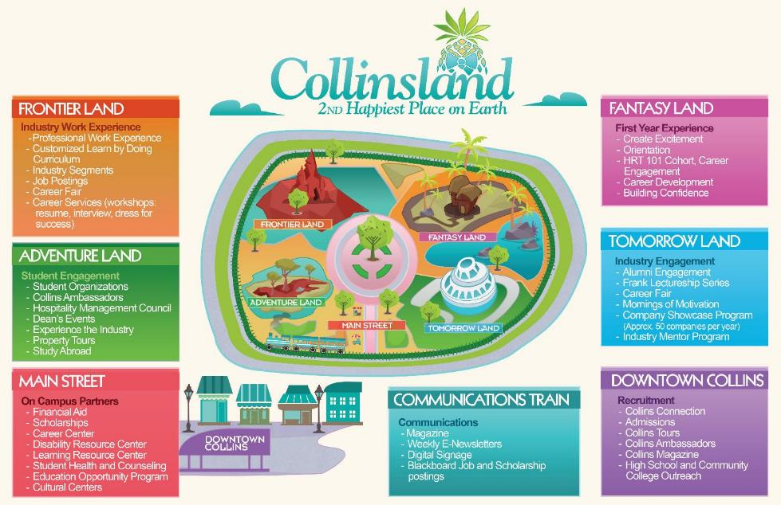
Welcome to…
Notes:
Welcome to Collinsland!
Image: Map of Collinsland with the areas of “Frontier Land, Adventure Land, Main Street, Communications Train, Fantasyland, Tomorrow Land and Downtown Collins

Slide 10
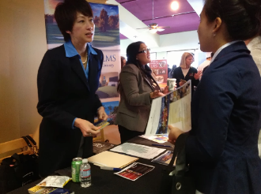
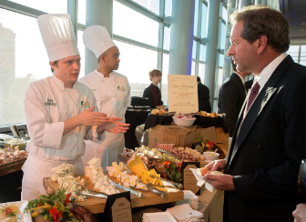
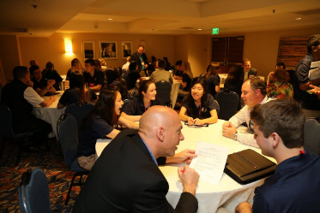
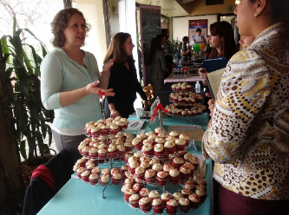
Frontier Land
Industry Work Experience
- Professional Work Experience
- Customized Learn by Doing Curriculum
- Industry Segments
- Job Postings
- Career Fair
- Career Services (workshops: resume, interview, dress for success)
Notes:
Frontierland - INDUSTRY WORK EXPERIENCE. This is where students navigate their new frontier by completing their required minimum 800 hours work experience in the industry, complete customized learn-by-doing curriculum in the areas of restaurants, hotels, and events (all lab-based), complete required HRT 341 Professional Work Experience course to provide professional development for students, attend the Hospitality Career Expo (80 companies annually), and attend Career Services workshops.
The most notable lab is the HRT 383L Food and Beverage Operations at the Restaurant at Kellogg Ranch, a student managed and operated restaurant open to the public for casual dining at lunch and formal dining at dinner. Students taking this class complete 24 contact hours per week for the ten week quarter. This intensive restaurant learning experience mirrors real-world work experience.
INDUSTRY WORK EXPERIENCE
Students are required to complete a minimum of 800 professional work experience hours before they enroll in HRT 341 Professional Work Experience (2 units). This course assists students in career preparation, including resume writing, interviewing skills, and personal assessment. Research has shown that students who work in the hospitality industry while they are in school tend to apply what they are learning at work to their studies in the classroom, therefore enhancing their mastery of subject matter.
The Collins College Career Services Workshops are designed to help students with resumes, interviewing skills, business and dining etiquette, dress for success, etc.
Annual Hospitality Career Expo - 80+ hospitality industry companies (200 recruiters) attend an annual career expo just for hospitality management students. Of these companies, 70% represent corporate (company-wide) recruiting.
Frontier Land
Industry Work Experience
- Professional Work Experience
- Customized Learn by Doing Curriculum
- Industry Segments
- Job Postings
- Career Fair
- Career Services (workshops: resume, interview, dress for success)

Slide 11
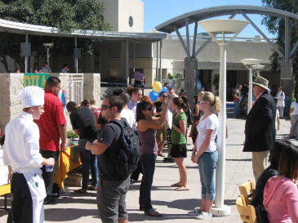
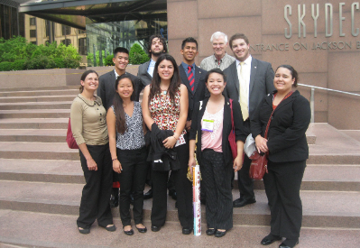
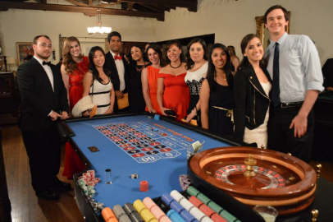
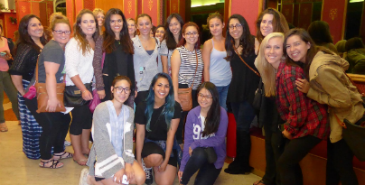
Adventure Land
Student Engagement
- Student Organizations
- Collins Ambassadors
- Hospitality Management Council
- Dean’s Events
- Experience the Industry
- Property Tours
- Study Abroad
Notes:
Adventureland - STUDENT ENGAGEMENT. This is where students are engaged in their learning adventure through industry-based student organizations, Dean's events that include industry, hospitality property tours, "Experience the Industry" trips to New York and Chicago, and industry focused month-long study abroad courses.
STUDENT ENGAGEMENT
Student Organization Groups - The Collins College has nine undergraduate student organizations (including an honor society) and one graduate student organization to promote student engagement with the hospitality industry. All of these organizations help students discover their interests in various segments of the hospitality industry, and they keep students connected with their major.
One student organization, the National Society for Minorities in Hospitality, specifically targets URM groups by helping connect and engage students with each other and the hospitality industry.
The Hospitality Management Council represents all student organizations within the college to coordinate activities and officers within the student organizations. These students comprise all leaders of the hospitality student organizations to further develop leadership skills and provide student engagement at a high level.
The Collins Ambassadors program engages competitively selected students who help with outreach, recruitment, and public relations activities for the College, helping to develop leadership and career skills for students.
Experience the Industry Program supports partial travel and meals for 16 students to attend The Hotel Experience Show in New York and 16 students to attend the National Restaurant Association Show in Chicago annually. These are study tours led by the Student Services Coordinator, a faculty member, and the Dean.
Industry-Focused Study Abroad opportunities for students are available for faculty-led groups to Apicious in Florence Italy (food and culture) and CATIE in Costa Rica (sustainable tourism). Both of these month-long study abroad programs include coursework and multiple tours to hospitality properties in these countries. These are partially supported by college scholarship funds.
Adventure Land
Student Engagement
- Student Organizations
- Collins Ambassadors
- Hospitality Management Council
- Deans Events
- Experience the Industry
- Property Tours
- Study Abroad

Slide 12
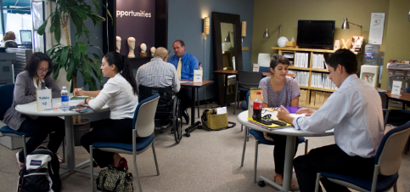
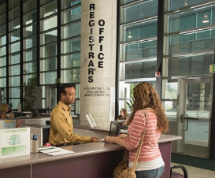
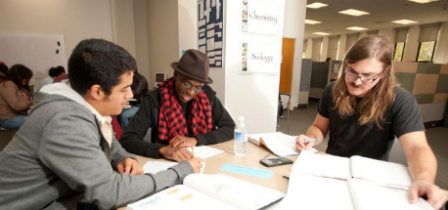
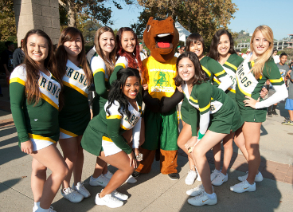
Main Street
On Campus Partners
- Financial Aid
- Scholarships
- Career Center
- Disability Resource Center
- Learning Resource Center
- Student Health and Counseling
Education Opportunity Program
Cultural Centers
Notes:
Main Street: ON-CAMPUS PARTNERS. This is where students engage with university services including Financial Aid, Scholarships, Career Center, Learning Resource Centers, Cultural Centers, EOP program, etc.
Housing offers College themed Communities
ON-CAMPUS PARTNERS
Students engage with university services including Financial Aid, Scholarships, Career Center, Learning Resource Centers, Cultural Centers, EOP program, etc.
Main Street
On Campus Partners
- Financial Aid
- Scholarships
- Career Center
- Disability Resource Center
- Learning Resource Center
- Student Health and Counseling
- Education Opportunity Program
- Cultural Centers

Slide 13
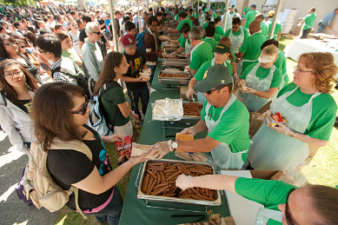
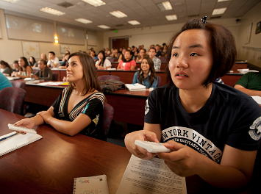
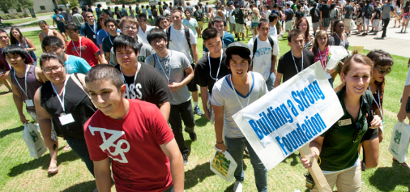
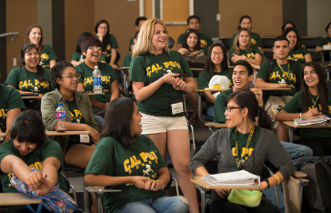
Fantasy Land
First Year Experience
- Create Excitement
- Orientation
- HRT 101 Cohort, Career Engagement
- Career Development
- Building Confidence
Notes:
Fantasyland - FIRST YEAR EXPERIENCE. This is where students are engaged in their first year experience through activities designed to orient students to college and the hospitality industry. In this first-year experience, all freshmen and transfer students are grouped into cohorts and take HRT 101 Introduction to the Hospitality Industry. In this course, campus and college resources are introduced, all aspects of the hospitality industry are presented through a resort simulation and course discussions, and industry professionals guest lecture. The purpose is to create excitement about the major and the hospitality industry. These experiences build student confidence through interacting with upper division students, alumni, and managers engaged in the hospitality industry.
FIRST YEAR EXPERIENCE
Beginning with Collins Connection, our annual recruiting event on the first Saturday in March for potential FTF and incoming transfer students, we introduce our student organizations at a club fair as part of the presentation and tours. We also have a session for parents and students explaining career opportunities in the hospitality industry and how students can participate in campus and college career services, and we have a panel of graduation seniors discuss how career engagement helped them get their management jobs upon graduation.
Connected with our first-year experience goals, fall 2014 was the first time we held all 180 seats in our three sections of HRT 101 Introduction to the Hospitality Industry course for incoming freshmen. We continued this strategy in fall 2015, and will continue this in the future. We had every freshman take the first year experience course in their first quarter. In fact, the remaining seats in the fall HRT 101 sections were provided to incoming transfer students who had yet to take a HRT 101 equivalent at their community college. We are tracking this group of freshmen and transfer students through the program.
Fantasy Land
First Year Experience
- Create Excitement
- Orientation
- HRT 101 Cohort, Career Engagement
- Career Development
- Building Confidence

Slide 14
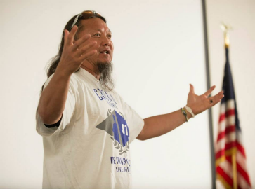
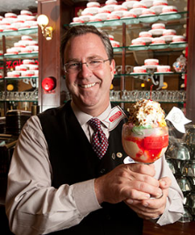
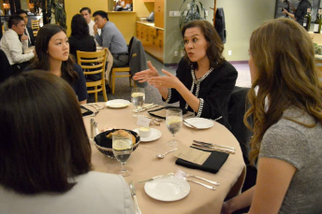
Tomorrow Land
Industry Engagement
- Alumni Engagement
- Frank Lectureship Series
- Career Fair
- Mornings of Motivation
- Company Showcase Program (Approx. 50 companies per year)
- Industry Mentor Program
Notes:
Tomorrowland: INDUSTRY ENGAGEMENT. This is where students shape their tomorrows by interacting with successful industry and alumni role models in the classroom, participating in The Collins College Board of Advisors Industry Mentoring Program and bi-monthly "Mornings of Motivation" program, attending Company Showcase Programs at the college (50 companies present workshops annually), and participating in the Richard Frank Lecture Series.
INDUSTRY ENGAGEMENT
Advisory Board Mentoring Program provides one-on-one quarterly mentoring of students by board members.
Mornings of Motivation is a career program in which Advisory Board members speak with students as a group (2 to 3 board members with 20 students) for approximately three hours once per quarter to discuss career paths, successes, and challenges. The purpose of this program is to provide motivation for students.
Richard N. Frank Lecture Series is a career engagement program at which owners, CEOs, and VPs of hospitality companies present at a lecture series annually. The program attempts to attract minority and female presenters to demonstrate the diversity in the industry, as is represented in the student body.
Throughout the year, the Collins College hosts approximately 50 hospitality companies to talk to students about their companies during U-Hour. These companies participate in our Company Showcase Program. Topics include company history, company culture, brands, and employment opportunities.
Annual scholarships from the Collins College of approximately $100,000 are available to students based on merit. An additional $100,000 in scholarships are provided by industry supporters primarily based on merit. Some of the industry scholarships are need-based.
Spaces for industry engagement in the college include a student organization meeting room in Bldg. 79B, and a Student Commons and H-Café in Bldg. 80, and space for the Hospitality Career Expo in Bldg. 80.
Tomorrow Land
Industry Engagement
- Alumni Engagement
- Frank Lectureship Series
- Career Fair
- Mornings of Motivation
- Company Showcase Program (Approx. 50 companies per year)
- Industry Mentor Program

Slide 15
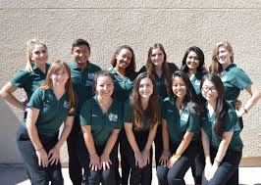
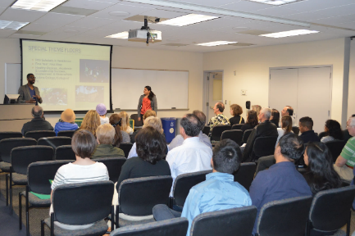
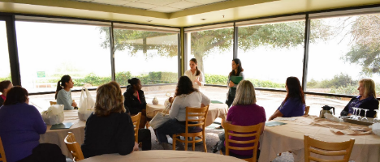
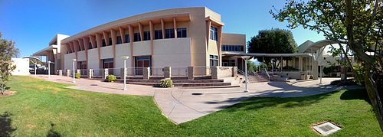
Downtown Collins
Recruitment
- Collins Connection
- Admission
- Collins Tours
- Collins Ambassadors
- Collins Magazine
Notes:
Downtown Collins - This is where students are recruited during admissions events and introduced to the industry before entering the Collinsland park.
Downtown Collins
Recruitment
- Collins Connection
- Admission
- Collins Tours
- Collins Ambassadors
- Collins Magazine

Slide 16
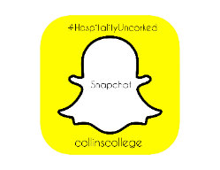
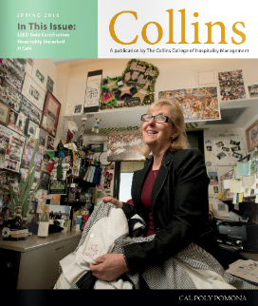
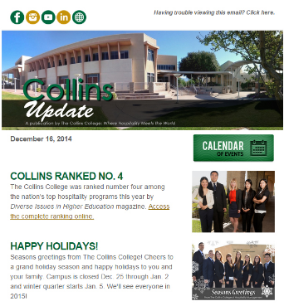
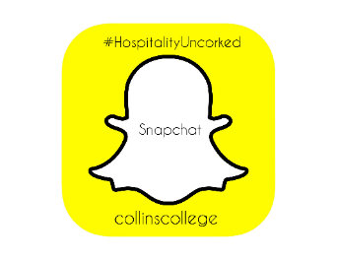
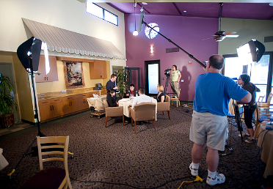
Communications Train
- Magazine
- Weekly E-Newsletters
- Digital Signage
- Blackboard Job and Scholarship postings
- Social Media
Notes:
Communications Train (travels around the park): COMMUNICATIONS TO STUDENTS. The train "circles" the park to make sure that students know about all the career and academic opportunities available to them. Communications to students at The Collins College include weekly e-newsletters, digital signage, Blackboard Job Postings, a semi-annual print magazine, and extensive use of social media.
FREQUENT COMMUNICATIONS
The full-time Communications and External Relations Coordinator communicates frequently, as noted below, with students to keep them informed and engaged.
Daily or weekly communications to students go out on the following social media channels: Facebook, Twitter, LinkedIn, YouTube, Vimeo, Snap Chat, Instagram, and BlogSpot.
Collins Update is an online newsletter that is sent out every Monday to all students. Information regarding advising, scholarship opportunities, student organization activities, career opportunities, university deadlines, college and university events and activities, and other student-related information is sent weekly.
Digital signage is used in building 80 to communicate to students pertinent information regarding advising, scholarship opportunities, student organization activities, career opportunities, university deadlines, college and university events and activities, and other student-related information.
Collins Magazine is a print publication that is produced twice per year. These magazines are given to prospective students and their parents to help them understand the wide variety of activities and accomplishments of students, faculty, and staff. This publication also focuses on career achievements of alumni. This publication can be found in spaces throughout the college so that current students may read it at their leisure.
Weekly information is posted on Blackboard with updates on scholarship opportunities and career opportunities. Also, through the Career Digest, an e-mail is generated and a phone notification goes out to the students when new job opportunities are posted.
Communications Train
- Magazine
- Weekly E-Newsletters
- Digital Signage
- Blackboard Job and Scholarship postings
- Social Media

Slide 17
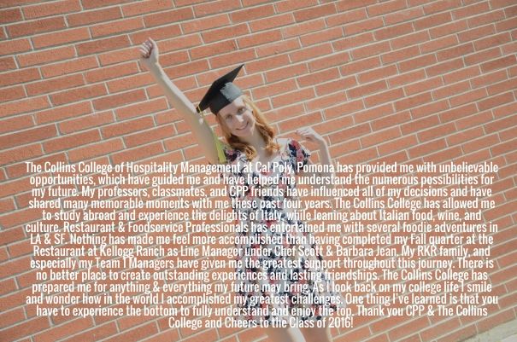
Notes:
The Collins College of Hospitality Management at Cal Poly Pomona has provided me with unbelievable opportunities, which have guided me and have helped me understand the numerous possibilities for my future. My professors, classmates, and CPP friends have influenced all of my decisions and have shared many memorable moments with me these past four years. The Collins College has allowed me to study abroad and experience the delights of Italy, while learning about Italian food, wine and culture. Restaurant and Foodservice Professional has entertained me with several foodie adventures in LA and SF. Nothing has made me feel more accomplished then having completed my Fall quarter at the Restaurant at Kellogg Ranch as Line Manager under Chef Scott and Barbara Jean. My RKR family, and especially my Team 1 managers have given me the greatest support throughout this journey. There is no better place to create outstanding experiences and lasting friendships. The Collins College has prepared me for anything and everything my future may bring. As I look back on my college life I smile and wonder how in the world I accomplished my greatest challenges. One thing I’ve learned is that you have to experience the bottom to fully understand and enjoy the top. Thank you CPP and The Collins College and Cheers to the Class of 2016! - Maria Ceko, Class of 2016

Slide 18
Time to create your own happiest place on earth!
Notes:
Collinsland- 2nd happiest place on earth
Time to create your own happiest place on earth!

Slide 19
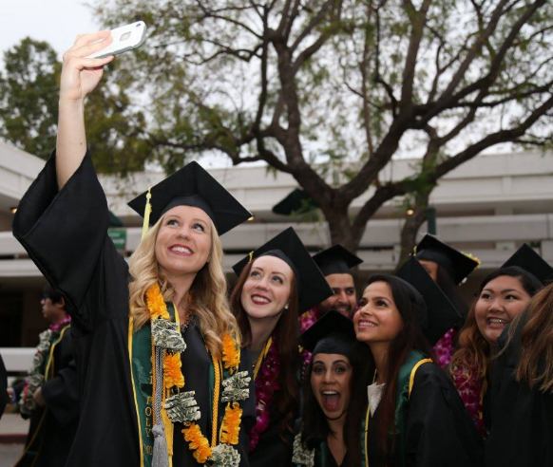
Cameras out, time for a selfie before entering the park!
Use #Collinsland
Notes:
Camera’s out! Time for a selfie before entering the park

Slide 20
Table Activity
Review, brainstorm and fill in your map with ideas and best practices for each of the different lands for your campus/department
Discuss amongst your table and prepare several ideas to be shared with the group.
10 minutes
Notes:
Table Activity
Review, brainstorm and fill in your map with ideas and best practices for each of the different lands for your campus/department
Discuss amongst your table and prepare several ideas to be shared with the group.
10 minutes

Slide 21
Room Activity
Select a representative from each table
Representatives, please share three ideas on the large wall map on behalf of your table, write your table number next to your idea
Group Discussion on best practices
30 minutes
Notes:
Room Activity
Select a representative from each table
Representatives, please share three ideas on the large wall map on behalf of your table, write your table number next to your idea
Group Discussion on best practices
30 minutes

Slide 22
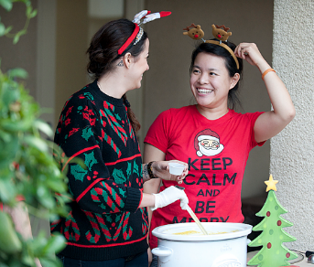
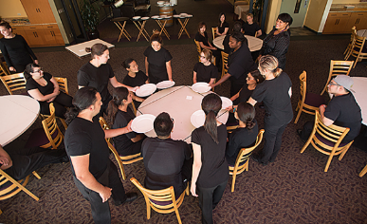
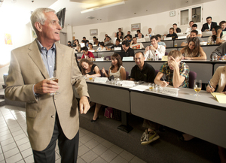
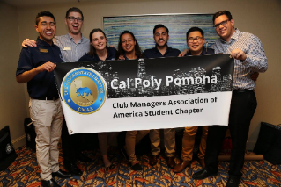
Final Thoughts
Story of the pineapple
Life on the hill and The Collins College family
Learn by Doing and Learn by Chewing
Notes:
Final Thoughts
Story of the pineapple
Life on the hill and The Collins College Family
Learn by Doing and Learn by Chewing

Slide 23
Thank you for attending!
Dr. Lea Dopson
Dean and James A. Collins Distinguished Chair lrdopson@cpp.edu
909.869.3646
Ann Lara
Career Services Coordinator
aelara@cpp.edu
909.869.4149
Notes:
Thank you attending!
Dr. Lea Dopson
Dean and James A. Collins Distinguished Chair lrdopson@cpp.edu
909.869.3646
Ann Lara
Career Services Coordinator
aelara@cpp.edu
909.869.4149

