Slide 1
Keeping Dreams Alive:
Increasing Passage Rates of Developmental Math Students
Elizabeth Adams, AVP Undergraduate Studies
Mark Stevens, Professor of Educational Psychology and Counseling
Katherine Stevenson, Professor of Mathematics, Director of Developmental Mathematics

Slide 2
Keeping Dreams Alive
Increasing Passage Rates of Students in Developmental Math
Mark Stevens
Professor, Educational Psychology and Counseling, Past Director of University Counseling
Elizabeth Adams
AVP, Undergraduate Studies
Katherine Stevenson
Professor, Mathematics
Director, Developmental Mathematics

Slide 3

Keeping Dreams Alive Today
Experience it:
What are dream navigators?
What does that look like in Dev Math?
What can we do to keep dreams alive?
Analyze it:
Love your data!
Build it:
What you need.
Do you have it?
How can we help?

Slide 4
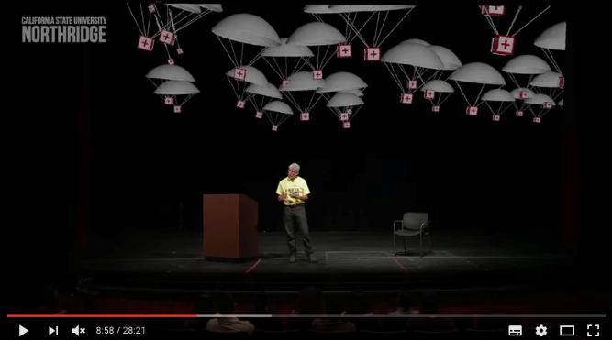
Students are Dream Makers
We are
Dream Navigators

Slide 5
What are Dream Navigators?
We Build a Culture of:
Encouragement
Engagement
Belonging
Belief

Slide 6
Experience Confidence and Enjoyment of Learning
Core Principles and Objectives of ExCEL Programs
Remember Your Purpose
Increase Your Sense of Belonging
Build Your Academic Confidence
Improve Help-Seeking Behaviors and Attitudes
Access Your Proud Learning Moments
Know Your Distraction Magnets

Slide 7
An Empathy Exercise
Why is a Sense of Belonging
So Important to our Students?

Slide 8
What Would Have Helped You
To Feel a Greater Sense of Belonging?
An Action or Words From Someone?
Internal Narrative?

Slide 9
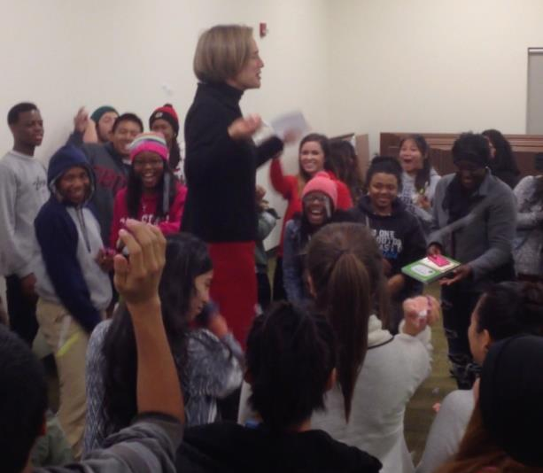
What does that look like in Developmental Math?

Slide 10

CSUN FACTS: 40,000+ Students
  Urban Serving
  Hispanic Serving
  Asian American and Native American Pacific Islander Serving
  Minority Serving
Developmental math serves
  2000-2500 students = 45-50% of FTFs
What is Developmental Math at CSUN?

Slide 11
CSUN FACTS: 40,000+ Students
  Urban Serving
  Hispanic Serving
  Asian American and Native American Pacific Islander Serving
  Minority Serving
Developmental math serves
  2000-2500 students = 45-50% of FTFs
Three classes at two levels:
  Level 1: Arithmetic & Intro to Algebra – Math 092 (ELM 0-32)
    Level 2: Algebra Intensive – Math 093 (ELM 34-48)
    Level 2: Quant. Reasoning & Statistics – Math 097 (ELM 34-48)
What is Developmental Math at CSUN?

Slide 12
What is Developmental Math at CSUN?
2000-2500 students annually
Three classes at two levels:
  Level 1: Arithmetic & Intro to Algebra – Math 092 (ELM 0-32)
    Level 2: Algebra Intensive – Math 093 (ELM 34-48)
    Level 2: Quant. Reasoning & Statistics – Math 097 (ELM 34-48)
Annual progression
Summer: Early Start Math
Fall
Spring
Summer
Self Support

Slide 13
Ideal: On track to graduate in 4-6 years
2000-2500 students annually
Three classes at two levels:
  Level 1: Arithmetic & Intro to Algebra – Math 092 (ELM 0-32)
    Level 2: Preparation for College Algebra – Math 093 (ELM 34-48)
    Level 2: Preparation for Statistics – Math 097 (ELM 34-48)
Summer: Complete Level 1
Fall:
Complete Level 2
Spring: Complete GE Math
Summer
Work in an internship
75% CR
65% CR

Slide 14
On track to… stop-out
Developmental Math at CSUN
2000-2500 students
Three classes at two levels:
  Level 1: Arithmetic & Intro to Algebra – Math 092 (ELM 0-32)
    Level 2: Preparation for College Algebra – Math 093 (ELM 34-48)
    Level 2: Preparation for Statistics – Math 097 (ELM 34-48)
Summer: Fail
Level 1
Fall:
Fail
Level 1
Spring: Still at Level 1
Summer
Stopped out
25% NC
35% NC
65% NC

Slide 15
On track to… stop-out
Developmental Math at CSUN
2000-2500 students
Three classes at two levels:
  Level 1: Arithmetic & Intro to Algebra – Math 092 (ELM 0-32)
    Level 2: Preparation for College Algebra – Math 093 (ELM 34-48)
    Level 2: Preparation for Statistics – Math 097 (ELM 34-48)
Summer: Fail
Level 1
Fall:
Fail
Level 1
Spring: Still at Level 1
Summer
Stopped out
25% NC
35% NC
65% NC
We failed 130 students

Slide 16
Keeping dreams alive!
Developmental Math at CSUN
2000-2500 students
Three classes at two levels:
  Level 1: Arithmetic & Intro to Algebra – Math 092 (ELM 0-32)
    Level 2: Preparation for College Algebra – Math 093 (ELM 34-48)
    Level 2: Preparation for Statistics – Math 097 (ELM 34-48)
Summer: Fail
Level 1
Fall:
GE
Math
Spring: Still in Level 1
Summer
Complete Dev Math
55-65% fail again
CR!!!
Notes:
We started here to help the most in need, and we are gradually backing this up to avoid that need.

Slide 17
What did we do to keep dreams alive?
CREAT CONTEXT TO CHANGE CULTURE!
Spring 2015 & 2016
250-400 students in Math 092 in spring
Supplemental Instruction for every section to embed social emotional learning in mathematical instruction.
Run by instructional student assistants (ISA)
Three social emotional learning interventions by professional counseling staff and faculty from College of Education
Weekly organizational and support meetings for ISAs with trained professionals, developmental math instructors and staff
Notes:
What ISAs do when there are no workshops:
They are the boots on the ground. They are welcoming the students at the start of term, creating a sense of belonging through team building games. They are there when the student is reviewing for an exam and can help address test anxiety. They are there when the test comes back and can work on help seeking and growth mindset in context.

Slide 18
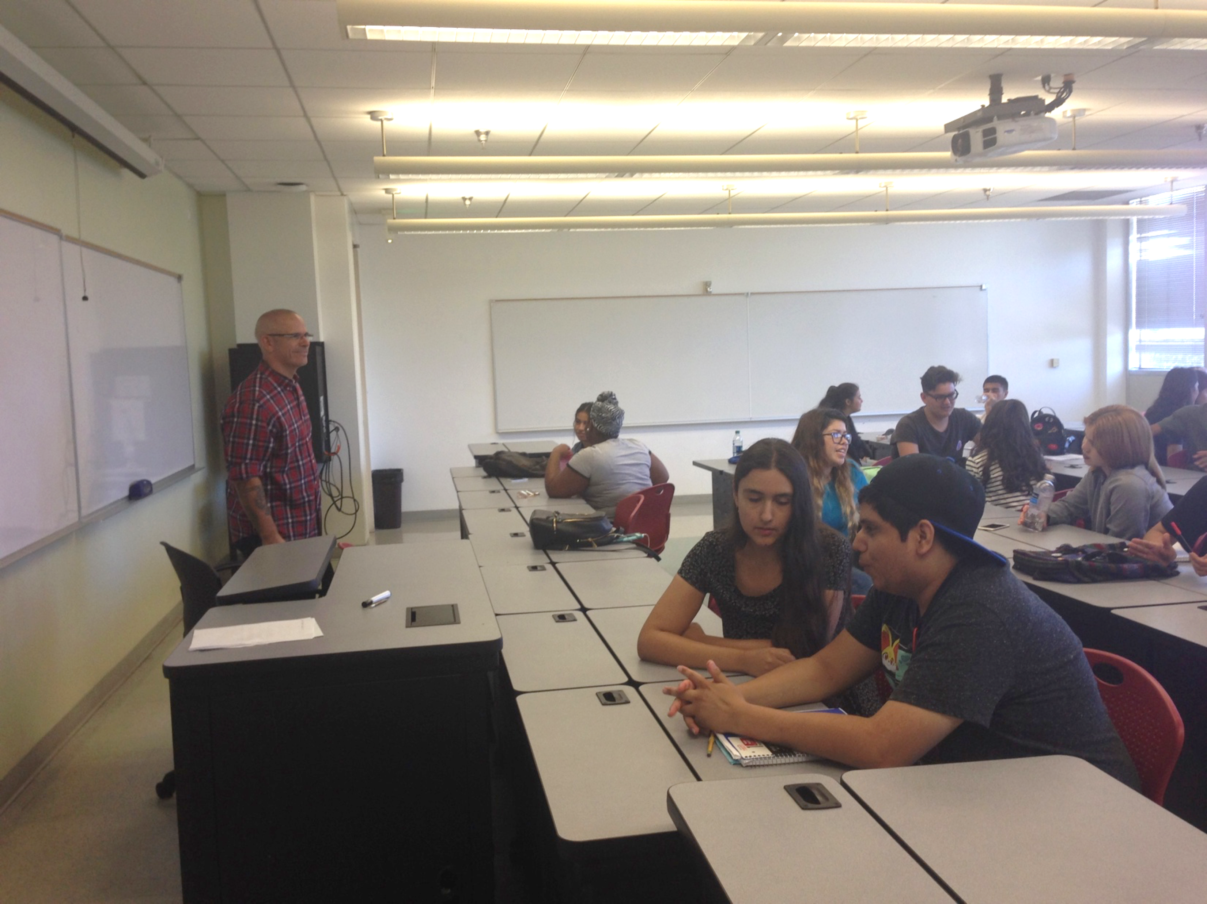
“I was able to attend the workshop…
I was inspired by Will.
He taught me to have a purpose,
to build within my community,
and to have self solidarity as well
as group solidarity.
I sure hope to have him for the
next workshops.”
Student at workshop 1 Friday 9/16/16
Keeping the dreams alive one at a time…
Notes:
By bringing the workshops to the students and the ISAs we also hit the faculty and gradually we have changed to culture.
Recall that developmental math faculty feel the same way about teaching dev math as students feel about taking it… Oh my god what if I fail, what is I can’t reach them, what if the Social Emotional stuff is just too hard for me to relate to.

Slide 19
Developmental math faculty
feel the same way about teaching
developmental math as students
feel about taking it…
“Oh my god what if I fail?
What if I can’t reach them?
What if the Social Emotional stuff
is just too hard for me to relate to?
Keeping the dreams alive one at a time…
Notes:
By bringing the workshops to the students and the ISAs we also hit the faculty and gradually we have changed to culture.
Recall that developmental math faculty feel the same way about teaching dev math as students feel about taking it… Oh my god what if I fail, what is I can’t reach them, what if the Social Emotional stuff is just too hard for me to relate to.

Slide 20
Our Dream: Everyone on track for graduating in 4-6 years
Developmental Math at CSUN
2000-2500 students
Three classes at two levels:
  Level 1: Arithmetic & Intro to Algebra – Math 092 (ELM 0-32)
    Level 2: Preparation for College Algebra – Math 093 (ELM 34-48)
    Level 2: Preparation for Statistics – Math 097 (ELM 34-48)
Summer: Most Complete Level 1
Fall:
Everyone Completes Level 1
Spring:
Everyone Completes Level 2
Summer: Everyone
Completes GE Math
Notes:
We started here to help the most in need, and we are gradually backing this up to avoid that need.

Slide 21
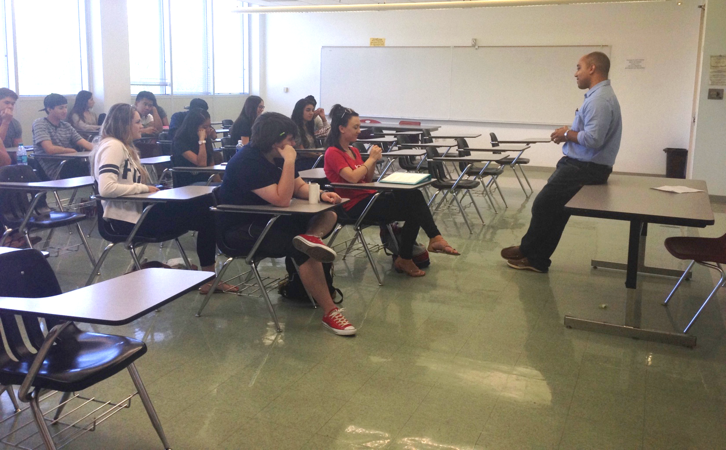
What does that look like in Developmental Math?
Notes:
Mark (15 minutes: Finish by minute 45)
-- Backdrop to the formation and intentions of ExCEL particularly in the context of math.
-- Engage audience in a one experiential exercises

Slide 22
ExCEL Interventions with Students taking Developmental Math
First: Purpose, Belonging, Help Seeking, Growth Mind-Set, Distraction Magnets
Second: Reducing Math Test Anxiety
Third: Wind Beneath Your Sail: Crossing the Finish Line Strong—Proud Learning Moments Revisited

Slide 23
Now for some applied quantitative reasoning…
Did adding the SI with ExCEL help?
Passage rates

Slide 24
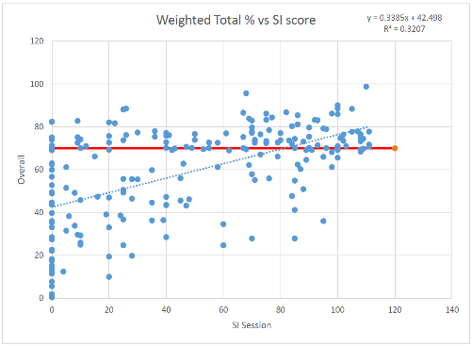
Was it the intervention that helped?
Probably, and here’s why we think so…

Slide 25
Who did it help? Impact by Ethnicity
How does that make sense given the intervention content?
Notes:
Think about how the data breaks down by ethnicity and how that relates to the choice of social-emotional themes: Belonging, Test Anxiety, and Wind in your sails.

Slide 26
Sustained
Impact by Ethnicity

Slide 27
Impact by the numbers
Semester | Ethnicity | # Students | Pass Rate
Spg 2013 | Black | 48 | 44%
Spg 2013 | Hispanic | 128 | 36%
Spg 2013 | Other | 14 | 57%
Spg 2013 | White | 6 | 50%
Total Spg 2013 |  | 196 | 40%
Spg 2014 | Black | 49 | 33%
Spg 2014 | Hispanic | 122 | 36%
Spg 2014 | Other | 17 | 53%
Spg 2014 | White | 13 | 77%
Total Spg 2014 |  | 201 | 40%
Spg 2015 | Black | 44 | 57%
Spg 2015 | Hispanic | 153 | 63%
Spg 2015 | Other | 20 | 65%
Spg 2015 | White | 15 | 47%
Total Spg 2015 |  | 232 | 61%
Spg 2016 | Black | 28 | 54%
Spg 2016 | Hispanic | 83 | 57%
Spg 2016 | Other | 50 | 44%
Spg 2016 | White | 34 | 56%
Total Spg 2016 |  | 195 | 53%
Correlation, Causation… beware conclusion
Intervention employed best practices
That studies show improve the
big three:
Belonging
Mindset
Productive Persistence

Slide 28
Impact by the numbers
Something else to notice
Semester | Ethnicity | # Students | Pass Rate
Spg 2013 | Black | 48 | 44%
Spg 2013 | Hispanic | 128 | 36%
Spg 2013 | Other | 14 | 57%
Spg 2013 | White | 6 | 50%
Total Spg 2013 |  | 196 | 40%
Spg 2014 | Black | 49 | 33%
Spg 2014 | Hispanic | 122 | 36%
Spg 2014 | Other | 17 | 53%
Spg 2014 | White | 13 | 77%
Total Spg 2014 |  | 201 | 40%
Spg 2015 | Black | 44 | 57%
Spg 2015 | Hispanic | 153 | 63%
Spg 2015 | Other | 20 | 65%
Spg 2015 | White | 15 | 47%
Total Spg 2015 |  | 232 | 61%
Spg 2016 | Black | 28 | 54%
Spg 2016 | Hispanic | 83 | 57%
Spg 2016 | Other | 50 | 44%
Spg 2016 | White | 34 | 56%
Total Spg 2016 |  | 195 | 53%

Slide 29
Impact by the numbers
Semester | Ethnicity | # Students | Pass Rate
Spg 2013 | Black | 48 | 44%
Spg 2013 | Hispanic | 128 | 36%
Spg 2013 | Other | 14 | 57%
Spg 2013 | White | 6 | 50%
Total Spg 2013 |  | 196 | 40%
Spg 2014 | Black | 49 | 33%
Spg 2014 | Hispanic | 122 | 36%
Spg 2014 | Other | 17 | 53%
Spg 2014 | White | 13 | 77%
Total Spg 2014 |  | 201 | 40%
Spg 2015 | Black | 44 | 57%
Spg 2015 | Hispanic | 153 | 63%
Spg 2015 | Other | 20 | 65%
Spg 2015 | White | 15 | 47%
Total Spg 2015 |  | 232 | 61%
Spg 2016 | Black | 28 | 54%
Spg 2016 | Hispanic | 83 | 57%
Spg 2016 | Other | 50 | 44%
Spg 2016 | White | 34 | 56%
Total Spg 2016 |  | 195 | 53%
Change does not exist in a vacuum!
Curricular Change
Early Start Math
Professional Development

Slide 30
Tenacity of impact – long term
Ethnicity | Semester Taking 092 | Last Semester Taking a Math Class | # Students | Pass Rate in Last Math Class
African American | Spg 2013 |  | 36
African American | Spg 2013 | Fall 2013 | 2 | 50.0%
African American | Spg 2013 | Sum 2013 | 6 | 16.7%
African American | Spg 2014 |  | 32
African American | Spg 2014 | Fall 2014 | 1 | 0.0%
African American | Spg 2014 | Sum 2014 | 9 | 66.7%
African American | Spg 2015 |  | 28
African American | Spg 2015 | Fall 2015 | 7 | 0.0%

Slide 31
Tenacity of impact – long term
Ethnicity | Semester Taking 092 | Last Semester Taking a Math Class | # Students | Pass Rate in Last Math Class
Latino/a | Spg 2013 |  | 89 | 0.0%
Latino/a | Spg 2013 | Fall 2013 | 8 | 62.5%
Latino/a | Spg 2013 | Sum 2013 | 21 | 28.6%
Latino/a | Spg 2014 |  | 89 | 0.0%
Latino/a | Spg 2014 | Fall 2015 | 4 | 50.0%
Latino/a | Spg 2014 | Sum 2014 | 24 | 25.0%
Latino/a | Spg 2015 |  | 83 | 0.0%
Latino/a | Spg 2015 | Fall 2015 | 39 | 43.6%
Latino/a | Spg 2015 | Sum 2015 | 1 | 100.0%

Slide 32
All developmental math students Fall 2016
1770 Students
Three intervention workshops by professional staff and faculty: September, October, November.
1200+ participated in workshop 1!
Dev. Math faculty & tutors invited to interventions.
Video tape Dr. Stevens with a "mock class" of student assistants to create a training tool.
Gearing it up!
Fall 2016
Quick and dirty gear up for spring 2017

Slide 33
All developmental math students Spring 2017
845 Students in 28-30 sections
Supplemental Instruction for every section run by instructional student assistants.
Three interventions by professional staff and faculty.
Dev. Math faculty required to attend to understand program.
Select math faculty identified to train to run interventions in Fall 2017.
Dev. Math tutors attend interventions as their spring tutor training.
Scaling it up!
Spring 2017:
Break 65% passage rates
Eliminate Achievement- Opportunity Gap
Get ready for Fall 2017

Slide 34
All developmental math students Fall 2017
1600 Students in 58-60 sections
Supplemental Instruction for every section? For those most in need?
Three interventions by professional staff and faculty.
Dev. Math faculty who have not already done so, required to attend to understand program.
Select Group of math faculty run interventions in Fall 2017.
Dev. Math tutors attend interventions as their fall tutor training.
Exploding it up!
Fall 2017:
Eliminate Math 092 for Spring 2018
Eliminate Achievement Gap

Slide 35

Inspiration
Selfies of Your Professors
Dr. Frankie Augustin
Faculty, College of Health and Human Development
www.youtube.com/watch?v=BKuJH6dV4YI

Slide 36
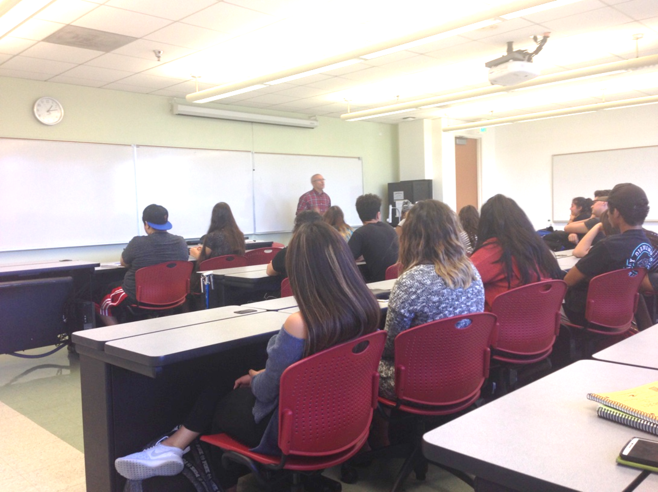
You can you keep dreams alive!
What you need.
Do you have it?
How can we help?

