Slide 1
Building the foundation for student success:
Optimizing classroom utilization to promote student access

Slide 2

Cal State LA: Context
Student Profile

Slide 4
Cal State LA: Context
Student Profile
Enrollment Growth

Slide 6
Cal State LA: Context
Student Profile
Enrollment Growth
Quarter to Semester Conversion

Slide 7
Quarters to Semesters: What Changes?
10 Week Quarter Term
4 Unit Classes
4 hours/week = 40 hours/term
45 4-unit courses = typical degree requirements
“Standard” course load = 3.75/term
15 Week Semester
3 Unit Classes
3 hours/week = 45 hours/semester
40 3-unit courses = typical degree requirements
“Standard” course load = 5/semester

Slide 8

How Many More Class Seats Are Needed for
Semesters vs. Quarters?
Fall 2015:
100,000 quarter class seats
Fall 2016:
?? semester class seats
Fall 2016:
133,000 semester class seats

Slide 9
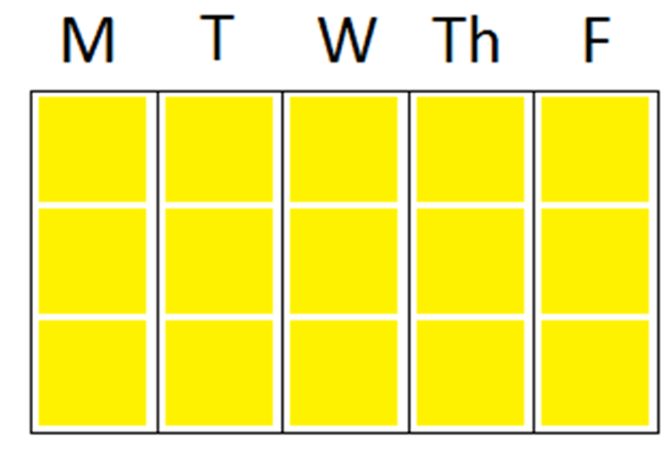
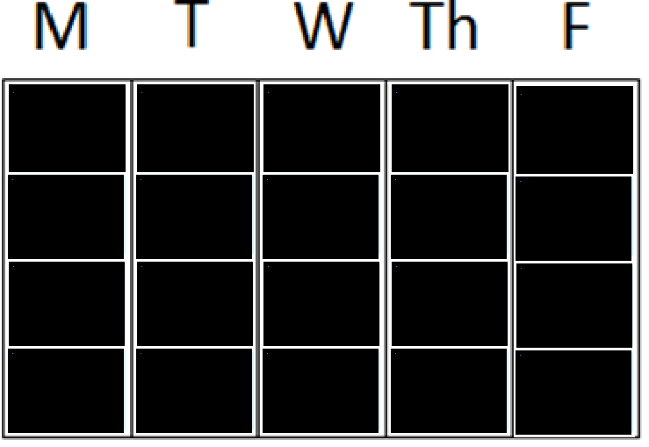
1/3 more 3-unit courses fit in room grid vs 4-unit courses
8:00 AM
9:00 AM
10:00 AM
11:00 AM
12:00 PM
1:00 PM
2:00 PM
3:00 PM
4:00 PM
5:00 PM
6:00 PM
7:00 PM
8:00 PM

Slide 10
Our Goals
Improve class enrollment capacity/classroom capacity
Increase the number of courses scheduled on our standard schedule grid to maximum usable class slots
Our Tactics:
Share data on unused classroom seats
Revise guidelines on faculty support for larger class sizes
Incentivize hybrid courses
Enforce on-grid scheduling

Slide 11
Tactic 1: Share data on unused classroom seats
October 2015 Presentations to Academic Affairs Colleges and Academic Senate Leadership
Fall 2015: 535 classes scheduled in rooms seating 50+
17,004 empty seats in those rooms
Average of almost 32 unused seat in each of those rooms

Slide 12
Tactic 2: Revise guidelines on faculty support for larger class sizes
Excess Enrollment Guidelines
Class size | GA hrs/wk |  | Additional WTUs
50-59 | 1-4 |  | -
60-74 | 4 |  | -
75-99 | 4 | and | 1.5
100-149 | 4 | and | 3
150+ | 8 | and | 3
“Colleges may deviate from these guidelines based on student enrollment demand, college resources and priorities, and classroom availability.”

Slide 13

Goal 1: Improve class enrollment capacity/classroom capacity - Outcomes
Classrooms of 50+ seats
Fall 15
534
83
54
51.5
Fall 16*
662
84.9
59.9
54.3
# Sections Scheduled
Average Room Capacity
Average Enrollment Cap
Average Enrollment
+24%
29
25
64%
91%
* pre-census

Slide 14
2016 HIGHER EDUCATION SCHEDULING INDEX
157 INSTITUTIONS

Slide 15
In Ad Astra’s 2106 HESI Index of 157 institutions, what is the average class Enrollment Ratio
(census enrollment/enrollment capacity)?
94%
77%
57%
86%

Slide 16
Tactic 3: Incentivize Hybrid Courses
Traditional FtF | Tuesday |  | Thursday
12:15-1:30 | Course 1 |  | Course 1
Hybrid | Tuesday |  | Thursday
12:15-1:30 | Course 1 |  | Course 2
Online | Course 1 |  | Course 2

Slide 17

Call for Participants
Hybrid Course Development for Semesters
Faculty support includes:
· High quality training and support for converting your courses to a hybrid format, which includes paid Quality Matters (QM) Designing Your Blended Course (DYBC) online professional development
· A $1,200 stipend and a $100 learning material grant
· Your class scheduled in a primetime teaching slot in (9AM-3 PM) Fall 2016

Slide 18
Goal 2: Increase the number of courses scheduled on our standard schedule grid to maximum usable class slots - Outcomes
85 hybrid courses on Fall 2016 schedule
64 scheduled 9 AM - 3PM = 32 extra courses in primetime
94% Fill Rate

Slide 19

Tactic 4: Enforce on-grid scheduling

Slide 20
Bad Tetris

Slide 21
Better Tetris

Slide 22
In Ad Astra’s 2106 HESI Index of 157 institutions, what is the average percentage of scheduling using non-standard meeting patterns?
6%
26%
14%
42%

Slide 23
Goal 2: Increase the number of courses scheduled on our standard schedule grid to maximum usable class slots - Outcomes

Slide 24
In Ad Astra’s 2106 HESI Index of 157 institutions, what is the average percentage of hours of institutions’ total scheduled hours that are in Prime Time?
39%
79%
59%
99%

Slide 25
 | Classroom Utilization (Standard Week) | Classroom Utilization (Prime Week) | Seat Fill/ Classroom Cap | Seat Fill/ Enrollment Cap | Off Grid Waste
Averages | 59% | 61% | 61% | 81% | 16%
Peer Averages | 51% | 73% | 62% | 73% | 14%
CSU-LA | 65% | 79% | 64% | 72% | 10%

Slide 26
Ultimate goal: Meet the enrollment needs of our students
 | # Sects w/Assigned Classroom | Student Credit Unit Capacity | Enrolled Student Credit Units
Fall 2015 | 3691 | 336314.5 | 316546.5
Fall 2016 | 4450 | 347717.5 | 316775.1
Change | 759 | 11403 | 228.6
20.5%

