Slide 1
Fresno State’s SI Program: Eliminating the Achievement Gap, Raising Grades, and Increasing Graduation Rates

Slide 2
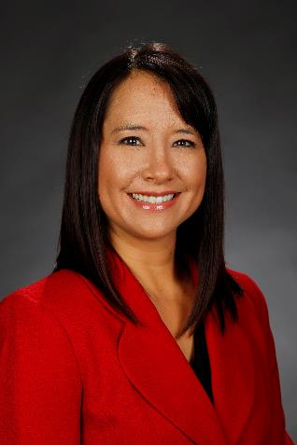
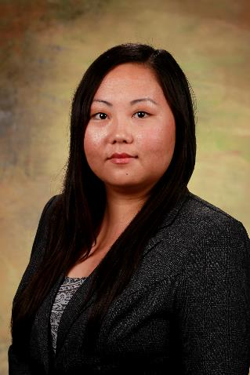
Tosha Giuffrida
Director, Learning Center
tgiuffrida@csufresno.edu
Mai Kou Vang
Coordinator, Supplemental Instruction
mvang@csufresno.edu

Slide 3

Notes:
Introduction of presentation & presenters
Mai Kou

Slide 4
ACTIVITY 2 minutes
Introduce and discuss the following:
  Name and Role
  Find a commonality between all group members
  What do you hope to gain from this presentation?

Slide 5
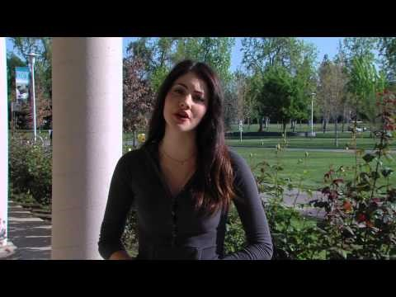

Slide 6
WHAT IS SI?
Supplemental Instruction (SI)
supplemental instruction
Created at University of Missouri-Kansas City (UMKC)
Targets high-risk courses
Voluntary attendance (no credit, no extra credit, no attendance reports to faculty)
Intensive training for SI Leaders
Regular feedback on SI sessions
SI Leaders are in the classroom
Usually targets high-risk students
Can be involuntary (labs, extended sessions) or voluntary
Tutoring, co-teaching, Q & A
Less feedback throughout the semester

Slide 7
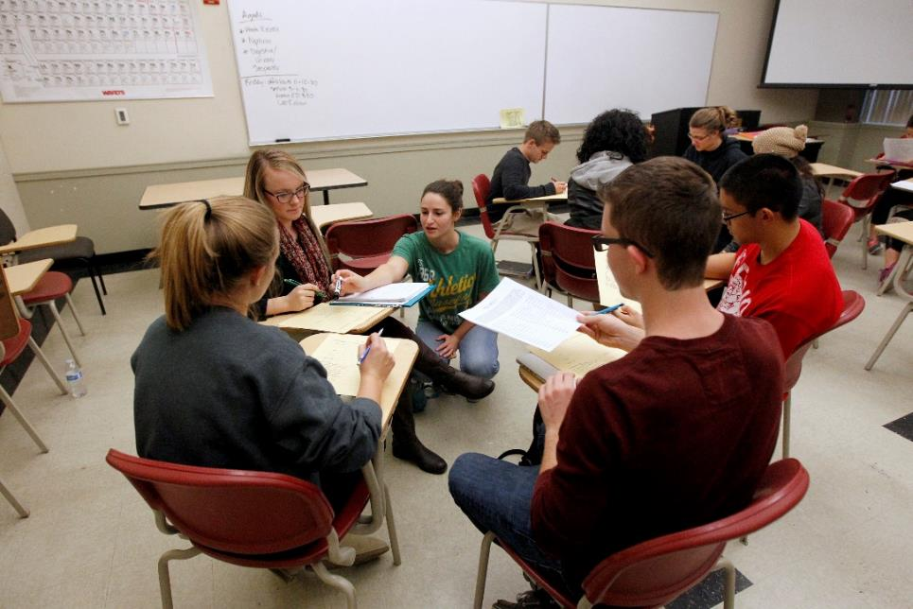
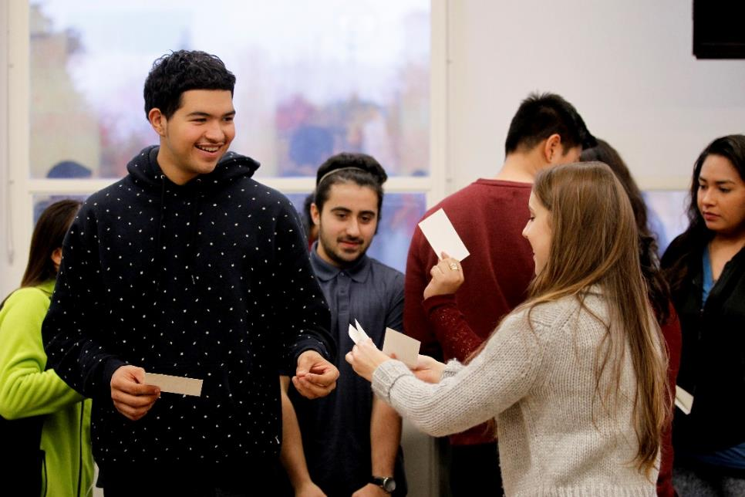
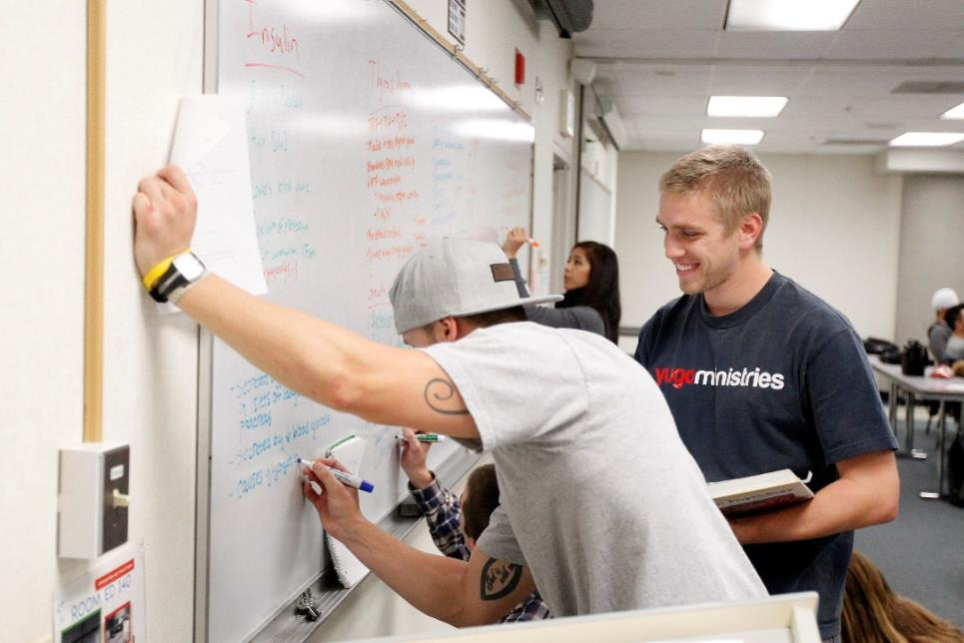
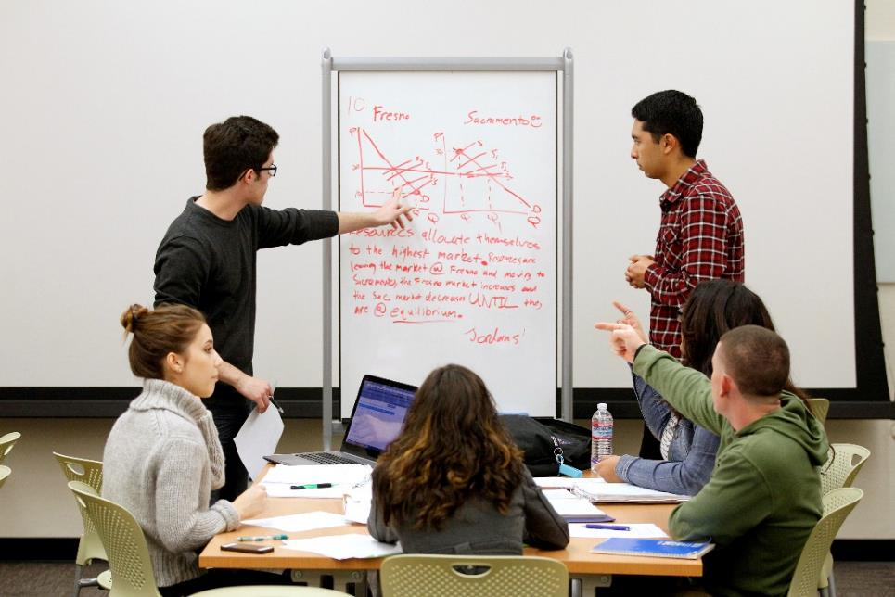
COLLABORATIVE LEARNING

Slide 8
USAGE

Slide 9
HIGH IMPACT PRACTICE
Raising Grades
Eliminating the Gap
Increasing Graduation

Slide 10
RAISING GRADES

Slide 11
ELIMINATING THE GAP

Slide 12
ELIMINATING THE GAP

Slide 13
INCREASING GRADUATION

Slide 14
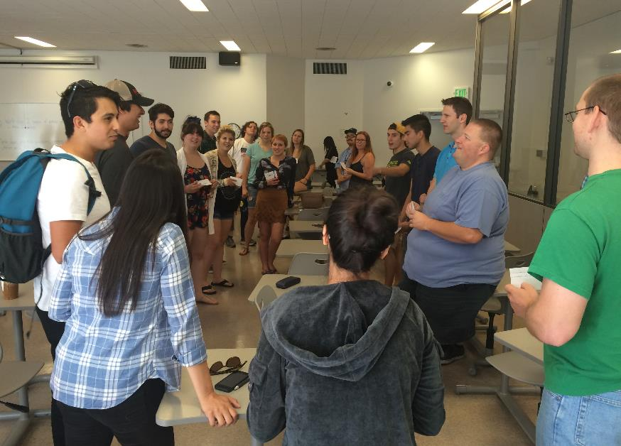
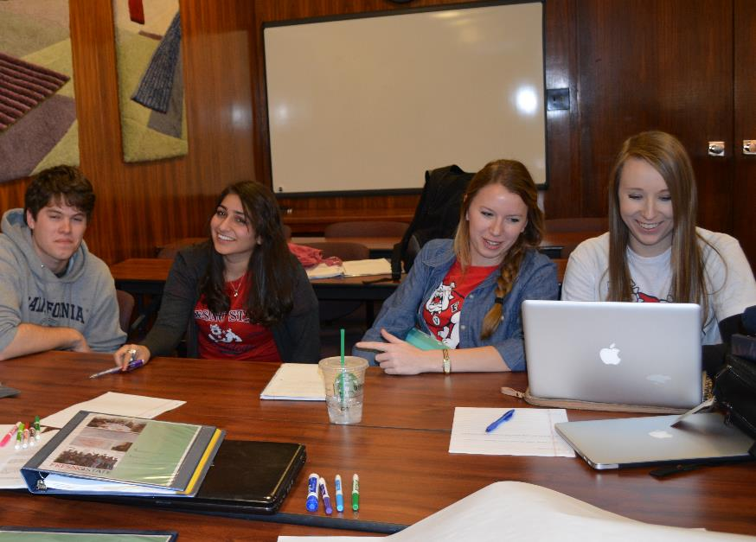
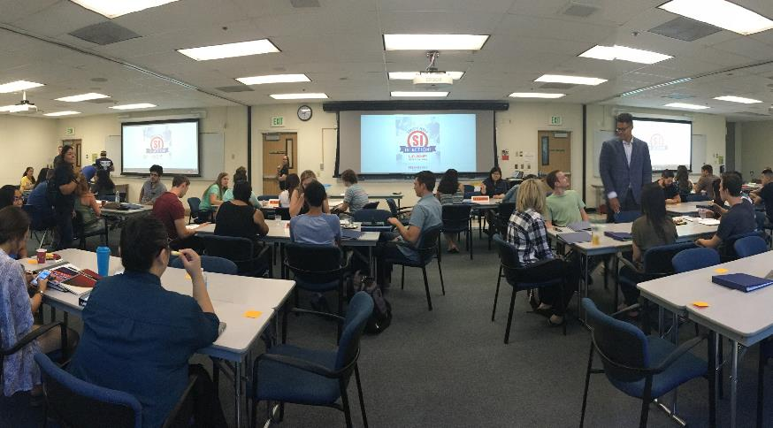
QUALITY COUNTS

Slide 15
STRUCTURE
Director, Learning Center
SI Coordinator
Admin Support
SI Mentor
SI Mentor
SI Assistant Coordinator
SI Leader (10)
SI Leader (10)
SI Leaders (7)
SI Leaders (21)

Slide 16
ACTIVITY 2 minutes
Identify challenges you have (or may have) implementing SI.
Notes:
https://www.polleverywhere.com/login

Slide 17
CHALLENGES
Space
Staff
Students
1-2 dedicated classrooms
50% general classroom
Office hours in Learning Center
1:24 staff to students
1:12 Best practice
Participation rate

Slide 18
PARTICIPATION

Slide 19
ACTIVITY 5 minutes
Identify ways to increase student participation in SI sessions.

Slide 20
PLAN TO INCREASE PARTICIPATION RATES
#OneThingLearned
Bring a friend
Bookmarks
Emails
Data Share
Faculty Promotion
Rotate seat in class
Blackboard Announcements

Slide 21
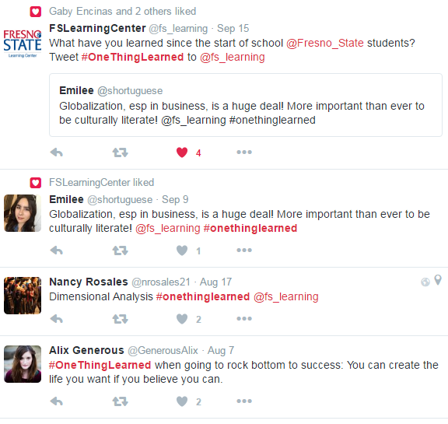
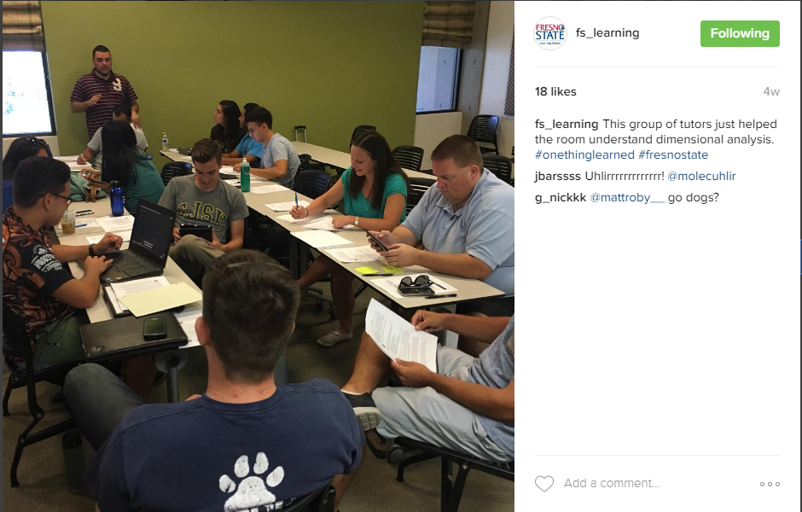
SOCIAL MEDIA

Slide 22
FACULTY PROMOTION
Faculty Learning Community
Sponsored UMKC International Conference
Build Awareness to Recruit New Faculty
Provide ongoing training, leadership and engagement

Slide 23
ACTIVITY 3 minutes
Identify partners on your campus who need to collaborate to support SI.

Slide 24
ACTIVITY (pair-share) 2 minutes
Complete the following statement:
One new or interesting thing I learned today is ___________________________.

