Slide 1
Encounter to Excellence:
Overcoming the Remediation Challenge
and Building a Culture of Student Success

Slide 2
Talk to the person next to you or as a group about your campus culture around taking small and successful boutique programs to scale?
  What program(s) on your campus, if scaled up, could benefit more first generation, low-income and underrepresented students.
  What challenges have your campus faced scaling up programs/initiatives?
  What accomplishments have your campus celebrated scaling up programs/initiatives??

Slide 3


Slide 4


California State University,
Palos Verdes
1960 - 17th Campus

Slide 5


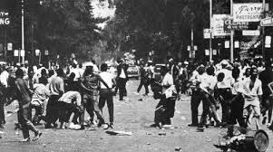

Watts
Rebellion
August 11-17,
1965

Slide 6
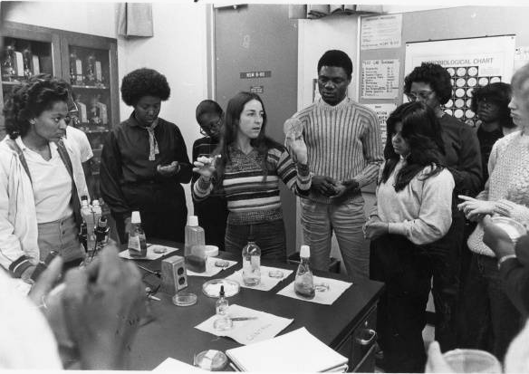
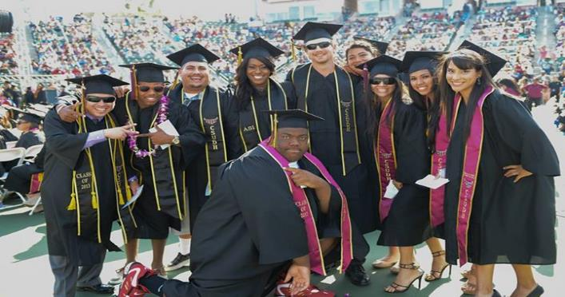
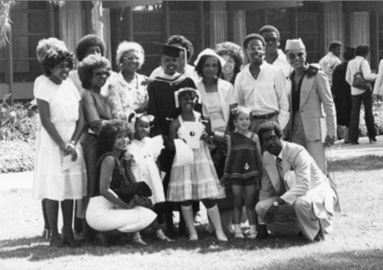
A Catalyst for Positive Change

Slide 7
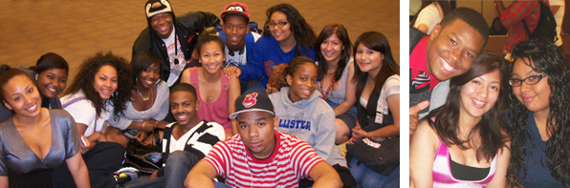
CSUDH has a service area that represents a portion of the Los Angeles metro area known today as the South Bay
  Carson
  Compton
  Long Beach
  Lynwood
  South Gate
  Paramount
  South Los Angeles

Slide 8
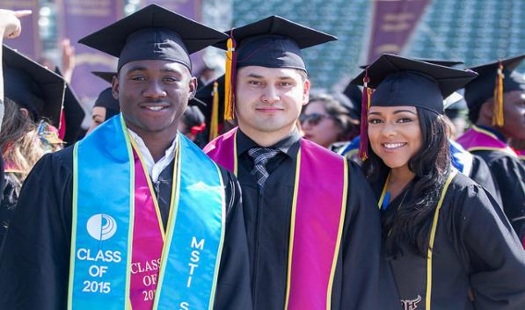
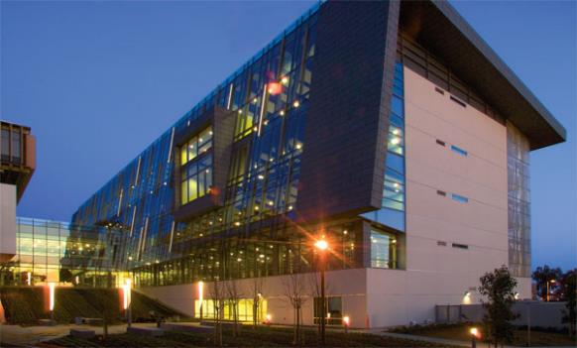
14,635 students
65% women; 35% men
61% first-generation
72% Pell eligible; 30% part-time
75% development in math/English
Non-Impacted CSU
Majority-Serving Institution (MSI) & Hispanic- Serving Institution (HSI)
Asian = 10.8%
African American = 14.5%
Hispanic = 60.3%
Native American = 0.1%
Pacific Islander = 0.3%
White = 10.9%
2 or more races = 3.1%
87%
1

Slide 9
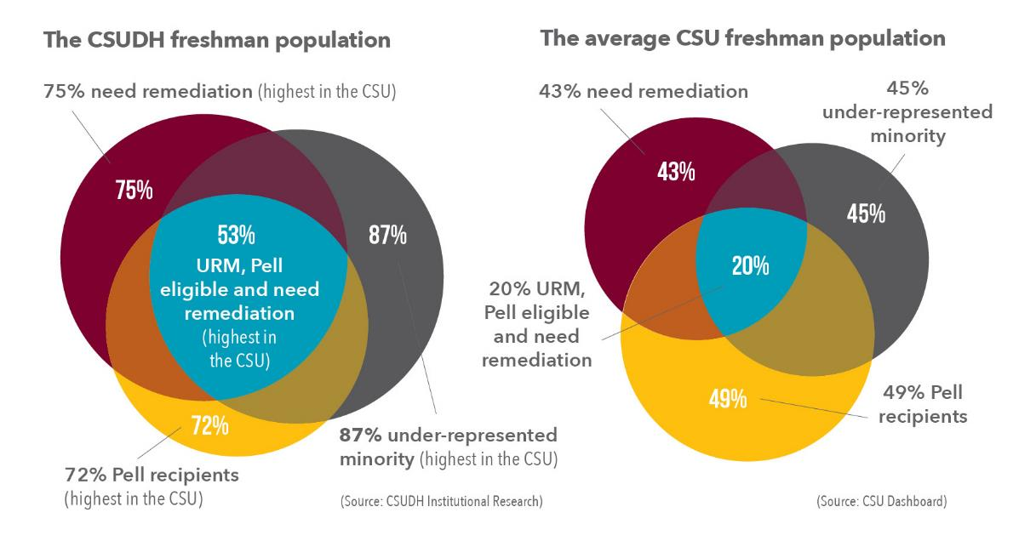

Slide 10
Student Data
Bridge students shown to be consistently less prepared than their peers upon entry to our institution.
Student Remediation Needs
2009-2015

Slide 11
In 2010, with poor retention and graduation rates, we needed to permanently increase the institution’s capacity to dramatically shift the outcomes for first-time freshmen.
Created a two-year Bridge initiative designed to assist academically underprepared students who qualify for CSUDH admission.
Since 2010, the program has served over 4,000 first-time, full-time freshmen, welcoming its largest class in 2016 of 1,100 students.

Slide 12
Counter-Narrative – Shifting the Paradigm
Accelerate
Achievement &
Ensure Equity
Infuse Effective
Teaching &
Learning
Educate
Diverse Learners
Foster
Promising Practices
Support
Student
Success

Slide 13

Summer Bridge
Supplemental Instruction
Cohort Model / Block Registration
Early Warning System
Intrusive Advising
Peer Mentoring
Leadership Development
Advancing High
Impact Practices

Slide 14
Academic Support
All students enrolled in developmental English and/or math are required to attend Supplemental Instruction twice per week for each course.
Supplemental Instructors sit in English and math classrooms to support instructors and students.
SIs provide small group support via workshops to students outside of class to supplement course material.

Slide 15
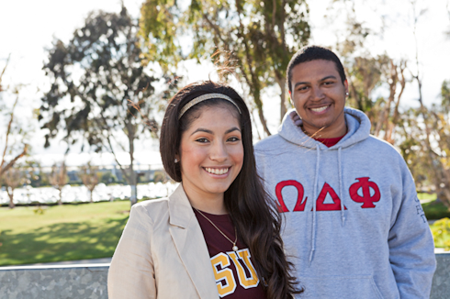
Peer Support
Peer Mentors work with students one-on-one and in small groups. They serve as role models and are able to provide the student perspective on how to be successful even when starting college in developmental courses.
Cohorted courses allow students to form study groups and benefit from other forms of peer support. Students can positively influence each other by attending class, participating in supplemental instruction, and supporting each other.

Slide 16
Peer Support
Intentional Investment in Peer Educators
YEAR | Number of SIs* | # of Peer Mentors
2010-2011 | 15 | 15
2011-2012 | 20 | 15
2012-2013 | 30 | 20
2013-2014 | 40 | 20
2014-2015 | 40 | 20
2015-2016 | 60 | 30
TOTAL STUDENTS | 205 | 120
$2,214,000
$1,296,000

Slide 17
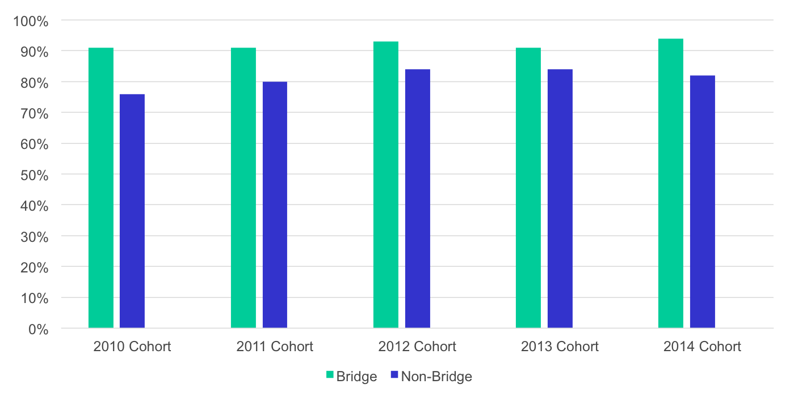
Student Outcomes
Remediation completion data shows Bridge students to complete remediation within one year at consistently higher rates than those in non-Bridge cohort.
Remediation Completion
2010-2014

Slide 18
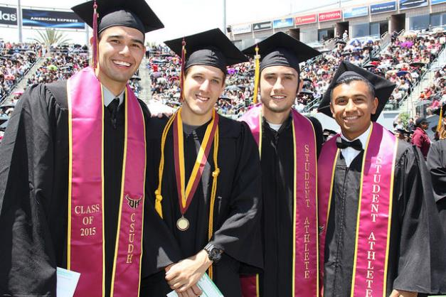
Students in the program who begin with one or two semesters of math and/or English remediation required have stronger chance of persistence
Over the last 6 years, they are generally 10-15 percentage points higher in retention than non-Bridge students.
Bridge students are persisting and graduation at consistently higher rates than the non-Bridge students.

Slide 19
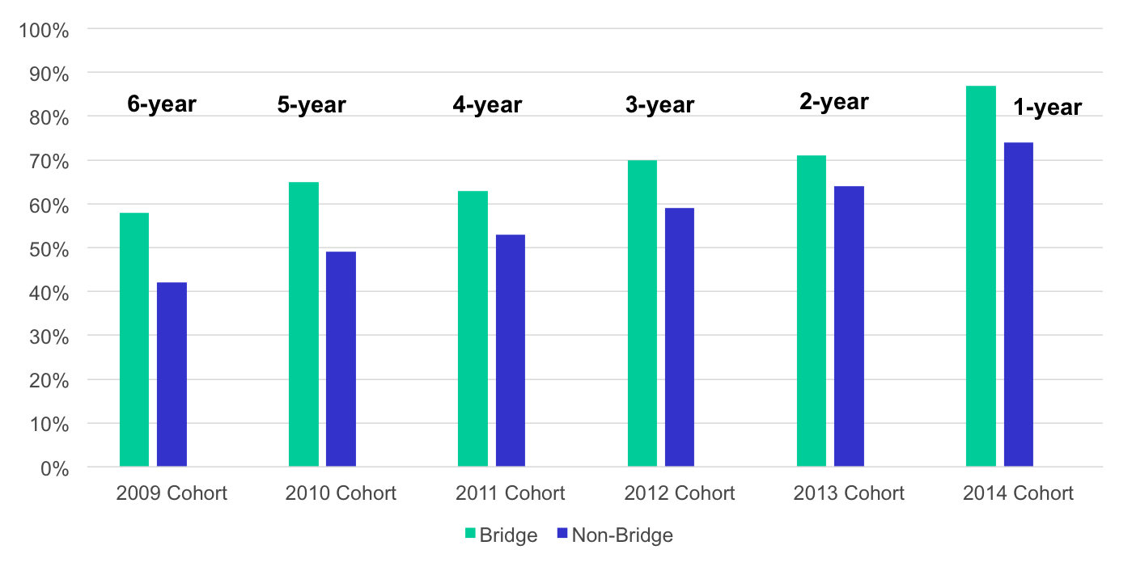
Retention data shows Bridge students to be retained at consistently higher rate than those in non-Bridge cohort.
Student Retention to
Fall 2015

Slide 20
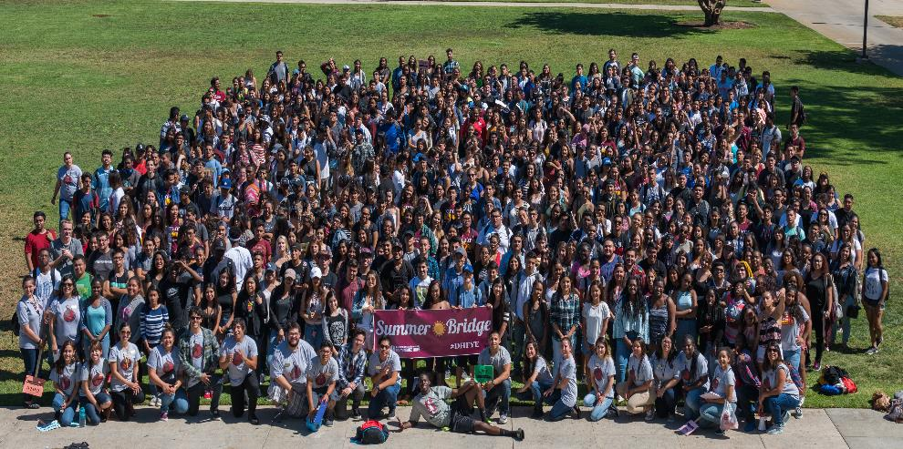
Scaling Up
What Works
2010 = 200 students
2011 = 250 students
2012 = 300 students
2013 = 650 students
2014 = 700 students
2015 = 1000 students
2016 = 1100 students

Slide 21

Transformational Leadership Makes All the Difference

Slide 22
CSUDH then…partnership by default
Boutique programs required collaboration with academic departments
  Securing cohorted courses
  Supplemental Instruction
Some level of collaboration between advisors across campus
  Occasional meetings
  Consultation as needed

Slide 23
CSUDH now…partnership by design
Commitment from leadership
  President, Provost, VPSA
  New - AVP of Retention and Academic Advising
Campus-wide consultation & external evaluation
  Advising Task Force
Dominguez Hills First-Year Experience (#DHFYE)
  Achieved equity for all freshmen – leveling the playing field
  Summer experience, relevant courses, academic support, intrusive advising, peer support, access to technology, campus engagement

Slide 24
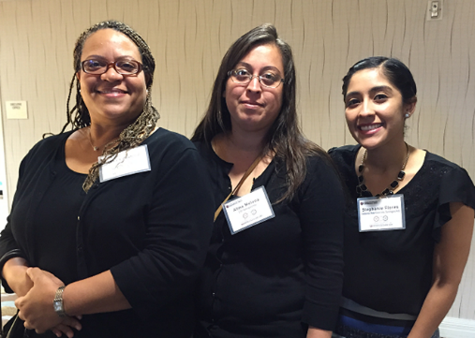
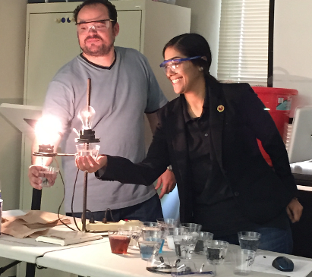
CSUDH now…partnership by design
Collaborative professional development opportunities for faculty and advisors to optimize time to degree completion, close the achievement gap, increase graduation rates.

Slide 25

CSUDH now…partnership by design
CSUDH Advising Summit
Inaugural CA Collaborative Conference

Slide 26
#DHFYE
Freshman
Convocation
Freshman Seminar
EAB-SSC
Institutionalized due to the success of Bridge cohort
Provides uniform support services to all freshmen
Comprised of both remedial and non-remedial students
Occurs during fall & spring semester
Goal is to connect freshmen to campus community & visualize themselves as college graduates
Fall semester is coordinated by Student Affairs; Spring semester is coordinated by Academic Affairs
Implemented to establish transparency among all advising entities
Historical/baseline data allow advisors to examine student performance & predict potential outcomes
UNV 101 – Freshman Dream Seminar
Provides opportunity for tenure-track faculty to develop innovative & engaging pedagogy
Fosters mentorship between faculty & students
Used to send communications, schedule appointments, & record appointment notes
Campus-Wide Focus on Student Success

Slide 27
Momentum for the 2025 Plan
The six year graduation rates increased from 28 percent for the 2007 cohort (2013 graduation) to 42.1 percent for the 2016 graduating class, represents a gain of 14 percentage point gain in three years.
We are experiencing the highest retention rates in 23 years. Entering freshmen one-year return rate is at 82 percent and transfer retention is 85 percent.
Our two year and three year retention rates are also on the rise.
Highest 1st, 2nd and 3rd retention rate for African-American and Latino males in last 20 years.

Slide 28
Lessons Learned
Scaling-up can be challenging if the resources and infrastructure do not exist to support growth.
Adequate staffing and space to deliver programs and services continue to be a challenge.
Due to higher student retention rates, unanticipated demand for additional course sections.
Internal and external partnerships critical to building capacity and obtaining funding to support intentional design of sustainable collaborative interventions.

Slide 29

Dr. William Franklin, Vice President of Student Affairs
wfranklin@csudh.edu
Dr. Paz Maya Oliverez, Associate Vice President of Student Success
poliverez@csudh.edu

