Slide 1
All at Once: Harnessing Major Structural Changes to Enhance Student Success
Jenny Zorn, Ph.D., Provost and Vice President for Academic Affairs
Kris Krishnan, Ed.D., Assistant Vice President for Institutional Research, Planning, and Assessment
Vernon Harper, Ph.D., Associate Vice President, Academic Programs
Vikash Lakhani, MBA, Assistant Vice President for Student Success

Slide 2
Presentation Overview
Overview of structural changes
Quarter to Semester Transition
New Leadership
General Education Reform
Curriculum Transformation
Providing a Context
Having the right data is key to student success
Right Data With Right Strategies - Moving the needle on 2/4-year graduation rates and closing the achievement gap
New CSU 2025 Graduation Initiative Goals

Slide 3
Overview of Structural Changes
Quarter to Semester Transition
New Leadership
General Education Reform
Curriculum Transformation

Slide 4
General Education Reform
Fundamental Question:
Can we improve student success by making the curriculum more relevant, coherent, and intentional?

Slide 5
General Education Reform
Providing Relevance—Reinforcement of Foundational Skills
Speaking, Writing, Thinking, Quantitative Reasoning
Required in Almost All Courses
30%+ of Final Grade Based on Demonstration of Skills
Common Rubrics for Grading/Feedback
Timely Feedback to Students
Faculty Learning Communities for Consistency

Slide 6
General Education Reform
Providing Coherence—Themes
Revolutionary Ideas & Innovations, Quality of Life, Sustainability & Justice
Must be the Organizing Principle of the Course
40%+ of Grade Must Be Related to Thematic Outcomes
Thematic Minors
Faculty Learning Communities

Slide 7
General Education Reform
Providing Intentionality—Reflection
Guidepost Sequence (GPS)
FYE
Junior Year Diversity/Reflection
GE Capstone or Senior Seminar
Reflect and Plan
Career & Other Life Goals
Tie to Their University Experiences & Coursework

Slide 8
Curriculum Transformation
Why Do We Think This Program Will Be Different?
No Grandfathering of Courses—All Courses Submitted for Initial Approval
Focus on Learning Outcomes
During Design & Review
Listed on Syllabus
Basis for Assessment
Mandatory Participation in Faculty Development/Learning Communities
Review of Courses

Slide 9
Population Statistics for Kern County
 | California | Kern County
Total Population (2015 est.) | 39,144,818 | 882,176
Race/Ethnicity (2014)
White alone | 38.5% | 36.2%
Hispanic or Latino alone | 38.6% | 51.5%
Black or African American alone | 6.5% | 6.3%
Asian alone | 14.4% | 5.0%
Income and Poverty (2014)
Median household income | $61,489 | $48,574
Persons below poverty level | 16.4% | 24.5%
Educational attainment (2014, persons age 25+)
High school graduate or higher | 81.5% | 73.0%
Bachelor’s Degree or higher | 31.0% | 15.2%
Providing a Context

Slide 10
Education Statistics for Kern County
 | California | Kern County | Kern High School District
Public School Student Population (15-16) | 6,235,520 | 180,304 | 37,318
9th-12th grade students | 1,955,355 | 53,362 | 37,318
English learners (K-12) | 43.5% | 40.7% | 42.7%
Socioeconomically disadvantaged (K-12) | 60.4% | 73.7% | 70.0%
Cohort Graduation Rate (14-15) | 82.3% | 82.5% | 86.9%
HS Graduates meeting ‘A-G’ eligibility | 43.4% | 30.7% | 32.2%
Providing a Context

Slide 11
Having the right data = right strategies on student success

Slide 12
Student Profiles (3 years) – Incoming Freshmen/Transfers

Slide 13
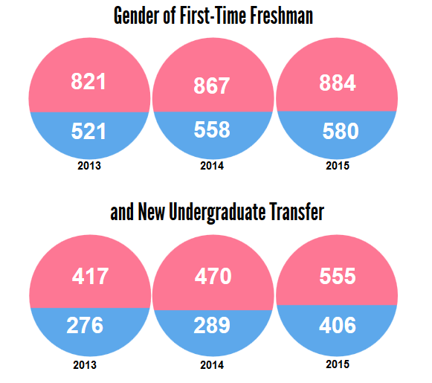
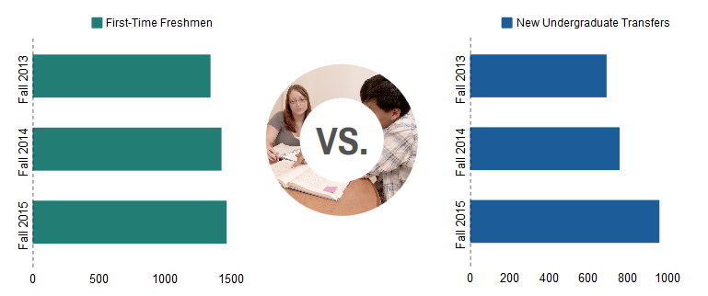
Student Profiles (3 years) – Incoming Freshmen/Transfers

Slide 14
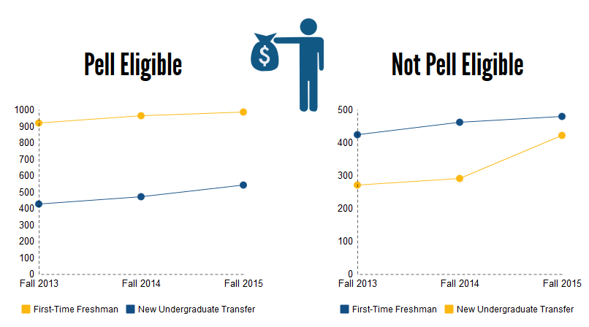

Slide 15
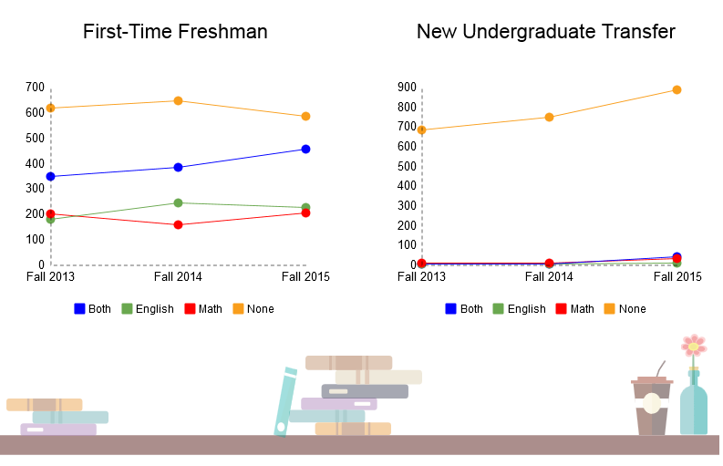
REMEDIATION
STATUS

Slide 16
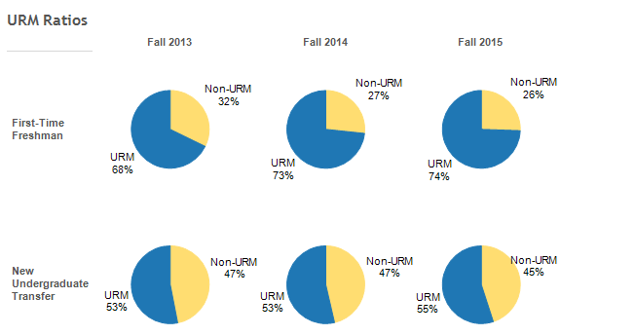
URM vs NON-URM

Slide 17
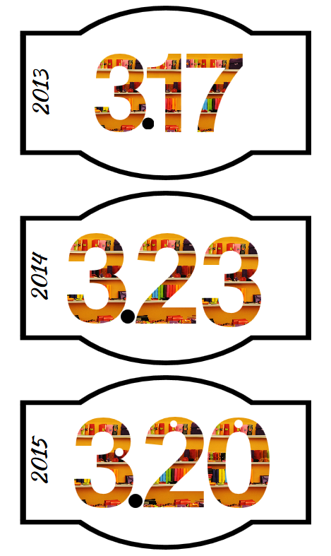
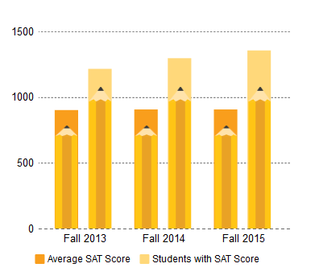
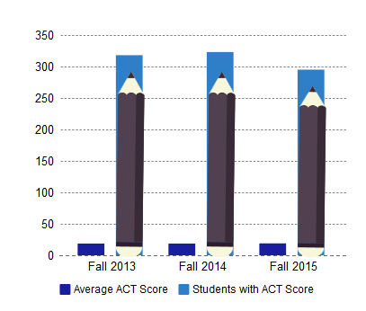
FIRST-TIME FRESHMAN AVERAGE GPA
FIRST-TIME FRESHMAN
AVERAGE SAT SCORE
FIRST-TIME FRESHMAN
AVERAGE ACT SCORE

Slide 18
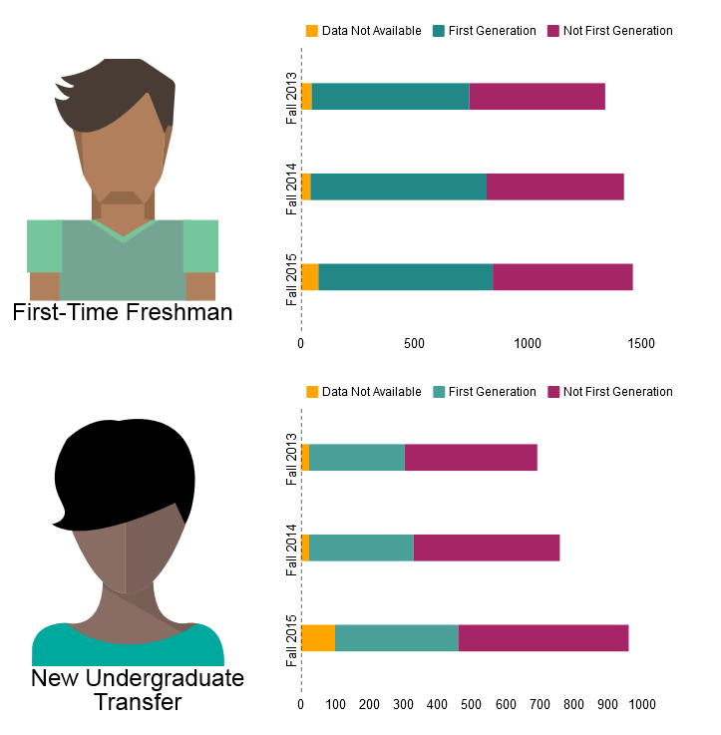
FIRST
GENERATION STUDENT

Slide 19
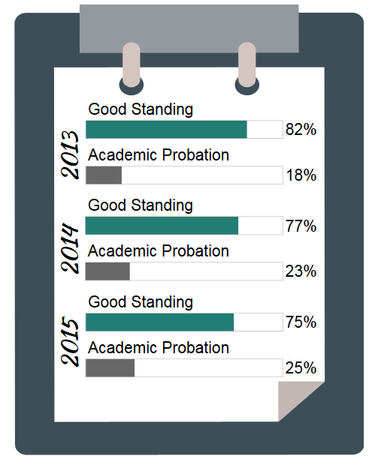
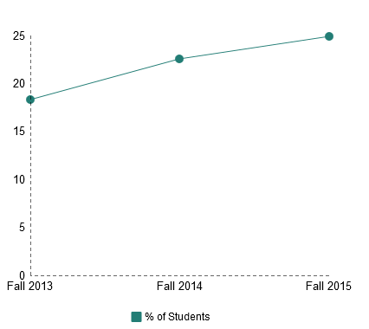
ACADEMIC STANDING:
FIRST-TIME FRESHMAN (3 years)

Slide 20
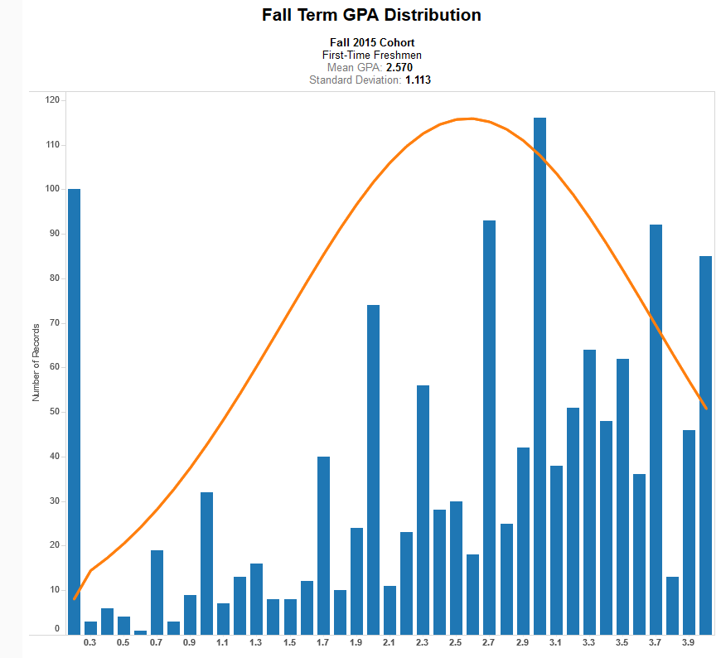

Slide 21
Credit Accumulation – First Time Freshmen

Slide 22
Right Data With Right Strategies - Moving the needle on 2/4-year graduation rates and closing the achievement gap

Slide 23
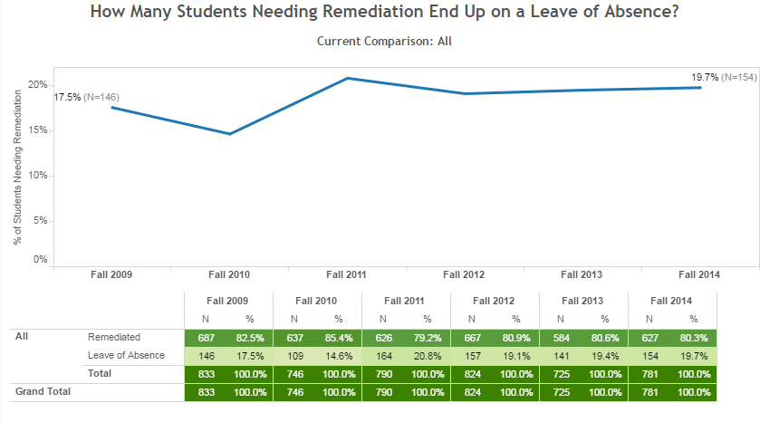
Right Data With Right Strategies - Moving the needle on 2/4-year graduation rates and closing the achievement gap

Slide 24
Challenge: None of the students on Leave of Absence returned to graduate from CSUB
Strategy 1: Develop a dashboard that easily tracks students on remediation
Strategy 2: Improve success rates in Early Start using Supplemental Instruction
Strategy 3: Co-requisite model in math/Stretch program in English
Strategy 4: Intrusive advising for students in lowest developmental math
Strategy 5: Based on the success of Early Start Math, implement Supplemental Instruction in fall developmental math classes.

Slide 25
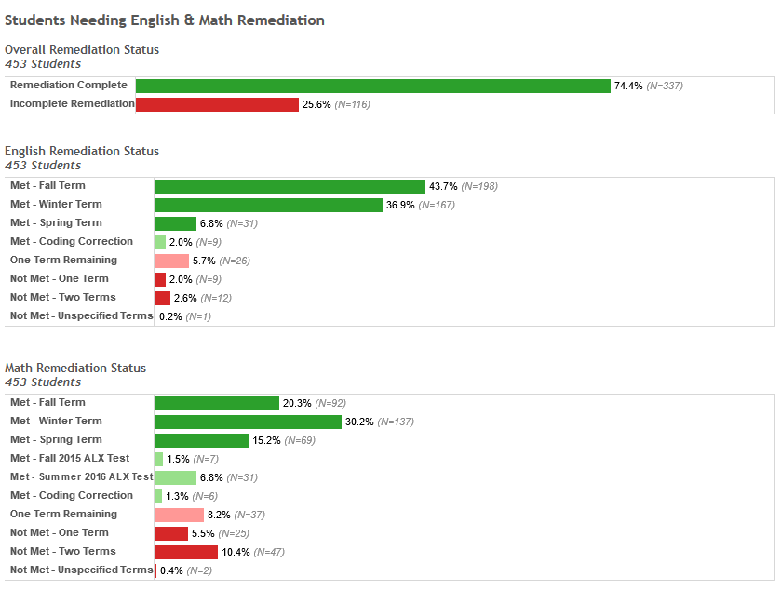
Developmental Education Dashboard

Slide 26
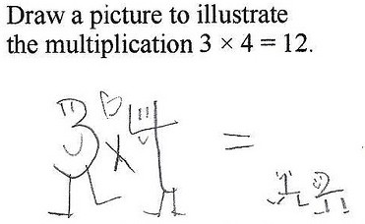
Supplemental Instruction

Slide 27
Co-Requisite Model in math/Stretch Program in English
Intrusive Advising for Students in Lowest Remedial Math
Supplemental Instruction in fall developmental math classes.

Slide 28
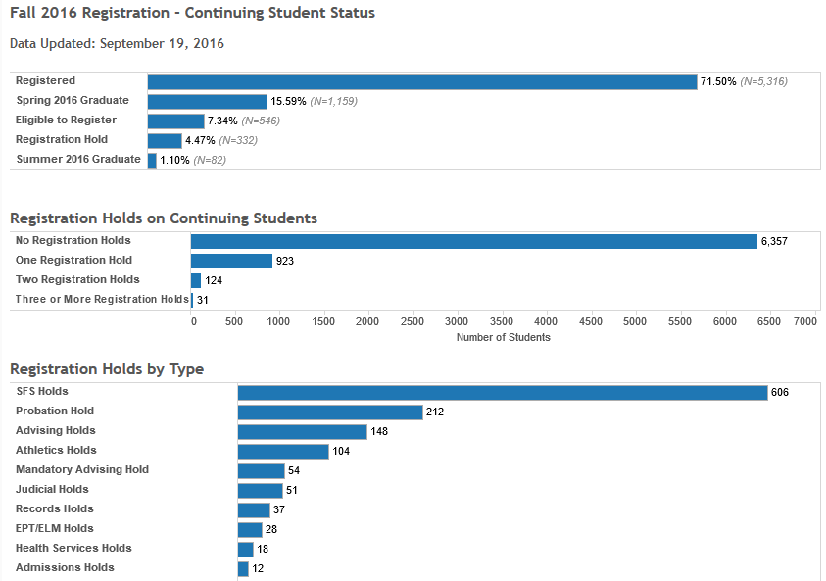
Right Data With Right Strategies - Moving the needle on 2/4-year graduation rates and closing the achievement gap

Slide 29
Challenge: There is a subset of students who don’t register for the subsequent term
Strategy 1: Pro-actively identify students not registered for future term
Strategy 2: Implement intrusive advising to follow up with students

Slide 30
Right Data With Right Strategies - Moving the needle on 2/4-year graduation rates and closing the achievement gap

Slide 31
Challenge: There is a subset of students who are close to 4-year/2-year graduation that have not applied for graduation
Strategy 1: Develop a dashboard that easily tracks student cohorts
Strategy 2: Implement intrusive advising to facilitate timely graduation

Slide 32
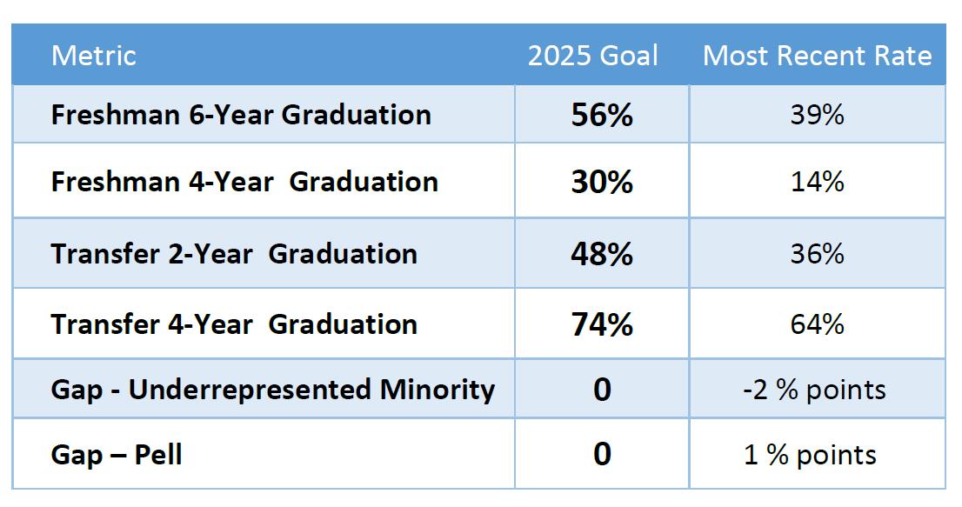
Graduation Initiative 2025 Goals

Slide 33
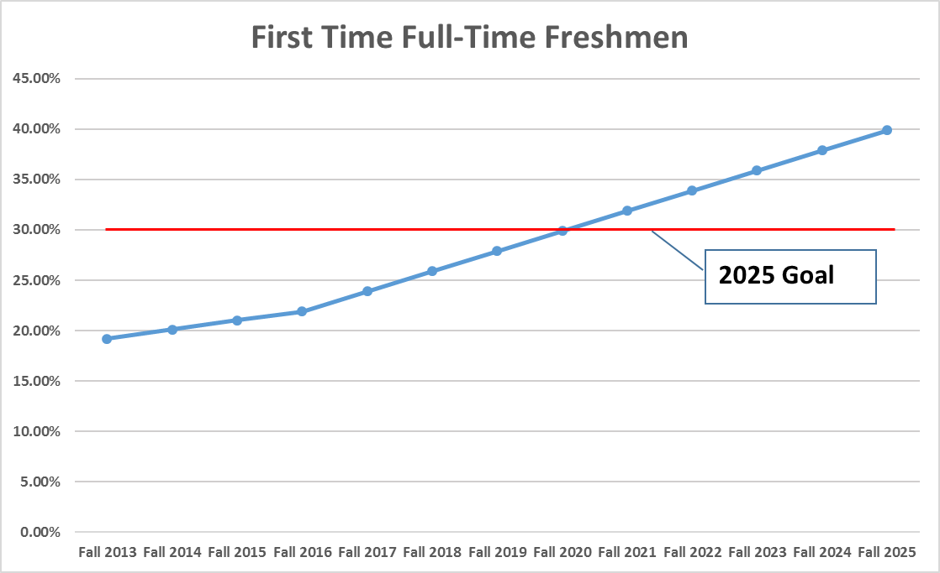
CSU Bakersfield – 4-year Graduation Rate Projection

Slide 34
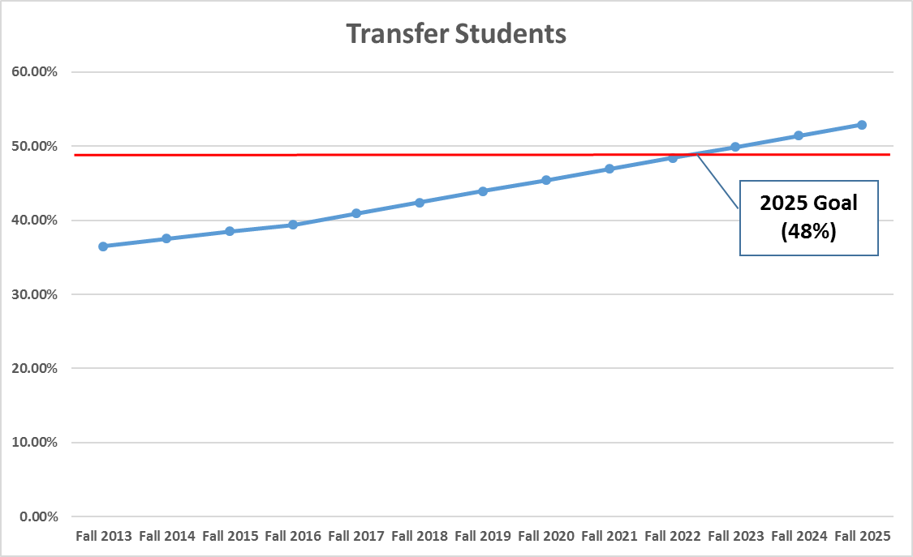
CSU Bakersfield – 2-year Graduation Rate Projection

