Slide 1
Students’ Pronouns and Preferred Names: Class Rosters That Promote Belonging and Inclusion
Institute for Teaching & Learning, CSU Chancellor’s Office November 21, 2019 Webcast

Slide 2
Why Gender Inclusion Matters
Why Gender Inclusion Matters
Policy imperative
CSU EO 1095/1096/1097 prohibits discrimination on the basis of gender identity
Educational imperative
Chancellor White’s Commitment to Inclusive Excellence (January 2018)*
Students are more active, engaged learners when they feel embraced and included
*Link to CSU Website on Inclusive Excellence

Slide 3
US Department of Education Dear Colleague Letter (May 13, 2016)
US Department of Education Dear Colleague Letter (May 13, 2016)
Reiterates civil rights protections for transgender students
Campus must not treat a transgender student differently from the way it treats other students of the same gender identity
No medical diagnosis or treatment requirement that students must meet as a prerequisite to being treated consistent with their gender identity

Slide 4
Dear Colleague Letter (May 13, 2016) - continued
Dear Colleague Letter (May 13, 2016) - continued
Requiring students to produce identification documents that reflect their gender identity in order to treat them consistent with their gender identity may violate Title IX when doing so has the effect of limiting or denying students equal educational access
Must provide transgender students equal access to educational programs/activities even in circumstances in which other students, parents, or community members raise objections or concerns

Slide 5
Definitions – Gender as a Construct
Definitions – Gender as A Construct
Gender Identity: a person's internal sense of being male, female, some combination of male and female, or neither male nor female
Cisgender: of, relating to, or being a person whose gender identity corresponds with the sex the person had or was identified as having at birth
Transgender: of, relating to, or being a person whose gender identity differs from the sex the person had or was identified as having at birth
Source: Link to Merriam-Webster Online Dictionary

Slide 6
Definitions (continued)
Definitions (continued)
Gender Transition: “Transitioning is the process of changing the way you look and how people see and treat you so that you become the gender you feel on the inside. Transitioning can means lots of different things. It can involve medical treatment and hormones. It can involve changing your name and preferred pronouns. It can involve changing your appearance and dress. It can involve coming out to your friends and family. It can be a long and ongoing process. Or it can be something that happens over a short period of time.”
Source: Planned Parenthood Website

Slide 7
Making Your Classroom Gender Inclusive
Making Your Classroom Gender Inclusive
Give students the chance to share their pronouns and preferred names in ways that respect personal boundaries
Have students complete a “get to know you” info sheet
Introduce yourself with your pronouns
Have students make name tags/tents that include their pronouns
Infuse trans issues and content by trans people in your course whenever relevant
Source: LSA Inclusive Teaching Initiative, University of Michigan

Slide 8
Making Your Classroom Gender Inclusive continued
Making Your Classroom Gender Inclusive
Make your syllabus trans-inclusive
Consider including specific ground rules about respecting each others’ pronouns and other gendered language
Include info that will be helpful for transgender students in the resources section of your syllabus, such as:
The location of the nearest gender-inclusive restrooms and a link to the gender inclusive restroom map
Instructions on how to change pronouns and preferred names online
Links and contact info for campus resources
Source: LSA Inclusive Teaching Initiative, University of Michigan

Slide 9
Gender Pronouns
Gender Pronouns
See Gender Neutral Pronoun Blog for more information

Slide 10
How Do I Know Which Pronouns to Use?
How Do I Know Which Pronouns to Use?
“What pronouns do you use?”
“How would you like me to refer to you?”
“How would you like to be addressed?”
“My name is Luoluo and my pronouns are she and her. What about you?”
Source: University of Wisconsin-Madison, LGBT Campus Center

Slide 11
What Happens When a Mistake Occurs?
What Happens When A Mistake Occurs?
If you make a mistake, most people appreciate a quick apology and correction at the time of the mistake. Try: “I’m sorry I used the wrong pronoun earlier. I’ll be more careful next time.”
If someone uses the wrong pronoun for another person try a brief correction: “I think Sam uses she and her pronouns. And yes, I’m going to her house later too!”
Source: University of Wisconsin-Madison, LGBT Campus Center

Slide 12
Pronouns and Preferred Names in PeopleSoft
Pronouns & Preferred Names in PeopleSoft

Slide 13
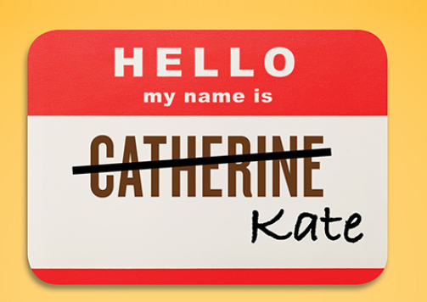
Preferred Names Section
Preferred Names

Slide 14
Preferred Names
Campus request for ability to request a preferred name change
Chancellor’s Office (CO) convened a work group of campus representatives and vetted the design from Student Affairs teams, campus Pride Center Coordinators, and the California State Student Association (CSSA)
Updates to the student system include:
Configuration to choose/not the administrative approval capability
Configuration to choose the segments of name student can update
14

Slide 15
Preferred Names slide 2
Preferred Name
Updates to the student system include:
Configuration to choose/not the CMS modification
Creates CSU Names tab in student self-service
Ability to make the CSU Names tab in student self-service inaccessible to specific students
As deemed by campus administration (e.g. student conduct violations, police or legal investigation)
Delivered by CMS Central to campuses with functionality turned off (August 2017)
15

Slide 16
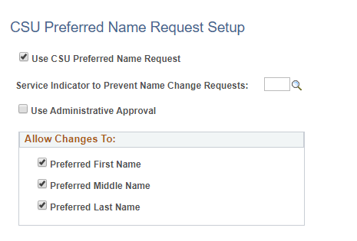
Preferred Name Configuration
Preferred Name
Configuration
Turned off = CSU Preferred Name Request unchecked

Slide 17
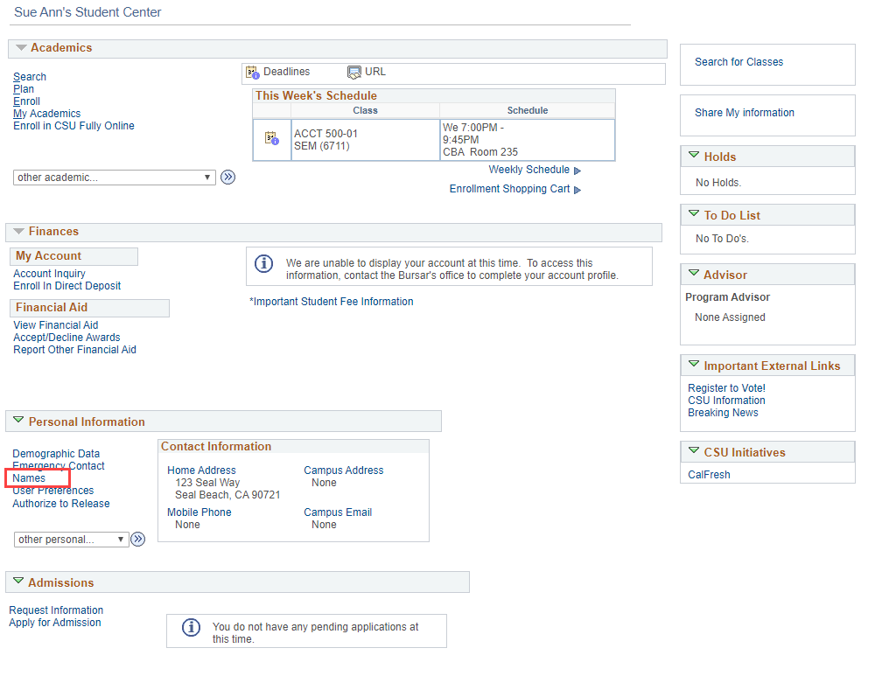
Preferred Names Student Center
Preferred Names
Student Center

Slide 18
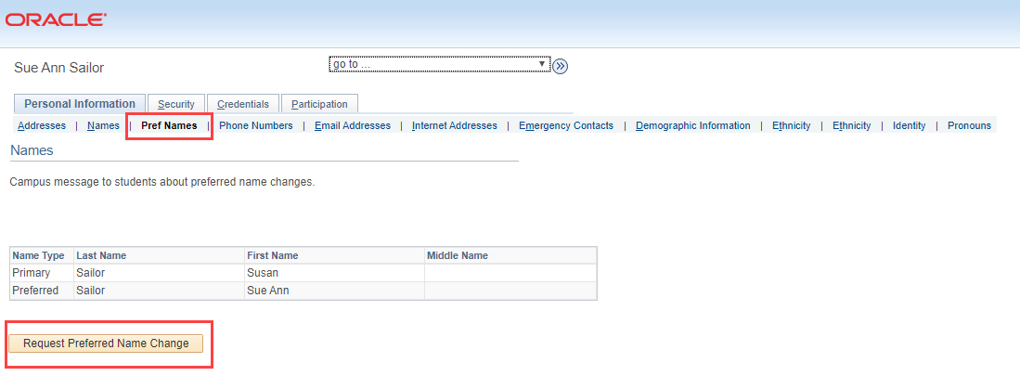
Preferred Names Student Center slide 2
Preferred Names
Student Center

Slide 19
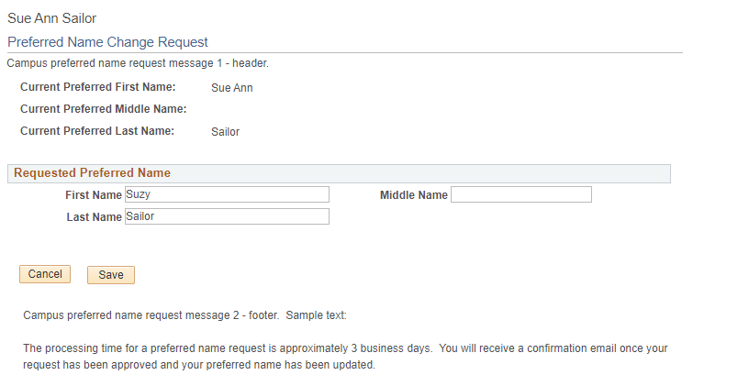
Preferred Names Student Center slide 3
Preferred Names
Student Center

Slide 20
Preferred Names Student Center slide 4
Preferred Names
Student Center

Slide 21
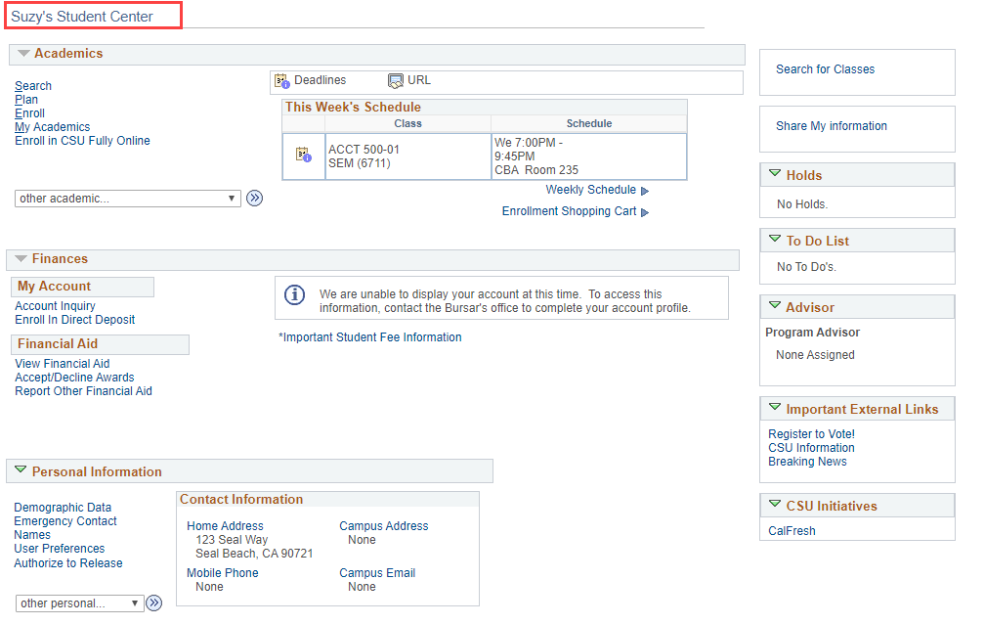
Preferred Names Student Center slide 5
Preferred Names
Student Center

Slide 22
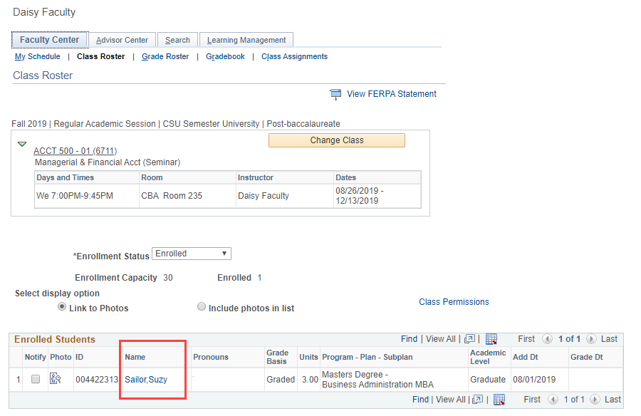
Preferred Names Class Roster
Preferred Names
Class Roster

Slide 23
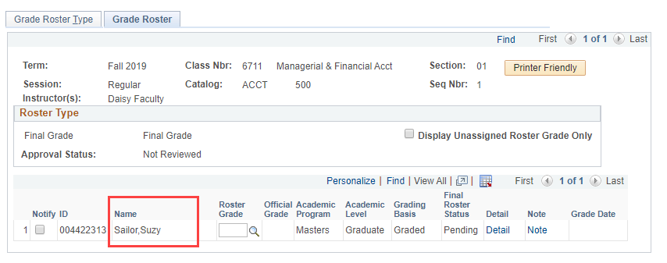
Preferred Names Grade Roster
Preferred Names
Grade Roster

Slide 24
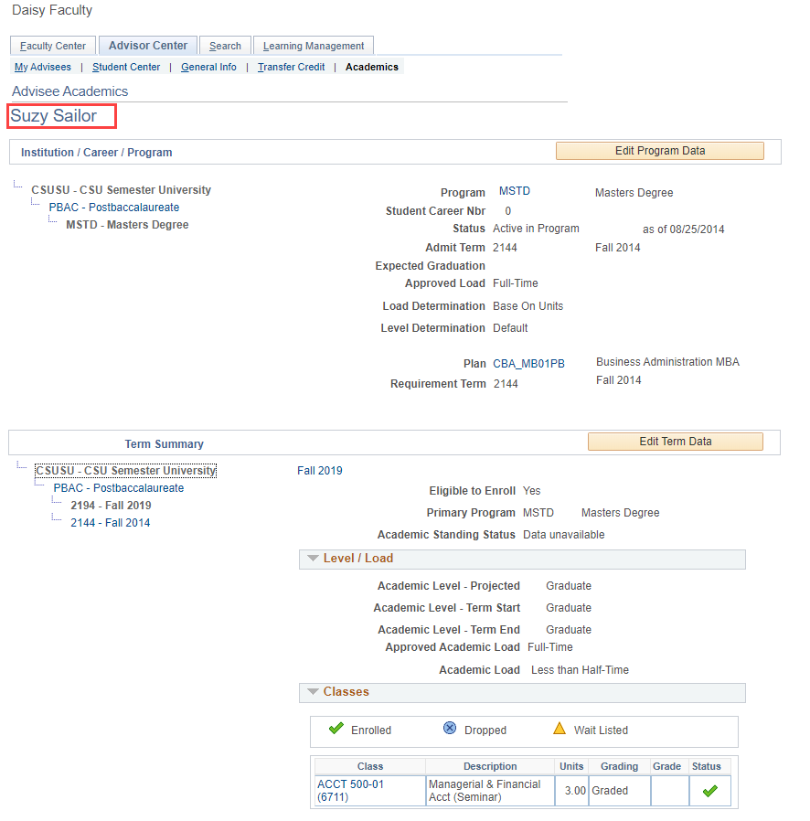
Preferred Names Advisor Center
Preferred Names
Advisor Center

Slide 25
Pronouns
Pronouns
Initiated from the Vice Presidents of Student Affairs
CO worked on initial design, campuses vetted design
Updates to the student system include:
Ability to configure pronouns to make available
Pronouns to appear on the Class Roster and Advisor Center
Delivered by CMS Central to campuses with functionality turned off (September 2019)
Recommendation from vetting – campuses strongly encouraged to provide training

Slide 26
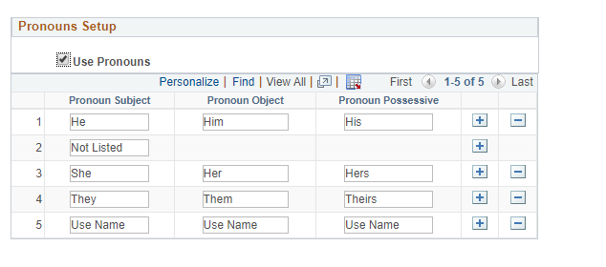
Pronouns Configuration
Pronouns
Configuration
Turned off = Pronouns Setup unchecked

Slide 27
Pronouns Student Center
Pronouns
Student Center

Slide 28
Pronouns Student Center slide 2
Pronouns
Student Center

Slide 29
Pronouns Student Center slide 3
Pronouns
Student Center

Slide 30
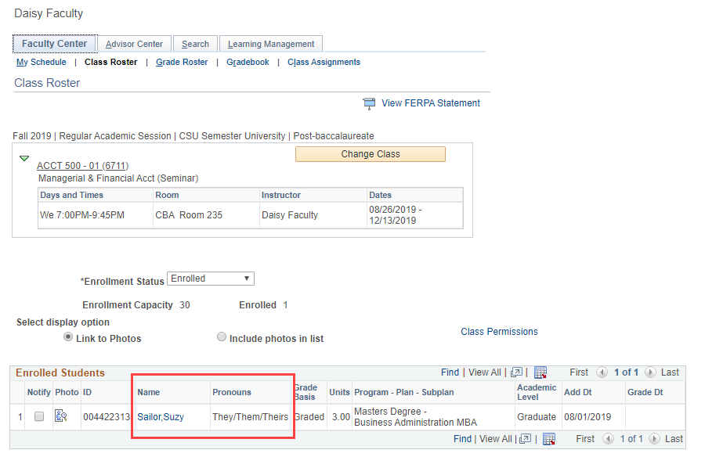
Pronouns Class Roster
Pronouns
Class Roster

Slide 31
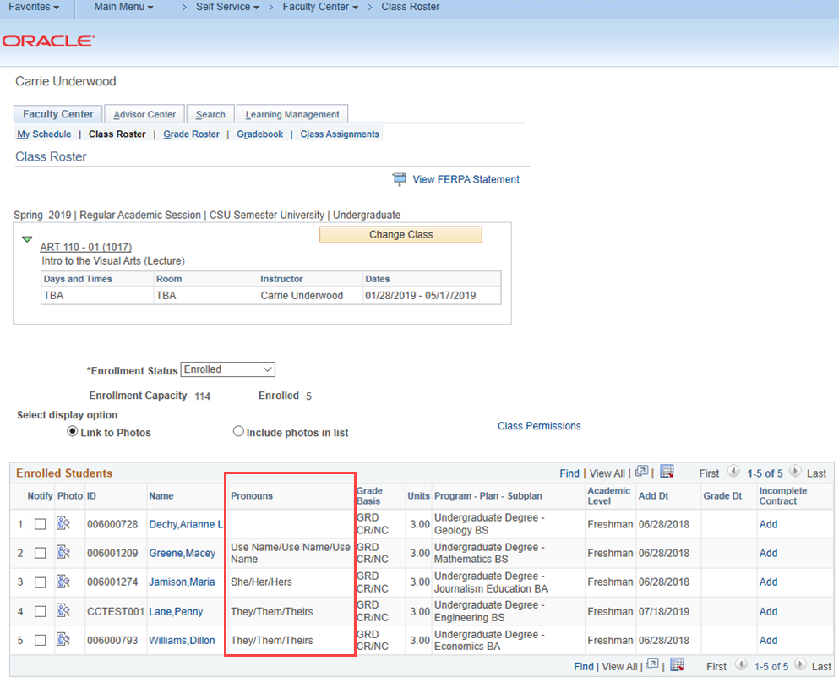
Pronouns Class Roster slide 2
Pronouns
Class Roster
**Did not include Pronouns on the Grade Roster

Slide 32
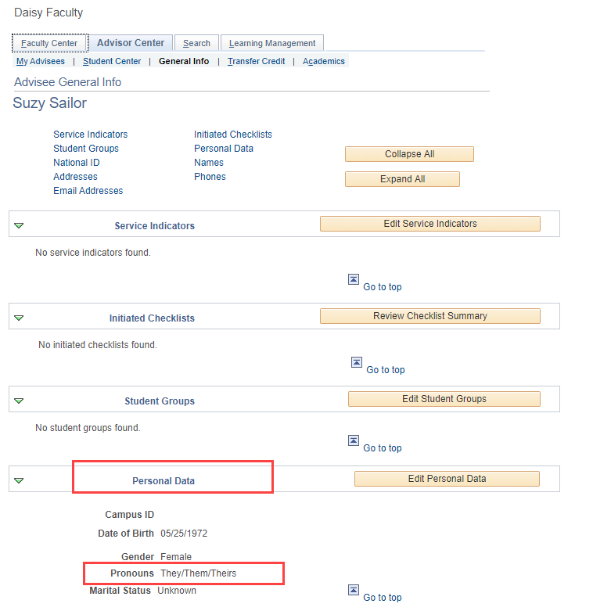
Pronouns Advisor Center
Pronouns
Advisor Center

Slide 33
Resource Links
Resource Links
Please type your resource links in the Q&A pod to share systemwide

Slide 34
Thank you! Questions?
Darlene Daclan: ddaclan@calstate.edu Luoluo Hong: lhong@calstate.edu

